Slide 1
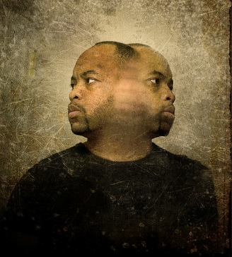
The Double-Minded Man
“For he who doubts is like a wave of the sea, driven by the wind and tossed.” (Jas 1:6)

Slide 2
The Double-Minded Man…
Has inconsistent faith
“Let him ask in faith” (Jas 1:6-8)
Doubt is the enemy of faith.
Doubt → Fear → Inaction
Knowledge → Faith (Expectation) → Action
What kind of faith?
Mar 11:12-14, 20-23; Rom 10:17; Eph 4:11-14; Heb 10:38-39, 11:1-40

Slide 3
The Double-Minded Man…
Has inconsistent love
“My brothers, show no partiality…” (Jas 2:1, 8-10)
Love your neighbor as yourself (Mat 22:39)
What kind of love?
1Co 13:4-8, esp. v. 7
1Jo 3:16-18, 4:18-19, 5:3

Slide 4
The Double-Minded Man…
Has inconsistent words
“From the same mouth come blessing and cursing.” (Jas 3:8-10)
A house divided shall not stand (Mat 12:22-37)
Psa 28:3, 62:4
What kind of words?
Praise (Psa 51:15, 119:171; Rom 15:6; Heb 13:15)

Slide 5
The Double-Minded Man…
Has inconsistent words
What kind of words?
Praise (Psa 51:15, 119:171; Rom 15:6; Heb 13:15)
Edification (Act 20:32; 1Co 14:3, 4, 12; 2Co 13:10)
Encouragement (Eph 6:22; Col 4:8; 1Th 4:18, 5:11, 14)

Slide 6
The Double-Minded Man…
Has inconsistent loyalty
“Do you not know that friendship with the world is enmity with God?” (Jas 4:4)
No man can serve two masters (Mat 6:24)
What kind of loyalty?
“You shall have no other gods before me.” (Exo 20:3)
Seek first the kingdom of God (Mat 6:33)
“Be faithful unto death” (Rev 2:10)

Slide 7
The Double-Minded Man…
Has an inconsistent heart
“Establish your hearts, for the coming of the Lord is at hand.” (Jas 5:8b)
“Be steadfast, immovable…” (1Co 15:58)
A firm foundation (Mat 7:24-27)
Feet shod with the preparation of the gospel of peace (Eph 6:15)
What kind of heart?

Slide 8
The Double-Minded Man…
Has an inconsistent heart
What kind of heart?
Complete (Deu 6:5; 1Sa 12:24; Pro 3:5; Rev 3:14-16)
Contrite (Psa 51:17; cf. 2Co 7:9, 10)
Clean (Psa 51:7; Eze 36:25-27; 2Co 5:17)

Slide 9
Conclusion
A Call to Action
Single purpose, single focus, to serve a single God
No man can serve two masters
“How long will you falter between two opinions?” (1Ki 18:21)
The decision is yours… will you decide today?

