Slide 1
Overview of the Bible
Lesson 5

Slide 2
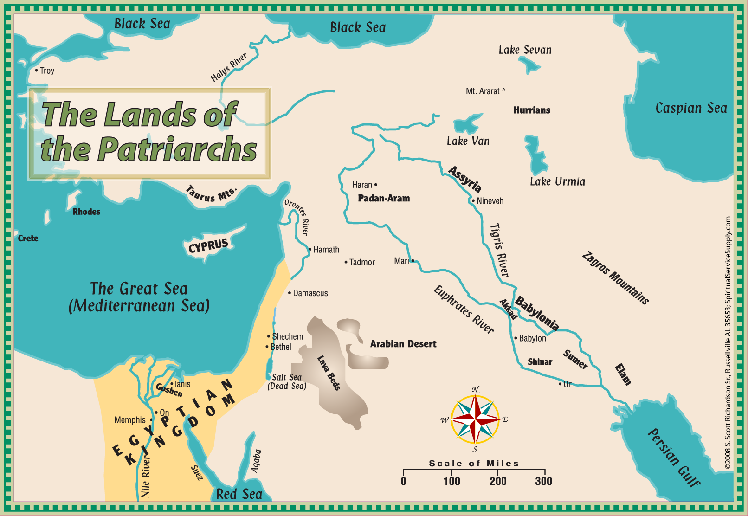
Nation
Land
Spiritual

