Slide 1
Family
Laying a Good Foundation

Slide 2
Why Preach on the Family?
Families are in trouble.
Causes problems in society.
The church suffers.
God has spoken.

Slide 3
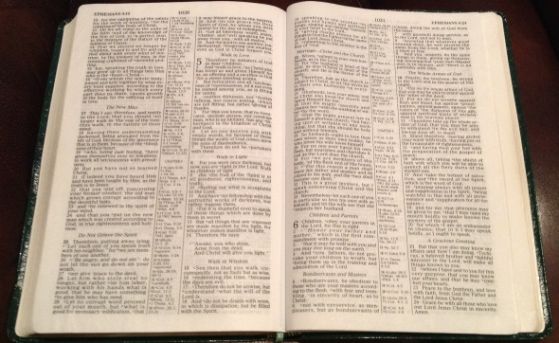
Go to the Right Source
Men often tend to look for something other than God’s word.
Be careful.
Many professionals are influenced by evolutionary beliefs.
What is the goal of the one giving advice?
Some simply don’t have good advice.
Advice can be helpful.
But we must first know God’s word. 1 John 4:1; Rom. 3:4
Don’t be like Judah. Jer. 2:13

Slide 4
Foundation: Marriage
Sociologists offer various theories for its origin.
Began with creation.
Both made in God’s image. Gen. 1:26-28
Adam was incomplete. Gen. 2:8-9, 15-20
The woman was a special part of the man. Gen. 2:21-25
Marriage is an honorable institution and to be treated with respect. Heb. 13:4; 1 Tim. 4:1-3

Slide 5
Foundation: Marriage
Lessons from its divine origin.
Homosexuality and polygamy are excluded. Matt. 19:4-6; Rom. 1:24-28
Sexual activity restricted to those willing to become a committed one flesh. Gen. 2:24; Heb. 13:4
Husbands should see wives as the perfect helper.
Wives should be helpers, not competitors.
Marriage should last a lifetime. Matt. 19:3-9

Slide 6
Conclusion
We can’t solve all of society’s problems regarding the family, but…
We can listen to God and make our marriages and families what God intended.
As we close let’s consider His provisions for the soul. Will you obey the gospel He designed for your salvation? Mark 16:15-16

