Slide 1
1 Corinthians
Background and Introduction; Chapter One

Slide 2
Read Acts 18:1-18. Also use other reference materials to gather some background materials on the city of Corinth.
I want to strongly encourage all to do this kind of research. It will enhance your understanding of the book and deepen your appreciation for the fact that these were real people in real places facing real challenges.

Slide 3
In what modern country would we find Corinth? What name was given to it in the NT?
  Greece. Achaia (Greece in Acts 20:2).

Slide 4
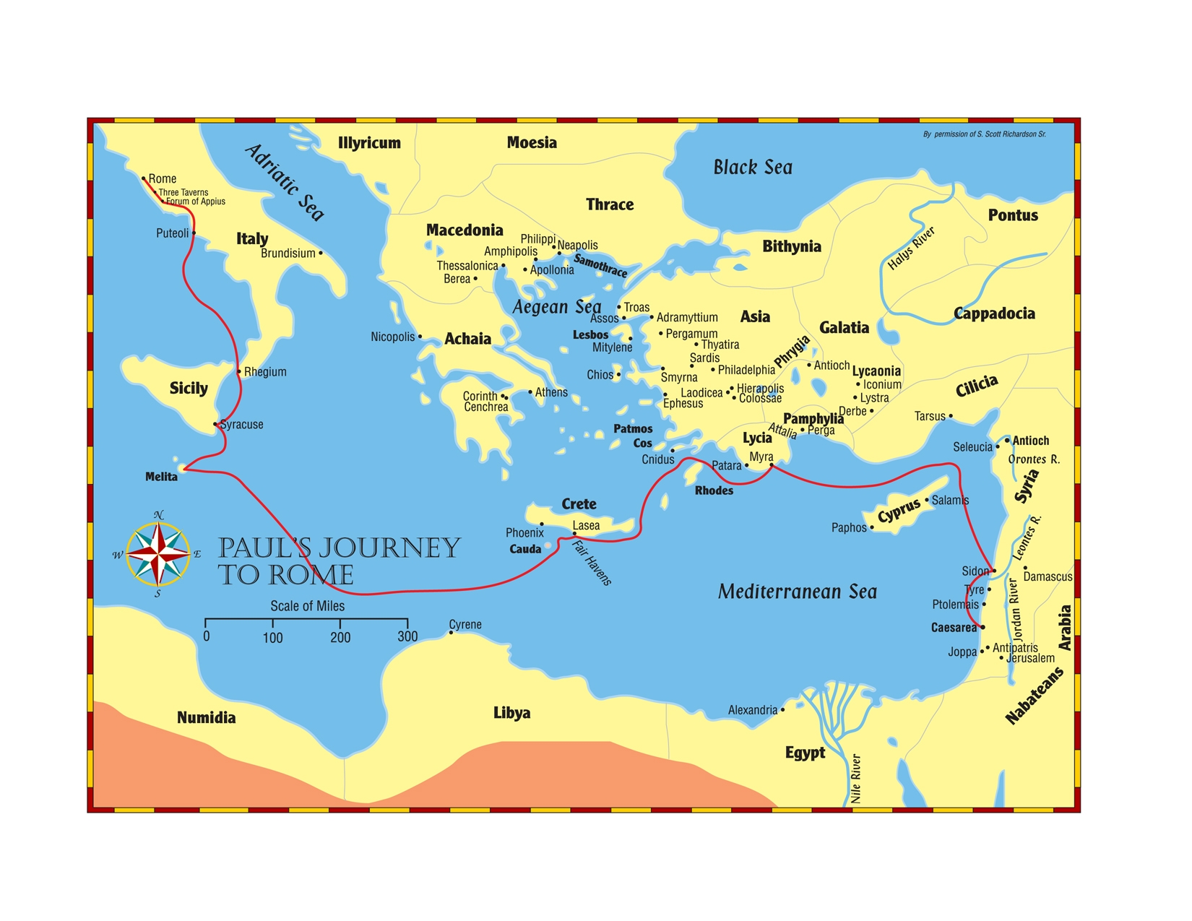

Slide 5
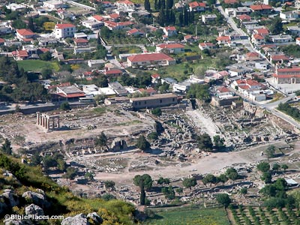

Slide 6
In what modern country would we find Corinth? What name was given to it in the NT?
  Greece. Achaia (Greece in Acts 20:2).
NT name for northern Greece?
  Macedonia.

Slide 7
Size of Corinth?
  1st century population estimated at approx. 500,000.
  Located on the Isthmus of Corinth, a tremendous amount of commerce moved through the city on both north-south and east-west routes.
  It had been destroyed in 146 B.C. and rebuilt in 46 B.C. by Julius Caesar.

Slide 8
What kind of reputation did the city have?
  While Athens was seen as the intellectual center of Achaia, Corinth was the commercial center.
  Featured a prominent temple to Aphrodite in which ritual fornication was practiced.
  To act like a Corinthian was synonymous with revelry and immorality.

Slide 9
On which of Paul’s “missionary” journeys did he first preach in Corinth?
  2nd. Ca. A.D. 51/52 when he was there.
How were his financial needs provided for?
  Worked as a tentmaker Acts 18:2, 3), also received financial support from some other churches (2 Cor. 11:8).

Slide 10
How long did he remain in Corinth the first time?
  At least 18 months (Acts 18:11), but probably no more than 2 years.

Slide 11
How much success did he have?
  A good deal (18:8).
  Possibly Aquila and Priscilla and definitely prominent Crispus.
  But the bulk seem to have been typical Corinthians. 1 Cor. 6:9-11
  Paul was hauled before the proconsul, but Gallio released Paul and dismissed the charges against him.

Slide 12
Where was Paul when he wrote 1 Corinthians?
  Ephesus. Acts 19; 1 Cor. 16:8
  Early A.D. 57 best guess about time of writing.

Slide 13
How had Paul learned about the troubles in the church at Corinth? 1:10, 11; 7:1
  Primarily the household of Chloe and a letter.

Slide 14
List the various problems facing the church at Corinth.
  Factions, carnality, immorality, lawsuits, questions about marriage, meats offered to idols, corruption of the Lord’s Supper, abuse of spiritual gifts, disorder and confusion, denial of the resurrection.
  As you go through the book note how many of the different problems involved division.
Write a one or two sentence summary of the contents of each chapter of 1 Corinthians.

Slide 15
The opening asserts Paul’s apostolic authority.
  He had authority and it came from God.
How did Paul describe the recipients of his letter in 1:2?
  The church of God.
  A divided group needed to be reminded that they were God’s church.
  Also said to be sanctified and saints.

Slide 16
Define the words saint and sanctified.
  A saint is a holy or sanctified person. Sanctified has reference to being set apart or holy.

Slide 17
Sanctified is perfect tense and signifies something done to them in the past with a continuing result. When were they sanctified?
  1 Cor. 6:9-11
  God makes us holy when He saves us, but He then expects us to be holy.
  Saints does not refer to an elite group, either of the dead or the living.

Slide 18
Understand what a local church is.
Sanctified people in a specific geographical area who call on the Lord and know that they belong to God.

Slide 19
In vv. 4-9 Paul’s thanksgiving puts more emphasis on what God had done for the Corinthians than what they were doing for God.
But in a letter that was going to be quite critical, he did begin with kindness and thanksgiving.

Slide 20
Vv. 4-6 is a masterful exhortation in the midst of thanks.
  God’s grace was given to you in Christ Jesus.
  You’ve been enriched through good teaching and have had the word confirmed to you.
  You have no excuses.

Slide 21
V. 8 does not teach the impossibility of falling away, but at this point he is stressing God’s willingness and ability to save.
God will do His part. And that leads to the next question.

Slide 22
Define the words faithful and fellowship as they are used in 1:9.
  Faithful: trustworthy or reliable. God will surely do His part to see that they arrive at the end blameless.
  Fellowship denotes a sharing together or relationship of togetherness. They had all been called into a special relationship with Christ.
    Would they forfeit it by failing to remain in fellowship with one another?

