Slide 1
1 Corinthians
Chapter 1:10-17;
Condemnation of Division and Appeal for Unity

Slide 2
In what modern country would we find Corinth? What name was given to it in the NT?
  Greece. Achaia (Greece in Acts 20:2).
NT name for northern Greece?
  Macedonia.

Slide 3
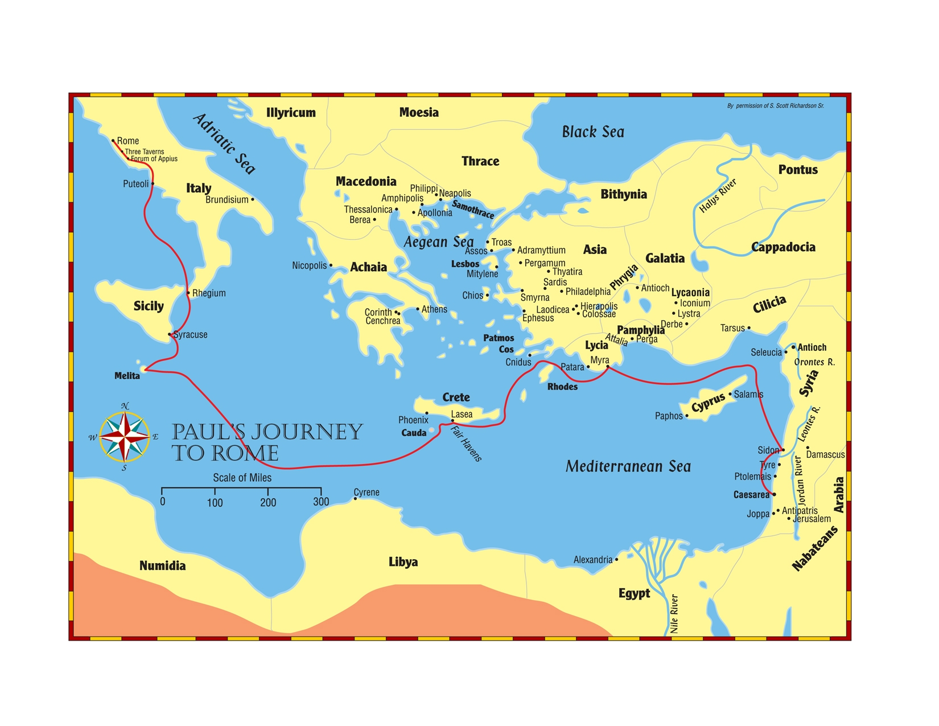

Slide 4
Corinth Background Information
  1st century population estimated at approx. 500,000.
  Located on the Isthmus of Corinth, a tremendous amount of commerce moved through the city on both north-south and east-west routes.
  It had been destroyed in 146 B.C. and rebuilt in 46 B.C. by Julius Caesar.

Slide 5
  While Athens was seen as the intellectual center of Achaia, Corinth was the commercial center.
  Featured a prominent temple to Aphrodite in which ritual fornication was practiced.
  To act like a Corinthian was synonymous with revelry and immorality.

Slide 6
It was during Paul’s 2nd “missionary” journey when he first preached in Corinth, around A.D. 51/52.
Paul worked as a tentmaker Acts 18:2-3 along side of Priscilla and Aquila.
Paul remained in Corinth at least 18 months (Acts 18:11), but probably no more than 2 years.

Slide 7
Where was Paul when he wrote 1 Corinthians, sometime between 55-57?
  Ephesus. Acts 19; 1 Cor. 16:8
How had Paul learned about the troubles in the church at Corinth? 1:10, 11; 7:1
  Primarily the household of Chloe and a letter.

Slide 8
List the various problems facing the church at Corinth.
  Factions, carnality, immorality, lawsuits, questions about marriage, meats offered to idols, corruption of the Lord’s Supper, abuse of spiritual gifts, disorder and confusion, denial of the resurrection.

Slide 9
The church at Corinth:
1) overvalued the role of the evangelist in their salvation; Paul says factions are evil, 1:10-17.
2) didn’t understand their relationship to the evangelist vs. the Lord; Paul instructs about true wisdom to save, 1:18-2:16.
3) misunderstood the role of the evangelist to them and to God; Paul places preachers in proper role as fellow laborers in the kingdom, 3:1- 4:15

Slide 10
11. What three expressions did Paul use to describe the unity he wanted?
  Speak the same things
  No divisions
  Perfectly joined together

Slide 11
11a. What can keep us from Unity?
  Different Doctrines, another gospel.
  Pride, lack of humility.
  Lack of brotherly love.

Slide 12
12. Why was Paul glad that he had not baptized many of them?
  He didn’t want them saying he had baptized in his name.
13. How do you reconcile 1:14-17 & Acts 18:8?
  Paul attacked those following preachers rather then Christ and is showing his preaching was to bring men to Christ, not himself.

Slide 13
I Corinthians 1:18 – 2:16
The True Wisdom of God

Slide 14
14. To whom is the message of the cross (preaching, word) foolishness?
  Those who are perishing.
15. What kind of sign did the Jews seek?
  Physical evidence, which they rejected.
16. What kind of wisdom did the Gentiles seek?
  Earthly philosophy to challenge their thinking, but Christ convicted them of sin.

Slide 15
The Corinthians were told to remember that not many _______________ according to the flesh, not many _______________, not many ______________, are called.

Slide 16
The Corinthians were told to remember that not many WISE according to the flesh, not many MIGHTY, not many NOBLE, are called.

Slide 17
“He who glories (boasts), let him glory in the _____________________.”

Slide 18
“He who glories (boasts), let him glory in the LORD.”

