Slide 2
It Takes Some Birds Longer to Get to Bird Island
Matthew 25

Slide 3
Human Beings have different capacities and abilities too.
Eph. 4:11 “And He Himself gave some to be apostles,
some prophets, some evangelists, and some pastors
and teachers, 12 for the equipping of the saints for
the work of ministry, for the edifying of the body
of Christ,”
But the race is not always to the swift,
nor the battle to the strong! (Ecclesiastes 9:11)
Ex. The tortoise and the hare & David beat the giant

Slide 4
In the race to win the “crown of life” there will be differing
capacities and abilities among the participants.
Romans 12:4,6
“For as we have many members in one body, but all the members
do not have the same function, …
Having then gifts differing according to the grace that is given to us,
let us use them:”

Slide 5
I Corinthians 12:14-26
For in fact the body is not one member but many.
If the foot should say, "Because I am not a hand, I am not of the body," is it therefore not of the body?
And if the ear should say, "Because I am not an eye, I am not of the body," is it therefore not of the body?
If the whole body were an eye, where would be the hearing? If the whole were hearing, where would be the smelling?
But now God has set the members, each one of them, in the body just as He pleased. And if they were all one member, where would the body be?

Slide 6
But now indeed there are many members, yet one body.
And the eye cannot say to the hand, "I have no need of you"; nor again the
head to the feet, "I have no need of you."
No, much rather, those members of the body which seem to be weaker are
necessary. And those members of the body which we think to be less honorable,
on these we bestow greater honor; and our unpresentable parts have greater
modesty, but our presentable parts have no need. But God composed the body,
having given greater honor to that part which lacks it,
that there should be no schism in the body, but that the members should
have the same care for one another. And if one member suffers,
all the members suffer with it; or if one member is honored, all the
members rejoice with it. “

Slide 7
Heb 12:12-13
“Therefore strengthen the hands which hang down,
and the feeble knees, and make straight paths
for your feet, so that what is lame may not be dislocated,
but rather be healed. “
Be a Barnabas!

Slide 8
Matt 25:14-23, "For the kingdom of heaven is like a man traveling to a far country, who called his own servants and delivered his goods to them. And to one he gave five talents, to another two, and to another one, to each according to his own ability; and immediately he went on a journey. Then he who had received the five talents went and traded with them, and made another five talents. And likewise he who had received two gained two more also. But he who had received one went and dug in the ground, and hid his lord's money.
After a long time the lord of those servants came and settled accounts with them.
"So he who had received five talents came and brought five other talents, saying, 'Lord, you delivered to me five talents; look, I have gained five more talents besides them.'

Slide 9
His lord said to him, 'Well done, good and faithful servant; you were faithful over a few things, I will make you ruler over many things. Enter into the joy of your lord.'
He also who had received two talents came and said, 'Lord, you delivered to me two talents; look, I have gained two more talents besides them.'
His lord said to him, 'Well done, good and faithful servant; you have been faithful over a few things, I will make you ruler over many things. Enter into the joy of your lord.'

Slide 10
Jesus assures us that the race does not go to the swift
and the smooth.
The 5 talent man was a ‘smoothie”.
The 2 talent man was a “grinder”.
Same commendation given by the Lord to both!
The Lord has good news for the “grinders” in His kingdom.

Slide 11
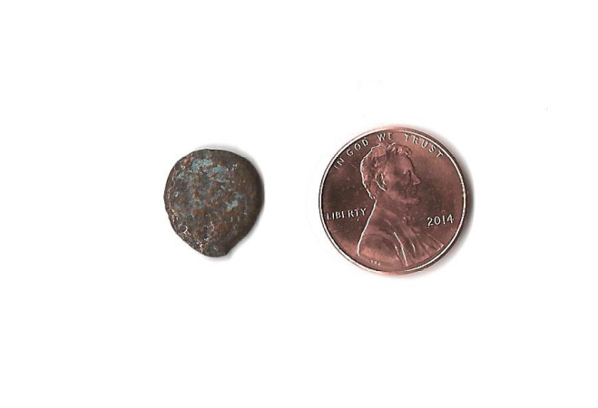
Judaic Lepton a.k.a.
“The widow’s mite”

Slide 12
Don’t give up the struggle!
Don’t let your “disability” get in the way of your ability.
Matthew 25:24-30
"Then he who had received the one talent came and said, 'Lord, I knew you to
be a hard man, reaping where you have not sown, and gathering where you
have not scattered seed. And I was afraid, and went and hid your talent in the
ground. Look, there you have what is yours.' "But his lord answered and
said to him, 'You wicked and lazy servant, you knew that I reap where I have
not sown, and gather where I have not scattered seed. So you ought to have
deposited my money with the bankers, and at my coming I would have received
back my own with interest. So take the talent from him, and give it to him who
has ten talents. 'For to everyone who has, more will be given, and he will have
abundance; but from him who does not have, even what he has will be taken
away. And cast the unprofitable servant into the outer darkness. There will be
weeping and gnashing of teeth.'

Slide 13
He was a “grinder” but he didn’t grind.
Bad idea in his own mind.
A word of caution.

Slide 14
Conclusion
The Lord has entrusted in us, our own talents.
We are stewards of those talents.
He is coming again to reap His harvest!
Will he find us “faithful” or “lazy”?

