Slide 1
The Theology of Romans
Romans 1:16-17
16 For I am not ashamed of the gospel of Christ, for it is the power of God to salvation for everyone who believes, for the Jew first and also for the Greek. 17 For in it the righteousness of God is revealed from faith to faith; as it is written, “The just shall live by faith.”

Slide 2
Romans 5:12
12 Therefore, just as through one man sin entered the world, and death through sin, and thus death spread to all men, because all sinned—

Slide 3
Isaiah‬ ‭59‬:‭2‬
But your iniquities have separated you from your God; And your sins have hidden His face from you, So that He will not hear.

Slide 4
Romans‬ ‭2‬:‭1‬
Therefore you are inexcusable, O man, whoever you are who judge, for in whatever you judge another you condemn yourself; for you who judge practice the same things.

Slide 5
‭Romans‬ ‭2‬:‭21-24‬
You, therefore, who teach another, do you not teach yourself? You who preach that a man should not steal, do you steal? You who say, “Do not commit adultery,” do you commit adultery? You who abhor idols, do you rob temples? You who make your boast in the law, do you dishonor God through breaking the law? For “the name of God is blasphemed among the Gentiles because of you,” as it is written.

Slide 6
Romans‬ ‭3‬:‭10-12‬
As it is written: “There is none righteous, no, not one; There is none who understands; There is none who seeks after God. They have all turned aside; They have together become unprofitable; There is none who does good, no, not one.”

Slide 7
Romans 2:5-9
5 But in accordance with your hardness and your impenitent heart you are treasuring up for yourself wrath in the day of wrath and revelation of the righteous judgment of God, 6 who “will render to each one according to his deeds”: 7 eternal life to those who by patient continuance in doing good seek for glory, honor, and immortality; 8 but to those who are self-seeking and do not obey the truth, but obey unrighteousness—indignation and wrath, 9 tribulation and anguish, on every soul of man who does evil, of the Jew first and also of the Greek;

Slide 8
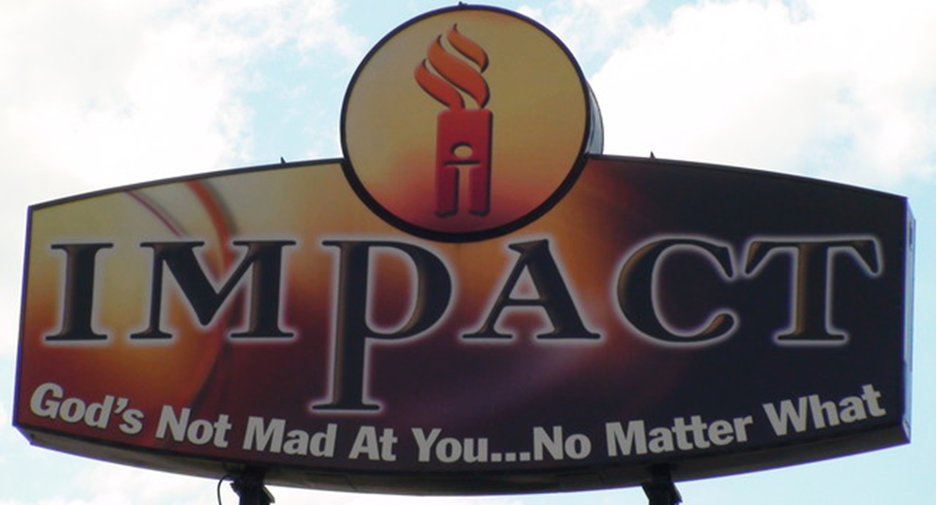

Slide 9
Romans 5
6 For when we were still without strength, in due time Christ died for the ungodly. 7 For scarcely for a righteous man will one die; yet perhaps for a good man someone would even dare to die. 8 But God demonstrates His own love toward us, in that while we were still sinners, Christ died for us. 9 Much more then, having now been justified by His blood, we shall be saved from wrath through Him. 10 For if when we were enemies we were reconciled to God through the death of His Son, much more, having been reconciled, we shall be saved by His life. 11 And not only that, but we also rejoice in God through our Lord Jesus Christ, through whom we have now received the reconciliation.

Slide 10
Romans 5
Therefore, having been justified by faith, we have peace with God through our Lord Jesus Christ, 2 through whom also we have access by faith into this grace in which we stand, and rejoice in hope of the glory of God.

Slide 11
Romans 3:21-26
21 But now the righteousness of God apart from the law is revealed, being witnessed by the Law and the Prophets, 22 even the righteousness of God, through faith in Jesus Christ, to all and on all who believe. For there is no difference; 23 for all have sinned and fall short of the glory of God, 24 being justified freely by His grace through the redemption that is in Christ Jesus, 25 whom God set forth as a propitiation by His blood, through faith, to demonstrate His righteousness, because in His forbearance God had passed over the sins that were previously committed, 26 to demonstrate at the present time His righteousness, that He might be just and the justifier of the one who has faith in Jesus.

Slide 12
Hebrews 11
4 By faith Abel offered to God a more excellent sacrifice than Cain,
7 By faith Noah, being divinely warned of things not yet seen, moved with godly fear, prepared an ark for the saving of his household,
8 By faith Abraham obeyed when he was called to go out to the place which he would receive as an inheritance. And he went out, not knowing where he was going.

Slide 13
James 2
21 Was not Abraham our father justified by works when he offered Isaac his son on the altar? 22 Do you see that faith was working together with his works, and by works faith was made perfect?23 And the Scripture was fulfilled which says, “Abraham believed God, and it was accounted to him for righteousness.” And he was called the friend of God. 24 You see then that a man is justified by works, and not by faith only.
25 Likewise, was not Rahab the harlot also justified by works when she received the messengers and sent them out another way?

Slide 14
James 2:19
19 You believe that there is one God. You do well. Even the demons believe—and tremble!

Slide 15
Romans 6
3 Or do you not know that as many of us as were baptized into Christ Jesus were baptized into His death? 4 Therefore we were buried with Him through baptism into death, that just as Christ was raised from the dead by the glory of the Father, even so we also should walk in newness of life.

Slide 16
Romans 11
19 You will say then, “Branches were broken off that I might be grafted in.” 20 Well said.Because of unbelief they were broken off, and you stand by faith. Do not be haughty, but fear. 21 For if God did not spare the natural branches, He may not spare you either.22 Therefore consider the goodness and severity of God: on those who fell, severity; but toward you, goodness, if you continue in His goodness. Otherwise you also will be cut off. 23 And they also, if they do not continue in unbelief, will be grafted in, for God is able to graft them in again.

