Slide 2
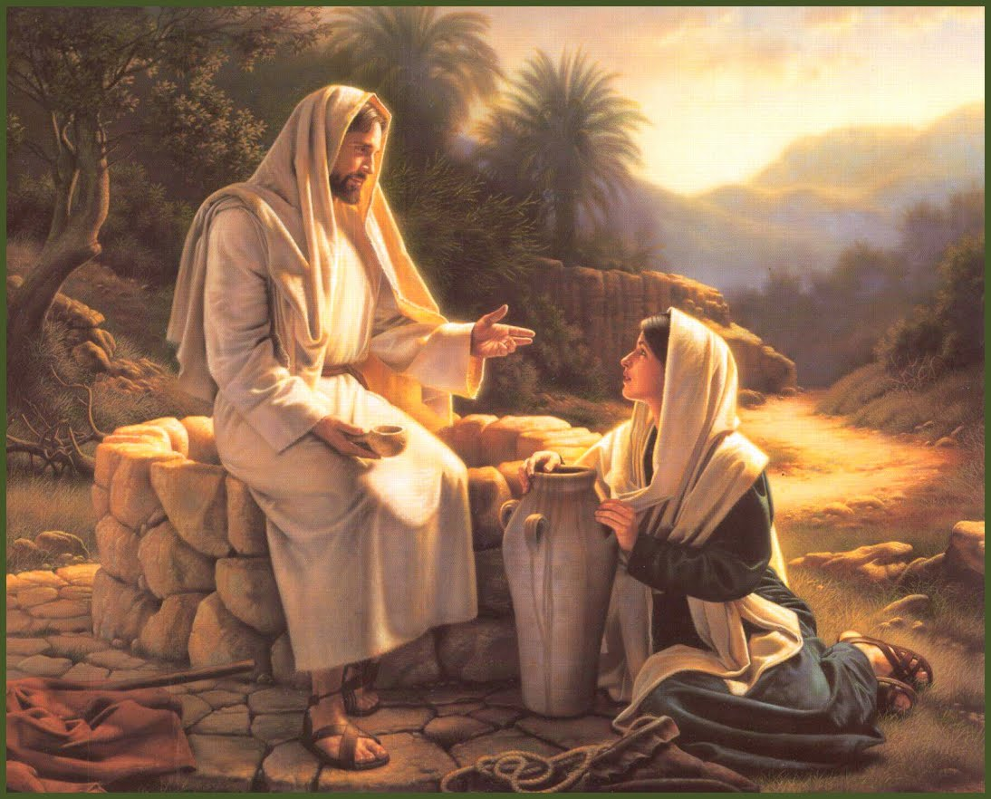
Hope For Broken Lives
John 4:1-42

Slide 3
Jesus Knows Each of Us Intimately
Since He is God, He knows all things – Job 37:16; 28:24; Psalm 147:5; Luke 12:6-7.
Verses 16-18

Slide 4
Jesus Knows Each of Us Intimately
He is therefore well acquainted with each of us – Mark 12:43; Proverbs 5:21.
Verses 16-18

Slide 5
Jesus Knows Each of Us Intimately
He knows every aspect of our lives – Psalm 139:1-6.
Verses 16-18

Slide 6
Jesus Knows Each of Us Intimately
He even knows our hearts – 1 Chronicles 28:9; Hebrews 4:12-13.
Verses 16-18

Slide 7
He Cares Deeply For Us
The Lord is a good – Psalm 100:5; 33:5; 107:8-9.
Verses 7-14

Slide 8
He Cares Deeply For Us
He is full of compassion and mercy – Psalm 86:15; James 5:11.
Verses 7-14

Slide 9
He Cares Deeply For Us
He knows our troubles and yearns to help us – 1 Peter 5:6-7; Matthew 11:28-30; Romans 10:12.
Verses 7-14

Slide 10
He Cares Deeply For Us
It is up to us to humble ourselves and open our hearts and lives to Him – Revelation 3:19-20.
Verses 7-14

Slide 11
He Has The Power To Mend Our Broken Lives
God is all powerful – Isaiah 40:28; Romans 1:20.
Verses 39-42

Slide 12
He Has The Power To Mend Our Broken Lives
Nothing is too difficult for Him – Jeremiah 32:17; Matthew 19:26; Job 42:2.
Verses 39-42

Slide 13
He Has The Power To Mend Our Broken Lives
If we submit to Him, He will work mightily in us – Ephesians 3:20-21; Philippians 2:12-13.
Verses 39-42

