Slide 1
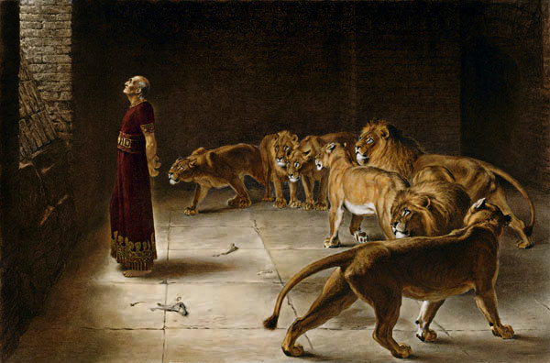
Lessons From Daniel’s Faith

Slide 2
Daniel’s Faith
Determination
1:8 But Daniel purposed in his heart that he would not defile himself with the portion of the king's delicacies, nor with the wine which he drank; therefore he requested of the chief of the eunuchs that he might not defile himself.

Slide 3
Daniel’s Faith
Determination
James 1:13 Let no one say when he is tempted, "I am tempted by God"; for God cannot be tempted by evil, nor does He Himself tempt anyone. But each one is tempted when he is drawn away by his own desires and enticed. Then, when desire has conceived, it gives birth to sin; and sin, when it is full-grown, brings forth death.

Slide 4
Daniel’s Faith
Prayer
2:17-18 Then Daniel went to his house, and made the decision known to Hananiah, Mishael, and Azariah, his companions, that they might seek mercies from the God of heaven concerning this secret, so that Daniel and his companions might not perish with the rest of the wise men of Babylon.
6:10 Now when Daniel knew that the writing was signed, he went home. And in his upper room, with his windows open toward Jerusalem, he knelt down on his knees three times that day, and prayed and gave thanks before his God, as was his custom since early days.

Slide 5
Daniel’s Faith
Determination
Prayer
Integrity

Slide 6
Daniel’s Faith
Integrity
6:3-5 Then this Daniel distinguished himself above the governors and satraps, because an excellent spirit was in him; and the king gave thought to setting him over the whole realm. So the governors and satraps sought to find some charge against Daniel concerning the kingdom; but they could find no charge or fault, because he was faithful; nor was there any error or fault found in him. Then these men said, "We shall not find any charge against this Daniel unless we find it against him concerning the law of his God."

Slide 7
Daniel’s Faith
Integrity
6:21 Then Daniel said to the king, "O king, live forever! My God sent His angel and shut the lions' mouths, so that they have not hurt me, because I was found innocent before Him; and also, O king, I have done no wrong before you."

Slide 8
Daniel’s Faith
Determination
Prayer
Integrity
Trusting God

Slide 9
Daniel’s Faith
Trusting God
- Ch 1 – Refused to defile himself
- Ch 2 – Requested to interpret the dream
- Ch 4, 5 – Delivered condemnation from God
- Ch 6 – Obeyed God, despite the law of man

Slide 10
Romans 8:31
What then shall we say to these things? If God is for us, who can be against us?
He who did not spare His own Son, but delivered Him up for us all, how shall He not with Him also freely give us all things? Who shall bring a charge against God's elect? It is God who justifies. Who is he who condemns? It is Christ who died, and furthermore is also risen, who is even at the right hand of God, who also makes intercession for us. Who shall separate us from the love of Christ? Shall tribulation, or distress, or persecution, or famine, or nakedness, or peril, or sword? As it is written: "For Your sake we are killed all day long; We are accounted as sheep for the slaughter.” Yet in all these things we are more than conquerors through Him who loved us. For I am persuaded that neither death nor life, nor angels nor principalities nor powers, nor things present nor things to come, nor height nor depth, nor any other created thing, shall be able to separate us from the love of God which is in Christ Jesus our Lord.

