Slide 2

Strengthening Our Commitment To The Lord
John 20:19-29

Slide 3
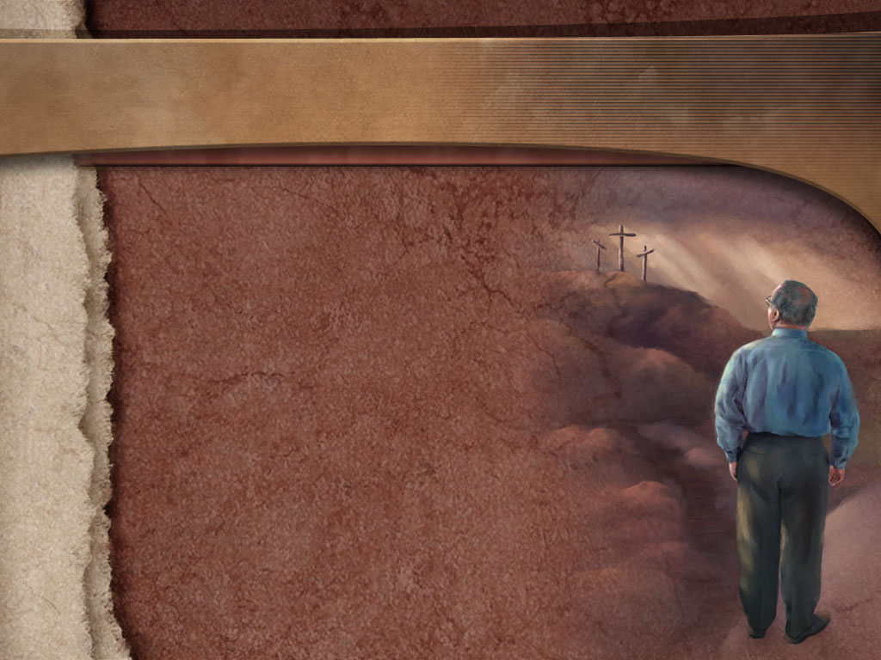
He Is Our Savior
It was for us that Jesus left the glory of heaven – 2 Corinthians 8:9; 1 Timothy 1:15.
John 20:20

Slide 4
He Is Our Savior
He willingly came to earth to pay the penalty for our sins – Isaiah 53:3-4,10-11; 1 Peter 2:24.
John 20:20

Slide 5
He Is Our Savior
No greater love could be shown – John 15:13.
John 20:20

Slide 6
He Is Our Savior
Because He gave His all for us, He expects our all in return – Acts 20:28; 1 Corinthians 6:19-20.
John 20:20

Slide 7
He Is Our Lord
Though He was humbled, Jesus has now been highly exalted – Daniel 7:13-14.
John 20:28

Slide 8
He Is Our Lord
His authority is absolute – Matthew 28:18; Revelation 19:16.
John 20:28

Slide 9
He Is Our Lord
It is all-inclusive – Ephesians 1:20-23.
John 20:28

Slide 10
He Is Our Lord
He must be obeyed – Acts 3:22-23; Mark 9:7.
John 20:28

Slide 11
He Is Our Lord
When we disregard His commands, we disrespect Him and His authority – Luke 6:46.
John 20:28

Slide 12
He Is Our Lord
Moreover, we jeopardize our salvation – Hebrews 5:9.
John 20:28

Slide 13
He Is Our God
He is the eternally blessed God – Romans 9:5; Philippians 2:5-6.
John 20:28

Slide 14
He Is Our God
All things were created by Him – John 1:1-3; Colossians 1:15-16.
John 20:28

Slide 15
He Is Our God
He therefore is our Creator. We belong to Him – John 1:10-11.
John 20:28

Slide 16
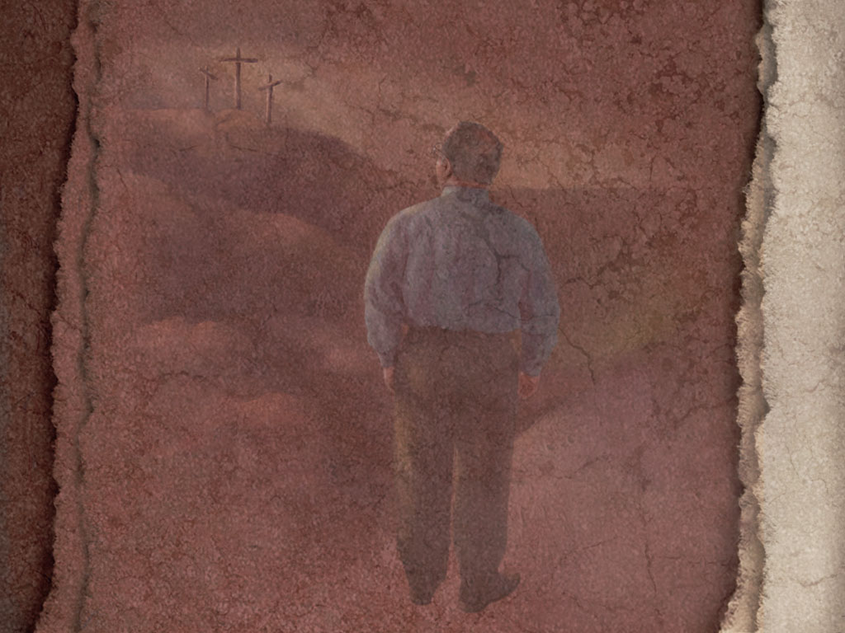
Jesus Is
Our Savior
Our Lord
Our God
He Deserves Our Total Commitment
John 20:20-29

