Slide 2
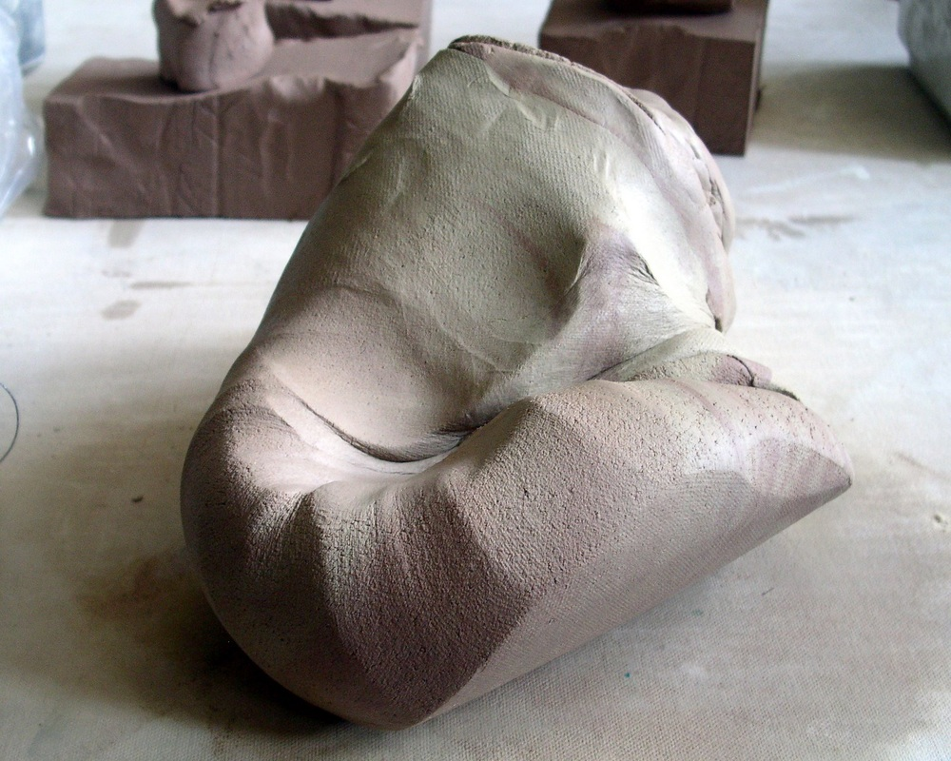
Some Resist the shaping of God’s Hands

Slide 3
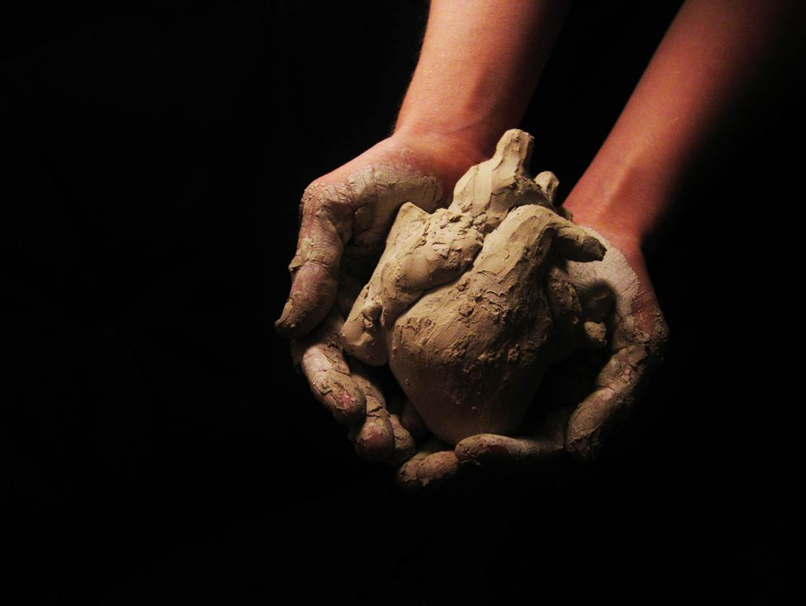
Some who are marred, give up hope

Slide 4
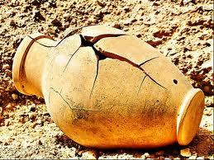
Some are distracted by the clay of others

Slide 5
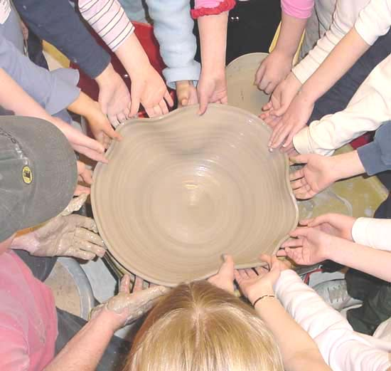
Some are pulled away before curing

Slide 6
Some Fully Embrace the touch of the Masters Hands

Slide 7
