Slide 2
God Working in Brazil
Highlights of 21 years

Slide 3
Background: The Country

Slide 4
Background: The Country
Population: 202 million

Slide 5
Background: The Country
Population: 202 million
Diversity of culture, climate, etc.

Slide 6
Background: The Country
Population: 202 million
Diversity of culture, climate, etc.
Large land area

Slide 7
Background: The Country
Population: 202 million
Diversity of culture, climate, etc.
Large land area
Improving economy

Slide 8
Background: The Country
Population: 202 million
Diversity of culture, climate, etc.
Large land area
Improving economy
Primary religious influences:
Catholicism
Neo-Pentecostalism

Slide 9
Background: 21 Years

Slide 10
Background: 21 Years
North American Participation
On site
From a distance

Slide 11
Background: 21 Years
North American Participation
On site
From a distance
Brazilian Participation
Churches
Preachers
Active Christians

Slide 12
Typical Process of “Cold” Contacts

Slide 13
Typical Process of “Cold” Contacts
Frustration: Religion or Life

Slide 14
Typical Process of “Cold” Contacts
Frustration: Religion or Life
Receive publication or do internet search

Slide 15
Typical Process of “Cold” Contacts
Frustration: Religion or Life
Receive publication or do internet search
Study via Website

Slide 16
Typical Process of “Cold” Contacts
Frustration: Religion or Life
Receive publication or do internet search
Study via Website
Contact
E-mail
Mail
Participation in public studies

Slide 17
Typical Process of “Cold” Contacts
Frustration: Religion or Life
Receive publication or do internet search
Study via Website
Contact
E-mail
Mail
Participation in public studies
New Christians

Slide 18
Typical Process of “Cold” Contacts
Frustration: Religion or Life
Receive publication or do internet search
Study via Website
Contact
E-mail
Mail
Participation in public studies
New Christians
New congregations

Slide 19
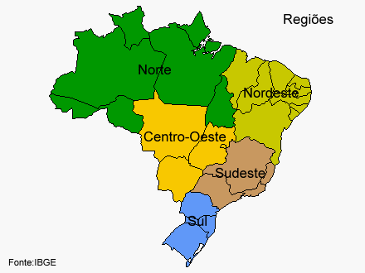
Primary sources of contacts

Slide 20
Primary sources of contacts
Personal contacts, especially of new converts

Slide 21
Primary sources of contacts
Personal contacts, especially of new converts
Printed material (bulletins, tracts, flyers, etc.)

Slide 22
Primary sources of contacts
Personal contacts, especially of new converts
Printed material (bulletins, tracts, flyers, etc.)
Newspaper articles

Slide 23
Primary sources of contacts
Personal contacts, especially of new converts
Printed material (bulletins, tracts, flyers, etc.)
Newspaper articles
Internet
Website
Videos
Facebook, etc.

Slide 24
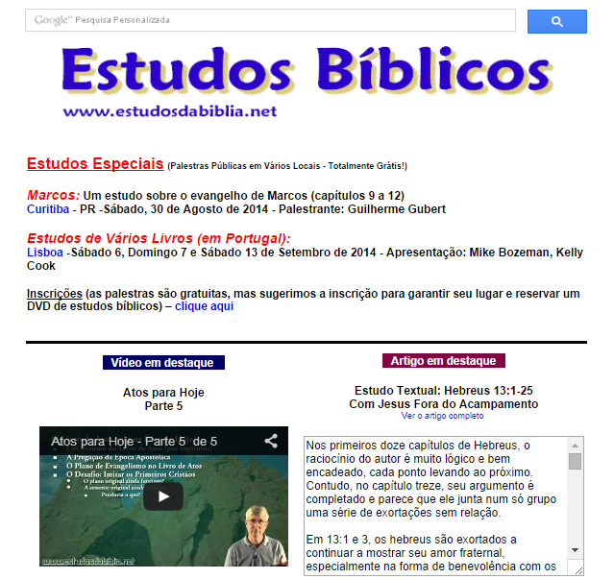
Website Activity

Slide 25
Website Activity
Videos (via YouTube)

Slide 26
Website Activity
Videos (via YouTube)

Slide 27
Website Activity
Main Site: 2013

Slide 28
Website Activity
Main Site: 2014

Slide 29
Website Activity
Main Site: 2015

Slide 30
Website Activity
3 weeks starting August 15, 2014
(Locations of access to main page)

Slide 31
Public studies throughout the country

Slide 32
Public studies throughout the country
“Neutral” locations

Slide 33
Public studies throughout the country
“Neutral” locations
Study marathons

Slide 34
Public studies throughout the country
“Neutral” locations
Study marathons
Question and answer periods

Slide 35
Public studies throughout the country
“Neutral” locations
Study marathons
Question and answer periods
Announced via website, flyers, etc.

Slide 36
Public studies throughout the country
“Neutral” locations
Study marathons
Question and answer periods
Announced via website, flyers, etc.
Topics chosen to challenge

Slide 37
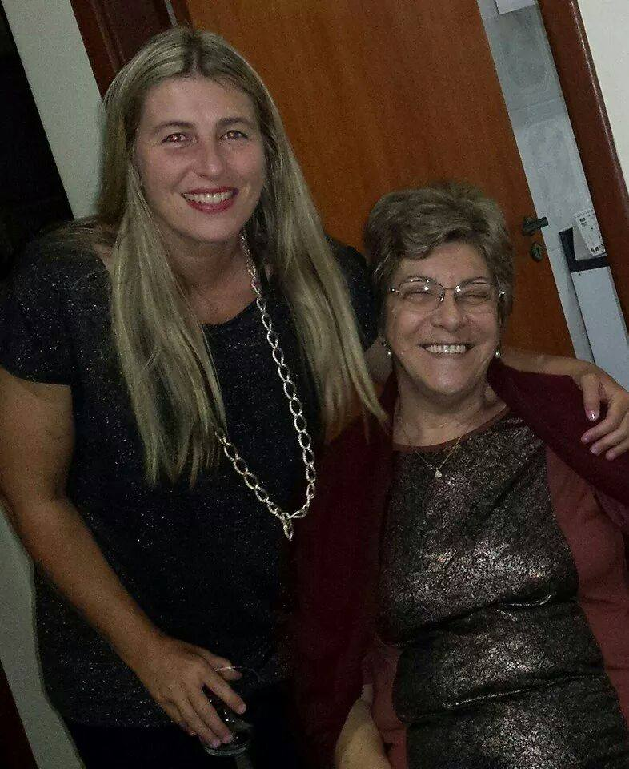
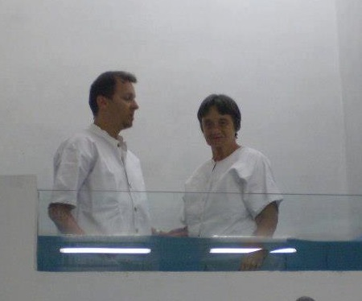
Preaching the gospel is about people

Slide 38
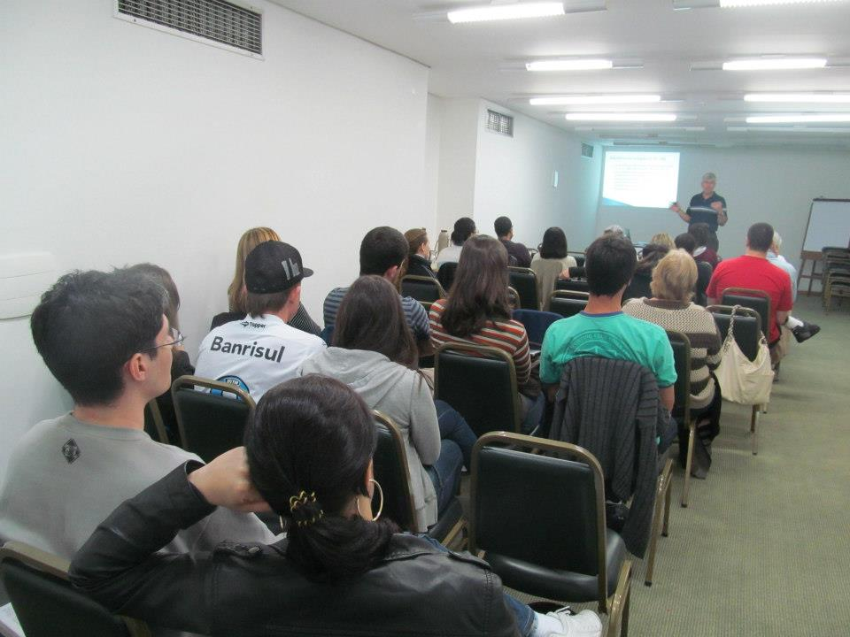
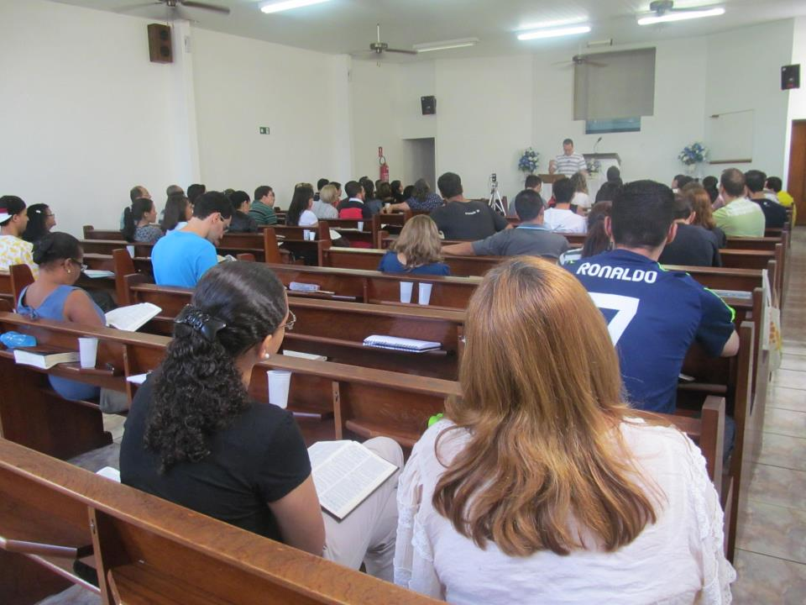
Preaching the gospel is about people

Slide 39
God has been working
Please continue praying for the effective spread of the gospel in Brazil

