Slide 1
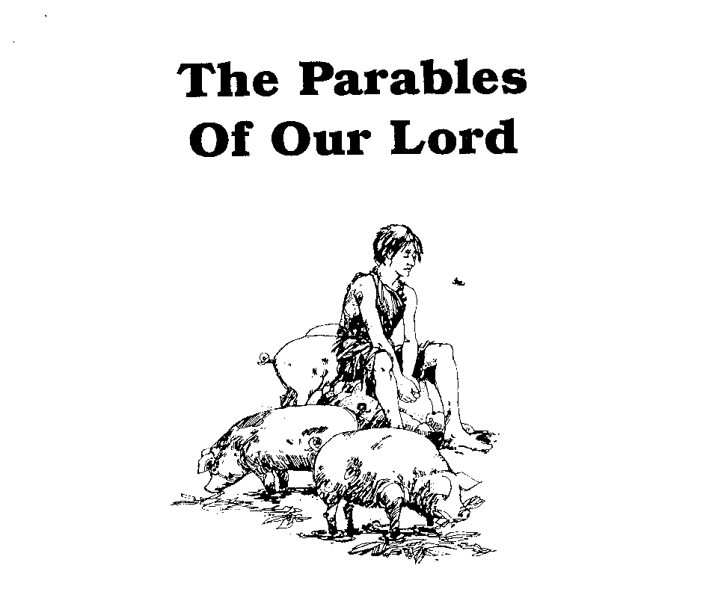
Parables of Jesus – Lesson 13
He who has ears,
let him hear

Slide 2
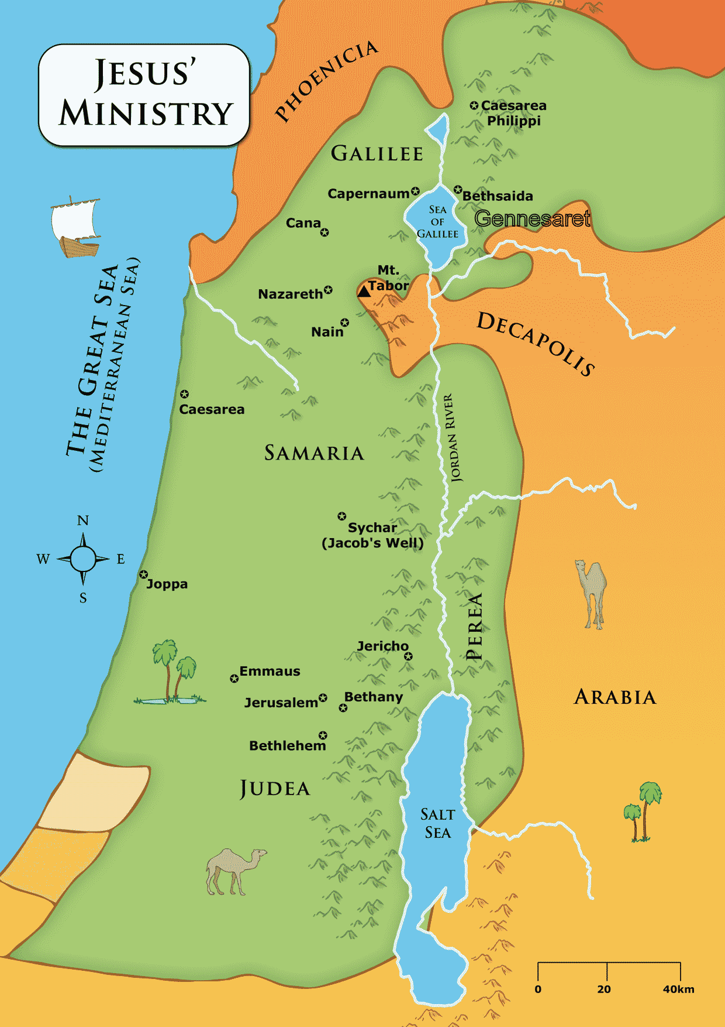

Slide 3
The Great Supper
1. What is the background for this parable?
A Sabbath day feast at Pharisee leader’s house
Healing of the man with dropsy
Jesus’ observations on their behavior
Their desire for places of honor
The host’s lack of concern for others

Slide 4
The Great Supper
1. What is the background for this parable?
“Blessed is everyone who will eat bread in the kingdom of God – v. 15
What does this mean?
Jesus responds with Parable of the Great Supper

Slide 5
The Great Supper
2. Who is the certain man? What does his supper represent?
Certain man = God
Supper = the kingdom of God
Many are invited
It is prepared, i.e., readied

Slide 6
The Great Supper
3. Who are they that are first bidden and expected at the feast?
Generally, the Jews
Specifically, those who would have been thought ‘appropriate’ for the feast, i.e., those to whom Jesus was speaking

Slide 7
The Great Supper
4. What three excuses did these guests offer? What do these signify?
“they all alike began to make excuses”
Excuses:
1. I have bought a piece of land…
2. I have bought 5 yoke of oxen
3. I have married a wife…

Slide 8
The Great Supper
4. What three excuses did these guests offer? What do these signify?
First: They are “insulting indifference” to the invitation.
Unconcerned about effort and expense made
Own desires must come first
Basically, “I don’t want to come”

Slide 9
The Great Supper
4. What three excuses did these guests offer? What do these signify?
Second, they may have been lame and invented excuses
Who buys property without seeing?
Who buys oxen without knowing if they work?
One evening away from wife?

Slide 10
The Great Supper
4. What three excuses did these guests offer? What do these signify?
Third, they may have been the real reasons they chose not to go
Nothing wrong with the activities but there was a more pressing obligation
“carefully take to heart the lesson that legitimate business and lawful and pure affections may be road blocks…and can cost us our souls”

Slide 11
The Great Supper
5. Who does the man next invite? Who are they?
“the head of the household became angry”
Invited poor, cripple, blind and lame…of the city
Likely the Jews thought to be of no importance
“of the city” indicates same general group

Slide 12
The Great Supper
6. Who does the man next send his servant to invite to the feast? Who are they?
Those in the highways and along the hedges
Likely indicates Gentiles
These would be outside the city, i.e., not the same general group

Slide 13
The Great Supper
7. What is the significance of there being room at the supper?
God has made provision for as many as will come
Revelation 22:17

Slide 14
The Great Supper
8. What judgment does the man pass on those that were bidden and did not come?
“none of those men who were invited shall taste of my dinner”

Slide 15
The Great Supper
9. What three other brief parables does Jesus give in this connection?
Parable of the Son or Ox in Well on Sabbath
Parable of the Guests (Take the Lower Place)
Parable of the Proper Guests

Slide 16
The Great Supper
10. What is the main lesson of all three?
God’s valuing of men and attitudes is different that what man determines

