Slide 1
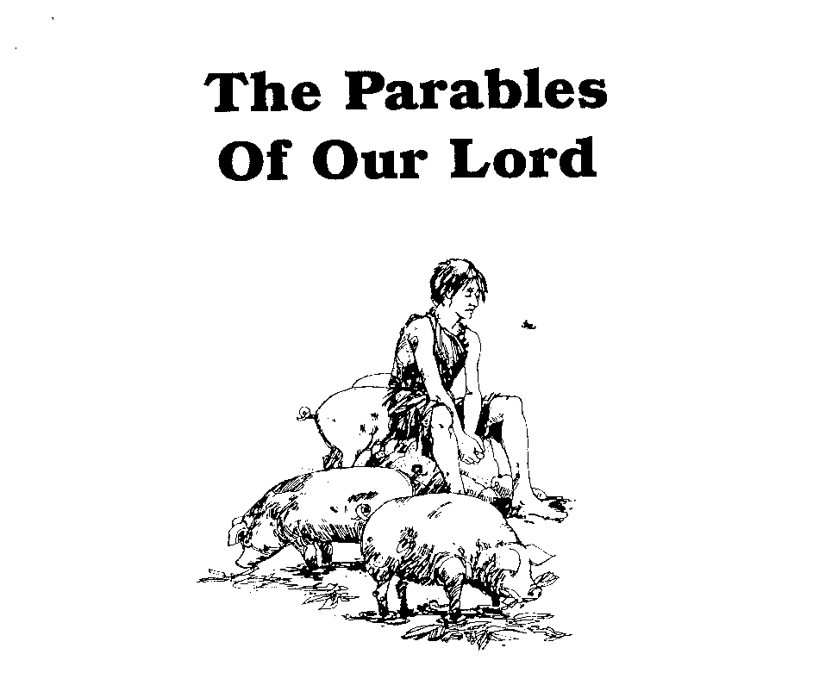
Parables of Jesus – Lessons 14-15
He who has ears,
let him hear

Slide 2
Lost Sheep & Lost Coin
1. What is the background for these parables?
Perean Ministry - the winter before Jesus’ crucifixion in the spring
The feast at the Pharisee leader’s house
Jesus teaching to “large crowds”

Slide 3
Lost Sheep & Lost Coin
1. What is the background for these parables?
“all the tax collectors and the sinners were coming near Him to listen to Him”
“the Pharisees and the scribes began to grumble”
“This man receives sinners and eats with them”

Slide 4
Lost Sheep & Lost Coin
1. What is the background for these parables?
“So He told them this parable, saying…”

Slide 5
Lost Sheep & Lost Coin
Look for the principle truth the parable is intended to teach
Most parables have only one point – not the whole scheme of redemption

Slide 6
Lost Sheep & Lost Coin
2. Who does the shepherd represent?
Jesus

Slide 7
Lost Sheep & Lost Coin
3. Who does the lost sheep represent?
Tax collectors and sinners
Anyone thought “unworthy” by Pharisees
Anyone who is lost in sin

Slide 8
Lost Sheep & Lost Coin
5. What does the shepherd do? Why?
Leaves rest of the flock
Goes after the lost sheep
Because that single sheep is important
Economically
Affection for the sheep

Slide 9
Lost Sheep & Lost Coin
6. How long does the shepherd search? What does this signify?
“until he finds it”
His concern and affection for the sheep
The Lord’s willingness to save

Slide 10
Lost Sheep & Lost Coin
7. When the sheep is found what does the shepherd do? What might this represent?
“he lays it on his shoulders”
The Lord’s willingness to deal with the weakness of His people

Slide 11
Lost Sheep & Lost Coin
8. After finding the sheep and returning home, what does the shepherd do? What is this?
“he calls together his friends and his neighbors” for rejoicing
Rejoicing in heaven over the salvation of one who was lost

Slide 12
Lost Sheep & Lost Coin
4. Who are the ninety-nine sheep in the fold?
Jesus compares them to “ninety-nine righteous people who need no repentance”
Who is it who needs “no repentance”?
Pharisees?

Slide 13
Lost Sheep & Lost Coin
2. Who does the woman represent?
Jesus

Slide 14
Lost Sheep & Lost Coin
3. Who does the lost coin represent?
Tax collectors and sinners
Anyone thought “unworthy” by Pharisees
Anyone who is lost in sin

Slide 15
Lost Sheep & Lost Coin
4. What was the coin’s real value?
Drachma in Greek which was equivalent to the Roman denarius
It was a “day’s wages”
Sentimental value?

Slide 16
Lost Sheep & Lost Coin
5. What does the woman do when she realizes the coin is lost?
Lights a lamp
Sweeps the house
Searches carefully

Slide 17
Lost Sheep & Lost Coin
8. What significance do the candle and broom have?
Characterizes a deliberate and focused searching

Slide 18
Lost Sheep & Lost Coin
6. What does this imply about the coin’s worth to the woman?
It was of great value

Slide 19
Lost Sheep & Lost Coin
7. What does the woman do when she finds the coin? What does this represent?
“calls together her friends and neighbors” for rejoicing
Rejoicing in heaven over the salvation of one who was lost

Slide 20
Lost Sheep & Lost Coin
10. What does the found coin represent?
A sinner who repents

Slide 21
Lost Sheep & Lost Coin
9. Who in the Lord’s audience is to be compared and contrasted with the woman in the parable?
Compared: The Lord, Jesus
Contrasted: The Pharisees and the scribes

Slide 22
Lost Sheep & Lost Coin
What can we learn? -The concern of God for each individual soul
Luke 19:10 "For the Son of Man has come to seek and to save that which was lost."
Matthew 9:13 "But go and learn what this means: 'I DESIRE COMPASSION, AND NOT SACRIFICE,' for I did not come to call the righteous, but sinners.”
2 Peter 3:9 The Lord is not slow about His promise, as some count slowness, but is patient toward you, not wishing for any to perish but for all to come to repentance.

Slide 23
…no Pharisee had ever dreamed of a God like [this]. One perhaps that would be merciful to the good who came to plead deserving ways, but certainly not one who would go in search of society’s worthless scabs. But there was nothing in Jesus’ ways the Pharisees could not have anticipated had they ever truly understood the God of the Old Testament on which they had so long doted. From the Garden of Eden to the last plaintive appeal of the prophets, He had been in relentless pursuit of His lost people – however sorry their state, however indifferent their response. Unlike the woman in the parable, Jesus will never recover all that are lost to Him, but it will never be for lack of seeking and searching.
-Earnhart

