Slide 1
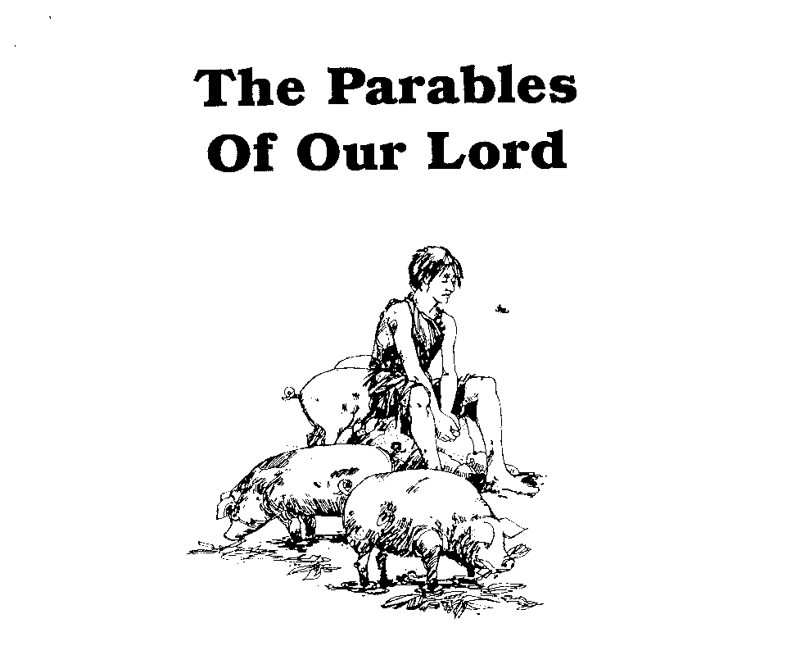
Parables of Jesus – Lesson 16
He who has ears,
let him hear

Slide 2
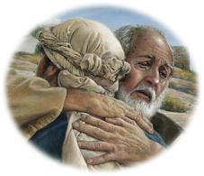
The Prodigal Son
“the pearl and crown of all the parables”
“It could better have been called the Parable of the Loving Father…”

Slide 3
The Prodigal Son
1. What is the background of this parable?
Luke 15:1-3
Three parables:
Parable of the Lost Sheep
Parable of the Lost Coin
Parable of the Prodigal Son

Slide 4
The Prodigal Son
All three parables have a “lost item” and one who desires to recover/find the lost item
Each speaks to God’s love for sinners particularly as demonstrated in Jesus
Third parable adds another element.
One who does not celebrate the “finding”

Slide 5
The Prodigal Son
Prodigal
Spending money or resources freely and recklessly; wastefully extravagant
A person who spends money in a recklessly extravagant way

Slide 6
The Prodigal Son
2. Who does the younger son represent?
The tax collectors and sinners of v. 1
Anyone thought “unworthy” by Pharisees
Anyone lost in sin
The younger son is the least important of the three characters in the parable.

Slide 7
The Prodigal Son
5. How came the younger son to be in the foreign land?
He left the father
He was prodigal in the foreign land
He became the “lowest of the low”

Slide 8
The Prodigal Son
6. What thing was necessary for the young man to return home?
“when he came to his senses
Realized the blessings in the father’s house
Repentance: “I will get up and go”

Slide 9
The Prodigal Son
3. Who does the father represent?
God

Slide 10
The Prodigal Son
7. How does the father receive the younger son?
Sees him “while he is still a long way off”
Felt compassion for him
Ran and embraced and kissed him

Slide 11
The Prodigal Son
8. What do the robes, shoes, ring and merrymaking in the parable represent?
The father’s rejoicing
The extravagance of the father’s love
The son’s restoration as a “son”

Slide 12
The Prodigal Son
4. Who does the elder brother represent?
The Pharisees and scribes

Slide 13
The Prodigal Son
9. What is wrong with the attitude of the elder brother?
What was his attitude?
Anger at both brother and father
Haughtiness based on his “own work”
Resentment at the father’s love for brother

Slide 14
The Prodigal Son
9. What is wrong with the attitude of the elder brother?
Ungrateful for what father had done for him
Lack of love for younger brother

Slide 15
The Prodigal Son
10. What did the elder brother refuse to accept from the younger brother?
Repentance

Slide 16
The Prodigal Son
Lessons from the younger son?
“The far country is not a place but an attitude.”
Many waste God’s gifts in sin….and in in respectable pursuits.
We must “come to our senses”, repent, and return to the father
Psalm 51:16-19

Slide 17
The Prodigal Son
Lessons from the older son?
He refused to be reconciled to either his brother or his father.
He thought himself valuable based on his works
He did not understand the father’s love
“He was abjectly poor in his imaginary worthiness when he could have been rich in God’s grace.”
Luke 17:10

Slide 18
The Prodigal Son
Lessons from the father?
“How powerfully Jesus reveals the heart of God toward sinners in this simple but compelling story.”
Does God “run”?
John 3:16; Romans 8:32; Ephesians 1, 2; Micah 7:18-20

Slide 19
The Prodigal Son
When did the father restore the prodigal to his place as “son”?
When the son repented and returned to the Father
When the son determined he would be as “one of [your] hired men”

