Slide 1
Parables of Jesus – Lesson 17
He who has ears,
let him hear

Slide 2
The Unprofitable Servant
1. What is the background for this parable?
Capernaum:
-Sower
-Seed Growing Itself
-Tares
-Mustard Seed
-Leaven
-Hidden Treasure
-Pearl of Great Price
-Drag Net
Jerusalem:
-Laborers in Vineyard
-Two Sons
-Wicked Husbandmen
Perean Ministry:
-Great Supper/Dinner
-Lost Sheep
-Lost Coin
-Prodigal Son

Slide 3
The Unprofitable Servant
Timing and setting is somewhat uncertain
Matthew and Luke chronology don’t match
In the 4 – 6 months prior to crucifixion?

Slide 4
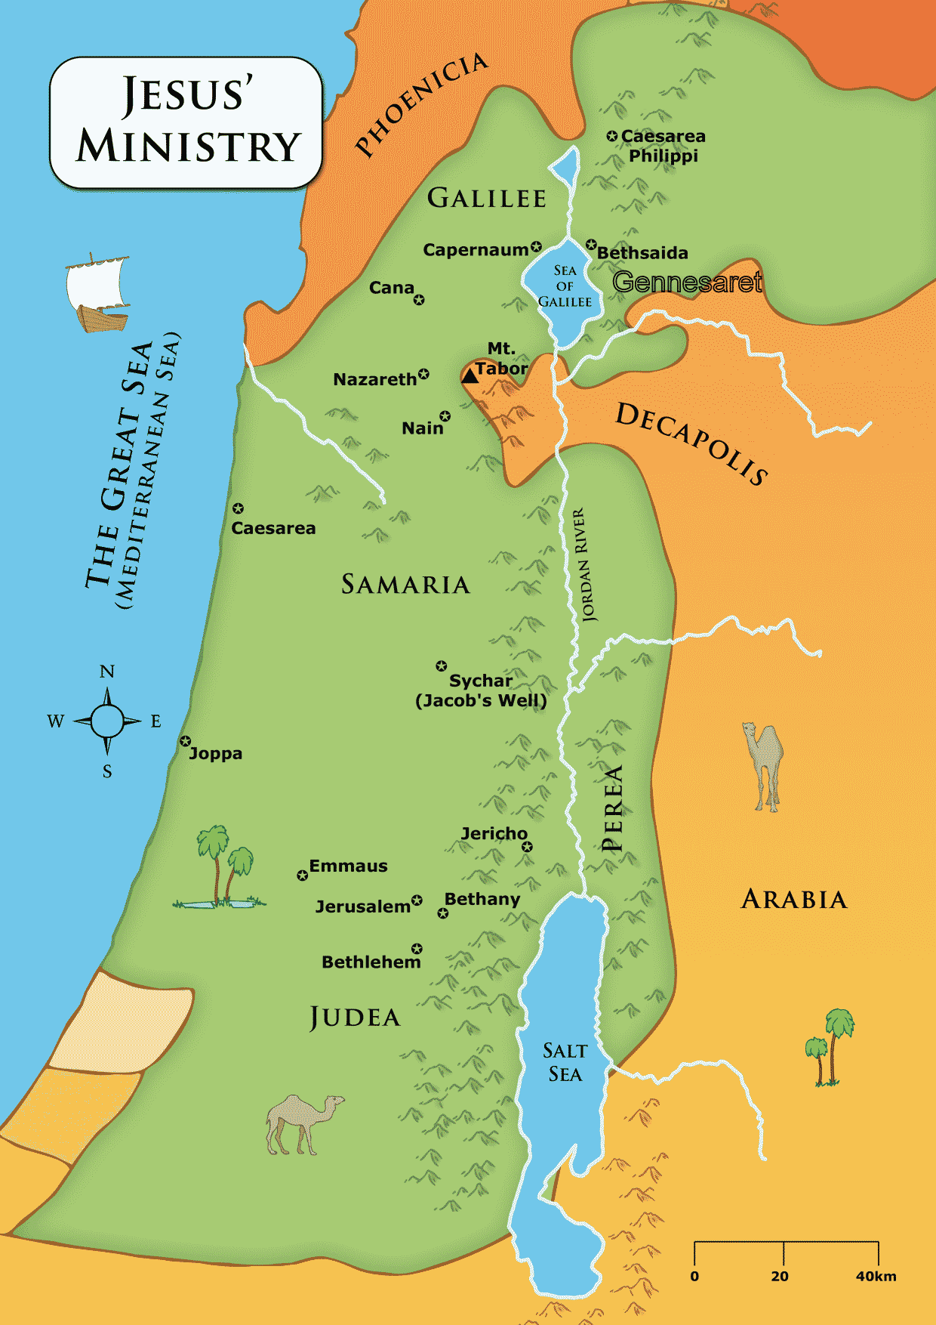

Slide 5
The Unprofitable Servant
A collection of Jesus’ teachings/sayings?
A common thread?

Slide 6
The Unprofitable Servant
2. Who does the servant represent?
The apostles – “so you too” (v. 10)
Anyone who serves God

Slide 7
The Unprofitable Servant
3. Who does the householder represent in this parable?
God

Slide 8
The Unprofitable Servant
4. What is the obligation of the servant toward the master? What are the duties described in the parable?
Duties: Outside: plowing, tending sheep; Inside: Prepare food, serve
Obligation: whatever was required/ commanded

Slide 9
The Unprofitable Servant
5. What obligation does the householder have toward the servant?
6. What will a master not say to his servant? Why?
Obligation: In parable → None
Will not thank the servant
Nothing unusual about master’s actions
THIS IS NOT A LESSON ABOUT THE MASTER

Slide 10
The Unprofitable Servant
7. To what does Jesus compare this truth about master/servant relations?
When you have done everything commanded by God, you still remain unprofitable

Slide 11
The Unprofitable Servant
8. In what sense is this servant unprofitable?
Not done anything above the expected
The master has not received “extra” or “gain” or “profit” beyond the expected

Slide 12
The Unprofitable Servant
10. Harmonize Luke 17:7 and Luke 12:37.
Luke 17: No consideration of master although reasonable to believe the master was “pleased”
Luke 12: Viewed from master’s standpoint: The master who joyed in the obedience of the servants and gave the undeserved

Slide 13
The Unprofitable Servant
Harmonize the “father” in the Prodigal Son with the “master” in Luke 17.
Point of view is different:
Father’s loving care in Prodigal Son
Master’s attitude not considered

Slide 14
The Unprofitable Servant
Lessons?
We cannot do enough to “earn” salvation – it is by grace. Romans 3:23-24; Titus 3:4-5
BUT, salvation is not by “grace only”. Romans 6

