Slide 1
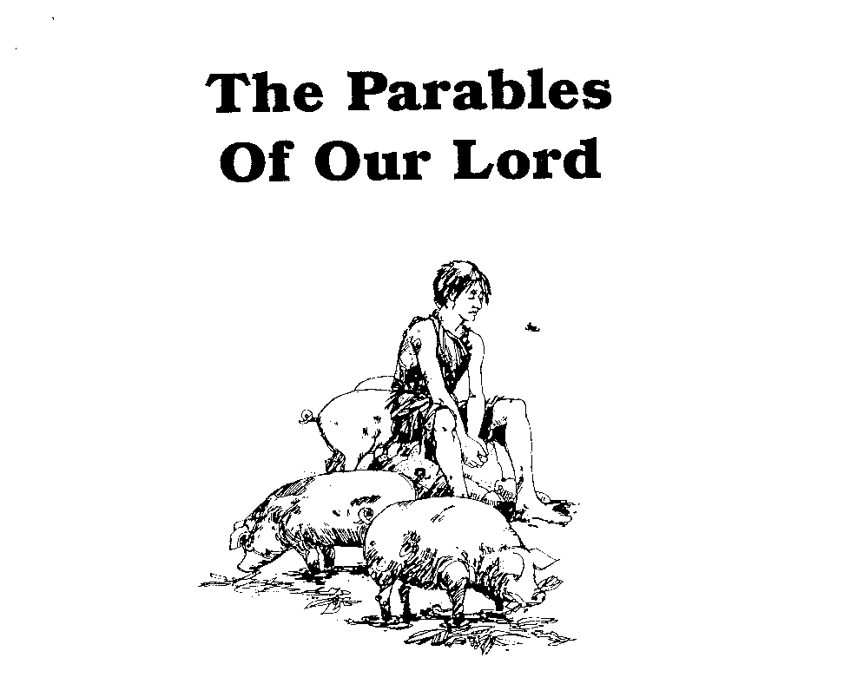
Parables of Jesus – Lesson 18
He who has ears,
let him hear

Slide 2
The Unmerciful Servant
1. What is the background of this parable?
Time?
On the way to “beyond the Jordan”
3 – 4 months prior to crucifixion?

Slide 3
The Unmerciful Servant
1. What is the background of this parable?
Setting
Conversation with the disciples/apostles
Question: Who then is the greatest in the kingdom of heaven?

Slide 4
The Unmerciful Servant
2. Who is represented by the king in this parable?
God
“wished to settle accounts with his slaves”

Slide 5
The Unmerciful Servant
3. Who is represented by the unmerciful servant in this parable?
Everyone who is “brought to him (God)”
Everyone who needs forgiveness and is forgiven by God

Slide 6
The Unmerciful Servant
5. What is the significance of the ten thousand talent debt owed to the king?
It was unpayable -“he did not have the means to repay”
Origin of debt is not mentioned
We cannot pay the debt for our sin regardless of the “reason”

Slide 7
The Unmerciful Servant
6. What does the king do for his servant? What does this represent?
At first: Sell everything the servant had including himself and family
Servant begs for patience and promises repayment
King forgives the debt completely
Represents God’s forgiveness of what we cannot pay

Slide 8
The Unmerciful Servant
4. Who does the other servant represent? How much did he owe?
Represents the brother who has sinned against you
He owed 100 denarii
Not unreasonable to believe he could repay this debt

Slide 9
The Unmerciful Servant
7. What does the servant do to his fellow-servant? What does this symbolize?
He attacks him and puts him in prison
What did the fellow-servant do and ask?
Symbolizes the one who will not forgive his brother

Slide 10
The Unmerciful Servant
8. What does the king do when he learns of the action of his servant?
He summons the servant
Calls him “wicked” – not because of the debt which had been forgiven but because of his failure to act “in the same way that I had mercy on you”

Slide 11
The Unmerciful Servant
9. What should the servant have done for his fellow-servant?
“Should you not also have had mercy on your fellow slave in the same way that I had mercy on you?”

Slide 12
The Unmerciful Servant
10. What punishment did the servant receive?
“his lord, moved with anger”
“handed him over to the torturers until he should repay all that was owed him”

Slide 13
The Unmerciful Servant
Lessons:
“My heavenly Father will also do the same to you if each of you does not forgive his brother from your heart.”
Really and truly to feel and act towards him as if he had not offended

