Slide 1
Parables of Jesus – Lesson 19
He who has ears,
let him hear

Slide 2
The Two Debtors
1. What is the background for this parable?
Timing?
Likely early 2nd year of the Lord’s ministry

Slide 3
The Two Debtors
1. What is the background for this parable?
7:29-30 – Sinners vs Pharisees
7:31-35 – Pharisees’ fickleness

Slide 4
The Two Debtors
Earnhart:
The story which gives rise to this parable is a very powerful one, so much so that the parable rests in its shadow, a simple little illustration which serves to explain the moving scene which has just been played out.

Slide 5
The Two Debtors
1. What is the background for this parable?
7:36 – Simon’s invitation
Hospitality?
Curiosity?
Insulting/demeaning?

Slide 6
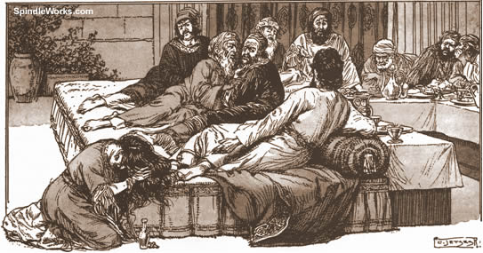
The Two Debtors
What is the background for this parable?
7:37-38 – The woman who was a sinner

Slide 7
The Two Debtors
1. What is the background for this parable?
7:39 – Simon’s response
Shocked/Scandalized/Appalled?

Slide 8
The Two Debtors
2. Who does the moneylender represent?
God / Jesus

Slide 9
The Two Debtors
3. Who does the debtor owing five hundred pence represent?
The woman
Sinners such as the woman
Those whom we may think as “worse sinners”

Slide 10
The Two Debtors
4. Who does the debtor owing only fifty pence represent?
Simon
People such as Simon
Those whom we may think as “not too bad” sinners

Slide 11
The Two Debtors
5. What is the significance of the difference in their indebtedness?
One is Large, One is Small
One appears unmanageable, One appears manageable
Importance is relative amounts for the debtors

Slide 12
The Two Debtors
6. What did these two men have in common?
“they were unable to repay”

Slide 13
The Two Debtors
7. Is there any difference in their position before the moneylender?
No

Slide 14
The Two Debtors
8. What did the moneylender do for both of these men?
“he graciously forgave them both”
“graciously”?

Slide 15
The Two Debtors
What question did Jesus ask Simon? What was Simon’s response?
Jesus: “So which of them will love him more?”
Simon: “I suppose the one whom he forgave more”
Jesus: “You have judged correctly”

Slide 16
The Two Debtors
How does Jesus compare the woman and Simon?
Simon:
-No water for feet
-No kiss
-No oil
Woman:
-Wet w/ tears, wiped w/ hair
-Has not ceased to kiss
-Anointed with perfume

Slide 17
The Two Debtors
What lesson does Jesus give Simon?
She loves much because her many sins are forgiven
But he who is forgiven little, loves little

Slide 18
The Two Debtors
What was Simon’s problem?
He felt superior to another sinner when he was in the same position: unable to pay
He did not realize/feel the same love
“it was [Simon’s] perception of his sins as few that was destroying him…he will have…difficulty in feeling any sense of gratitude toward God”

Slide 19
The Two Debtors
Lessons?
Every person is a sinner who cannot pay the debt of sin
Every person is saved by the “graciously” forgiving God
Every person should love much
Real love is manifested by serving God

