Slide 1
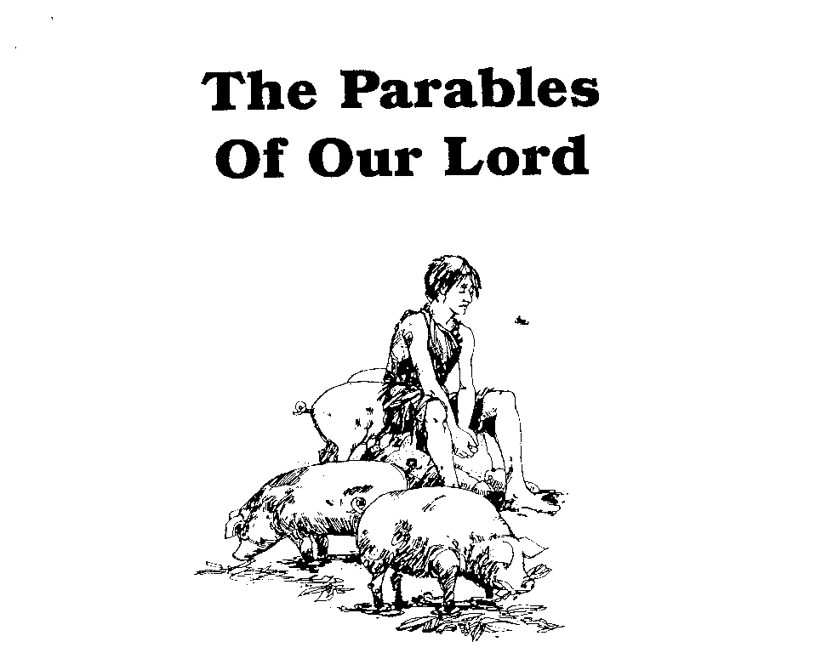
Parables of Jesus – Lessons 22
He who has ears,
let him hear

Slide 2
The Pharisee and The Publican
What is the background for this parable?
Time: A few months before the crucifixion
Setting: Appears different from the preceding parable of the unjust judge.

Slide 3
The Pharisee and The Publican
1. Who went up to the temple to pray?
“one a Pharisee and the other a publican”
Pharisee: “separated”
Publican: tax collector

Slide 4
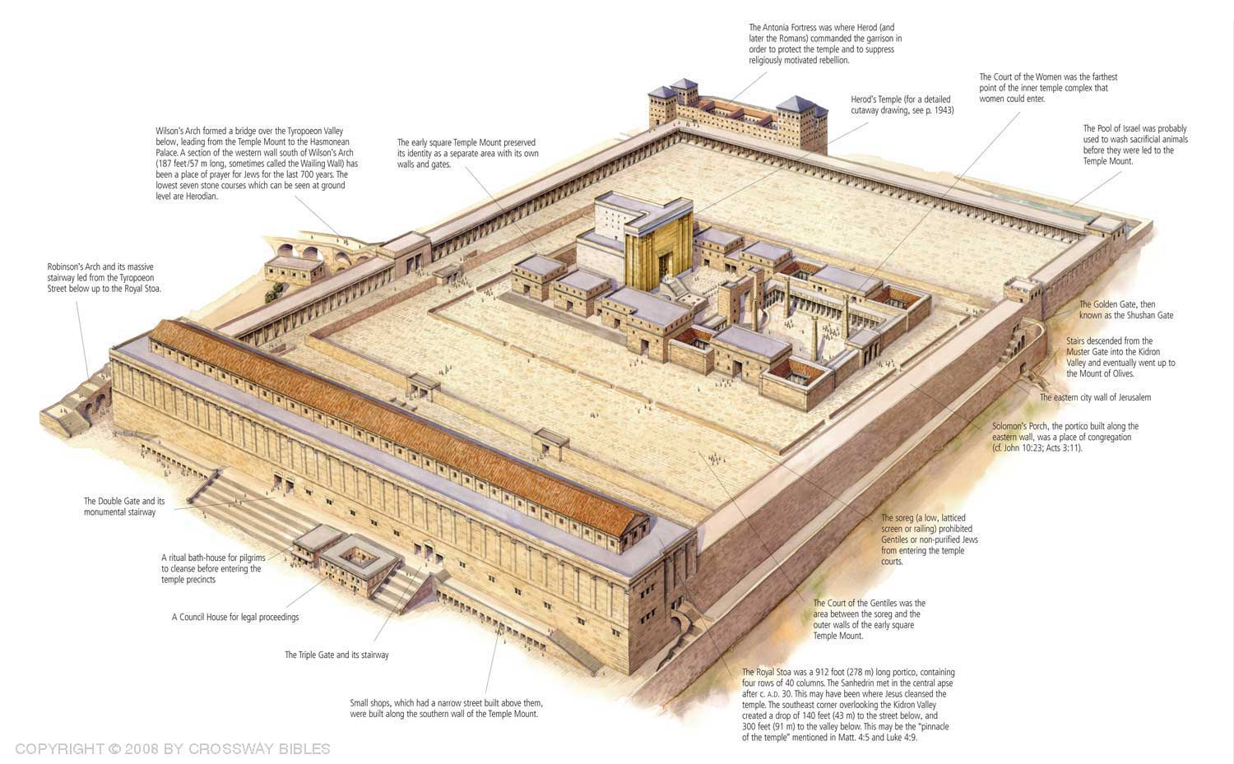

Slide 5
The Pharisee and The Publican
2. Describe the Pharisee.
“full of himself”, “holier than thou”, self-righteous, no self-awareness of his true standing before God
“stood” – “struck an attitude ostentatiously where he could be seen” - RWP

Slide 6
The Pharisee and The Publican
3. Describe the Publican.
Humble, aware of his sin, aware of his standing before God and his need for God’s mercy

Slide 7
The Pharisee and The Publican
4. With whom did the Pharisee compare himself in his prayer?
“not like other people”
“or even like this tax collector”

Slide 8
The Pharisee and The Publican
5. To whom did Jesus say the Pharisee prayed?
“was praying this to himself”

Slide 9
The Pharisee and The Publican
6. What is the character of his prayer?
Recitation of his own goodness
Grateful for his own virtues
“The Pharisee asked for nothing because he felt no need, confessed no sin because he felt no guilt.”

Slide 10
The Pharisee and The Publican
7. What did the Publican pray?
Posture: “unwilling to lift up his eyes to heaven”, “beating his breast”
Prayer: “God, be merciful to me, the sinner!”

Slide 11
The Pharisee and The Publican
8. What is the character of his prayer?
In presentation and word, a recognition of his sinfulness and the need for God’s mercy
“the sinner” – the Pharisee thought others were sinners but the Publican thought of himself alone as the sinner

Slide 12
The Pharisee and The Publican
9. Who went home justified?
The Publican
The man “despised” by the Pharisee was the one “approved” by God

Slide 13
The Pharisee and The Publican
10. On what basis did Jesus make this determination?
“for everyone who exalts himself will be humbled, but he who humbles himself will be exalted"

Slide 14
The Pharisee and The Publican
Applications?
Avoid self-righteousness. Luke 17:10; Romans 3:23
Avoid arrogance – seek humility. 1 Peter 5:5-6
“All of the goodness of the Pharisee could not save him without humility”

