Slide 1
Parables of Jesus – Lesson 25
He who has ears,
let him hear

Slide 2
The Good Samaritan
1. What is the background of this parable?
Time: Within the last year of Jesus’ life? Luke 9:51

Slide 3
The Good Samaritan
1. What is the background of this parable?
Sending out/return of the 70 – 10:1-22
Jesus’ private comments to disciples – 10:23
A lawyer tests Him – 10:25-29

Slide 4
The Good Samaritan
Who were the Samaritans?
2 Kings 17:24ff
How did the Jews consider the Samaritans?
John 4:9; John 8:48

Slide 5
The Good Samaritan
4. What happened to the man of whom Jesus spoke?
Going down from Jerusalem to Jericho
Fell among robbers
Left half-dead
Implication is that he was a Jew

Slide 6
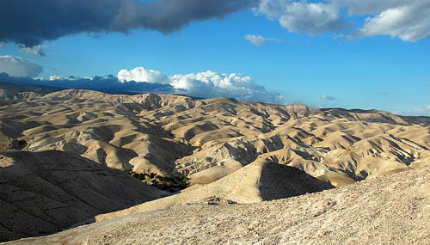
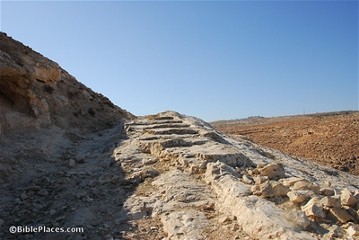
The Good Samaritan
Wilderness of Judea
“The Ascent of Adummim” - Red

Slide 7
The Good Samaritan
5. Who happened to come by? What did he do?
A priest “going down that road”
“he passed by on the other side”

Slide 8
The Good Samaritan
6. Who next happened by? What did he do?
A Levite
“passed by on the other side”
KJV/NKJV: “came and looked on him”

Slide 9
The Good Samaritan
7. Who finally came by and helped the man? What did he do?
A Samaritan
Bandaged wounds, applied oil and wine, put him on own beast, brought him to an inn, took care of him overnight, paid for continuing care

Slide 10
The Good Samaritan
8. What word does Jesus use to describe this man’s action? What does it mean?
compassion
sympathetic pity and concern for the sufferings of others

Slide 11
The Good Samaritan
What question did Jesus then ask the lawyer? What was the lawyer’s response?
“Which of the three was a neighbor to the man who fell among thieves?”
“The one who showed mercy on him”

Slide 12
The Good Samaritan
Applications?
9. What lesson was Jesus trying to teach the lawyer?
“Neighbor” is not defined by location, affinity, race, commonality

Slide 13
The Good Samaritan
Applications?
10. Who is a “neighbor”?
Anyone in some need

Slide 14
The Good Samaritan
Applications?
Neighbor love is not a response to my neighbor’s goodness but to his need.
Neighbor love is willing to be inconvenienced and to sacrifice self for others
“Who among us has not played it safe when suddenly confronted with the physical or spiritual misery of others?”

Slide 15
The Good Samaritan
Applications?
We cannot be “good” and fail to love our neighbor as taught in this parable
“Righteousness” cannot trump compassion and mercy even for our enemies and those who would do us wrong – Romans 12:20-21

