Slide 1
MAN IN THE MIRROR
Matthew 21:28-32

Slide 2
The heart is more deceitful than all else and is desperately sick; who can understand it?
_{- Jeremiah 17:9 -}
Notes:
Walking after his own evil heart (Jer 16:12)…Engraved on the tablet of their heart (17:1)…Heart turns away (17:5)

Slide 3
The sin of Judah is written down with an iron stylus; with a diamond point it is engraved upon the tablet of their heart…
_{- Jeremiah 17:1-2 -}
Notes:
Walking after his own evil heart (Jer 16:12)…Engraved on the tablet of their heart (17:1)…Heart turns away (17:5)

Slide 4
I will put My law within them and on their heart I will write it; and I will be their God…for I will forgive their iniquity, and their sin I will remember no more.
_{- Jeremiah 31:33-34 -}
Notes:
Walking after his own evil heart (Jer 16:12)…Engraved on the tablet of their heart (17:1)…Heart turns away (17:5)

Slide 5
Moreover, I will give you a new heart and put a new spirit within you; and I will remove the heart of stone from your flesh and give you a heart of flesh.
_{- Ezekiel 36:22-32 -}
Notes:
Walking after his own evil heart (Jer 16:12)…Engraved on the tablet of their heart (17:1)…Heart turns away (17:5)

Slide 6
RECEIVE THE IMPLANTED WORD

Slide 7
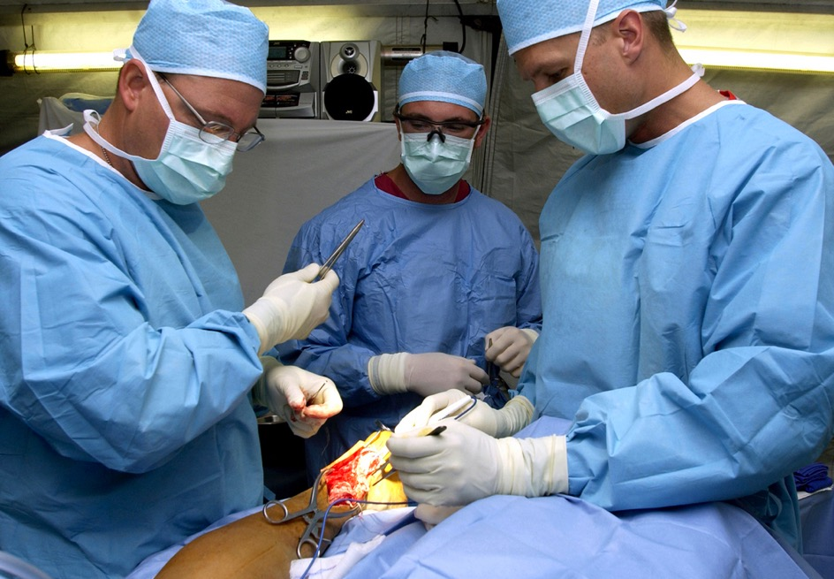
The Implant
LET GOD’S WORD CUT INTO ME ^{(Hebrews 4:12)}
Pentecost ^{(Acts 2:37)}
Lydia ^{(Acts 16:14)}

Slide 8
The Implant
LET GOD’S WORD CUT INTO ME ^{(Hebrews 4:12)}
TAKE THE WORD/HEART
All those who received his word ^{(Acts 2:41)}
Lydia responded/brought near ^{(Acts 16:14)}
Samaritans received the word of God ^{(Acts 8:4-14)}
Gentiles received the word of God ^{(Acts 11:1)}
Bereans received the word ^{(Acts 17:11)}
Notes:
Bold is same word as James 1

Slide 9
The Implant
LET GOD’S WORD CUT INTO ME ^{(Hebrews 4:12)}
TAKE THE WORD/HEART
CLEAN OUT THE MALIGNANCIES ^{(James 1:21)}

Slide 10
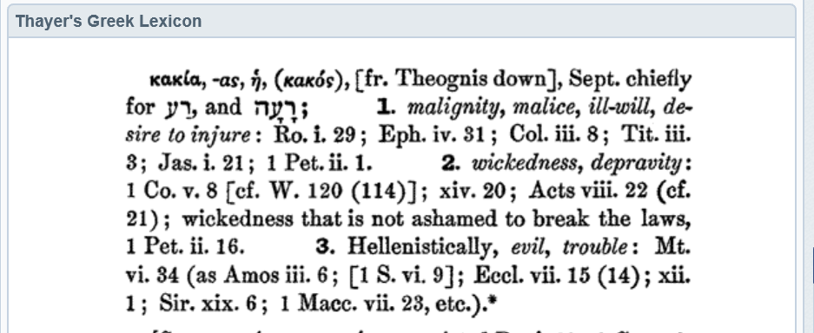

Slide 11
The Implant
LET GOD’S WORD CUT INTO ME ^{(Hebrews 4:12)}
TAKE THE WORD/HEART
CLEAN OUT THE MALIGNANCIES ^{(James 1:21)}
So I won’t die ^{(Acts 8:19-24)}
So I can grow ^{(1 Peter 2:1-3)}

Slide 12
The Implant
LET GOD’S WORD CUT INTO ME ^{(Hebrews 4:12)}
TAKE THE WORD/HEART
CLEAN OUT THE MALIGNANCIES ^{(James 1:21)}
STRENGTHEN IT ^{(1 Thess 2:13; 3:1-5)}
God & His word are able to build up ^{(Acts 20:32)}
Make my calling and election sure ^{(2 Peter 1:10)}
Notes:
DECEIVED by these afflictions (1 thess 3:3)

Slide 13
Moreover, I will give you a new heart and put a new spirit within you; and I will remove the heart of stone from your flesh and give you a heart of flesh.
_{- Ezekiel 36:22-32 -}
TAKE IT & LIVE?
REJECT IT & DIE
Notes:
Walking after his own evil heart (Jer 16:12)…Engraved on the tablet of their heart (17:1)…Heart turns away (17:5)

