Slide 1
MAN IN THE MIRROR

Slide 2
“Blessed is the womb that bore You and the breasts at which you nursed.” But He said, “On the contrary, blessed are those who hear the word of God and observe it.”

Slide 3
“Blessed is the womb that bore You and the breasts at which you nursed.” But He said, “On the contrary, blessed are those who hear the word of God and observe it.”

Slide 4
BLESSED IN HIS DOING

Slide 5
Blessed is
The slave who is ready ^{(Luke 12:35-40)}
Welcomes the master immediately ^{(12:36)}
The Master will serve him ^{(12:37)}
Keeps intruders out ^{(12:39)}
If I knew when—I’d be ready
Notes:
Home alone

Slide 6
Blessed is
The slave who is ready ^{(Luke 12:35-40)}
The slave who does his job ^{(Luke 12:41-48)}
Give food to the Master’s servants ^{(12:41)}
Put him in charge of all Master’s possessions ^{(12:44)}
Notes:
Home alone

Slide 7
But The Slave Who…
KNEW
Master was returning ^{(12:36,45)}
His job ^{(12:36,42,47)}
DID NOT DO
Will be cut into pieces ^{(12:46)}
Assigned with
Unbelievers ^{(12:46)}
Hypocrites ^{(Matt 24:50-51)}
Receive many lashes ^{(12:47)}
Did not know…did not do
Will receive few lashes ^{(12:48)}
Therefore, to one who knows the right thing to do and does not do it, to him it is sin.
- James 4:17 -

Slide 8
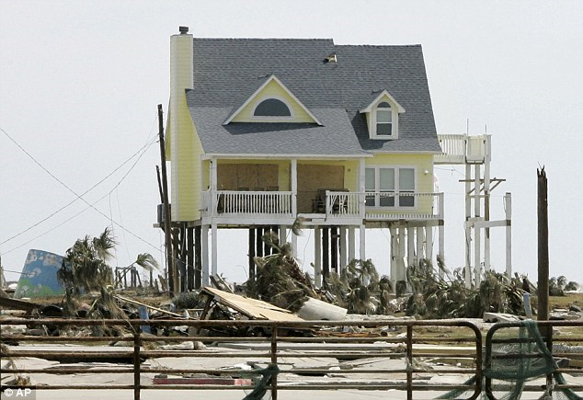
I’M BUILDING MY HOUSE
Notes:
CNN story only house that survived on the peninsula after Hurricane Ike…Galveston, TX

Slide 9
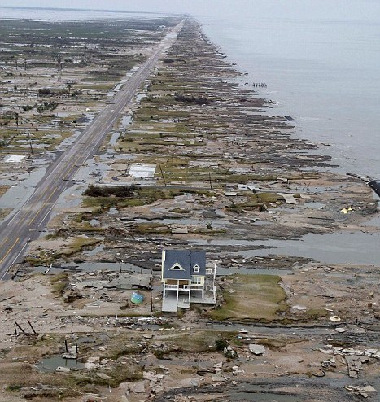

Slide 10
MAN IN THE MIRROR

