Slide 1
Abraham's Call
Gen 11:31 And Terah took Abram his son, and Lot the son of Haran his son's son, and Sarai his daughter in law, his son Abram's wife; and they went forth with them from Ur of the Chaldees, to go into the land of Canaan; and they came unto Haran, and dwelt there.
Gen 12:1 Now the LORD had said unto Abram, Get thee out of thy country, and from thy kindred, and from thy father's house, unto a land that I will shew thee:
Gen 12:2 And I will make of thee a great nation, and I will bless thee, and make thy name great; and thou shalt be a blessing:
Gen 12:3 And I will bless them that bless thee, and curse him that curseth thee: and in thee shall all families of the earth be blessed.

Slide 2
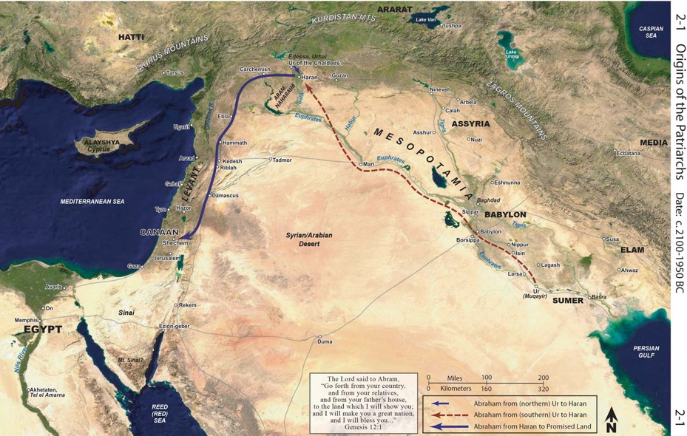

Slide 3
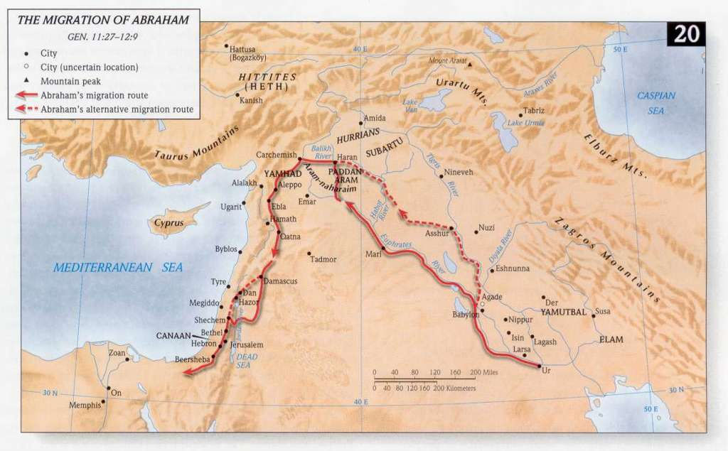

Slide 4
Abraham Enters Canaan
Gen 12:1 Now the LORD had said unto Abram, Get thee out of thy country, and from thy kindred, and from thy father's house, unto a land that I will shew thee: Gen 12:2 And I will make of thee a great nation, and I will bless thee, and make thy name great; and thou shalt be a blessing: Gen 12:3 And I will bless them that bless thee, and curse him that curseth thee: and in thee shall all families of the earth be blessed.
Gen 12:4 So Abram departed, as the LORD had spoken unto him; and Lot went with him: and Abram was seventy and five years old when he departed out of Haran. Gen 12:5 And Abram took Sarai his wife, and Lot his brother's son, and all their substance that they had gathered, and the souls that they had gotten in Haran; and they went forth to go into the land of Canaan; and into the land of Canaan they came.

Slide 5
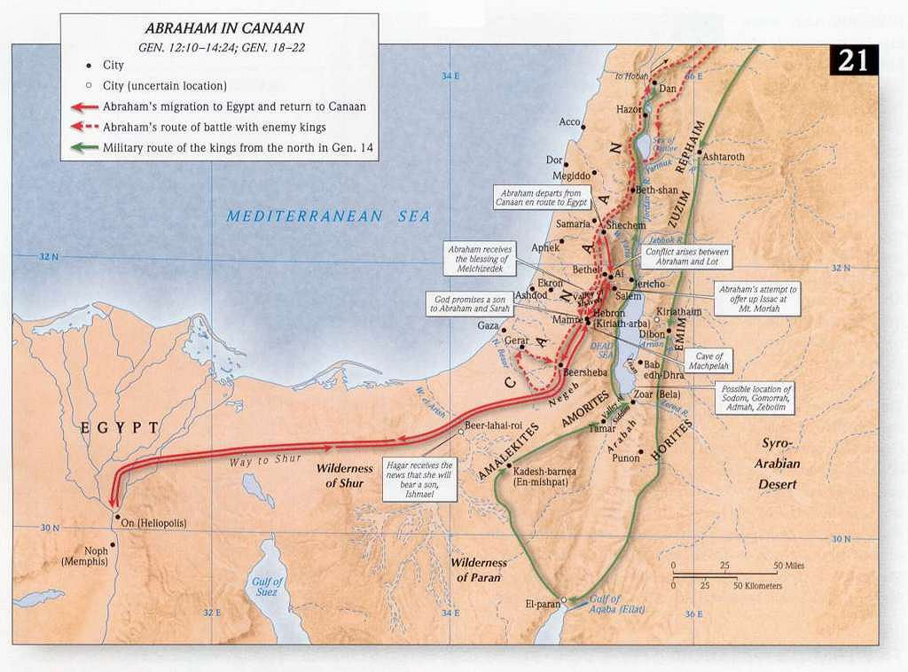

Slide 6
Abraham Moves to Shechem
Gen 12:6 And Abram passed through the land unto the place of Sichem, unto the plain of Moreh. And the Canaanite was then in the land.
Gen 12:7 And the LORD appeared unto Abram, and said, Unto thy seed will I give this land: and there builded he an altar unto the LORD, who appeared unto him.
Gen 12:8 And he removed from thence unto a mountain on the east of Bethel, and pitched his tent, having Bethel on the west, and Hai on the east: and there he builded an altar unto the LORD, and called upon the name of the LORD.

Slide 8
