Slide 1
Why I Trust the Scriptures
2 Peter 1:3

Slide 2
We Have Good Translations
Consider the history of translations.
Things to keep in mind about translations.
What credentials and viewpoints to they bring to the table?
What is their goal in making this translation?
We need to be careful not to overstate the differences between translations.
We will always need to be able to look back to the original languages.

Slide 3
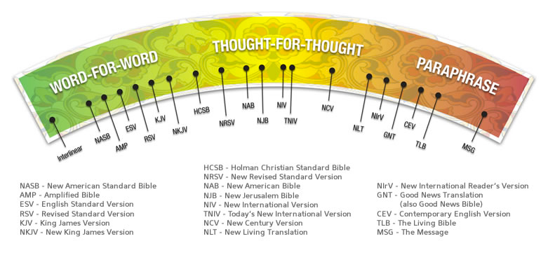
We Have Good Translations

