Slide 1
Saints in Caesar’s Household
Philippians 4:21-22
“Greet every saint in Christ Jesus. The brethren who are with me greet you.
All the saints greet you, but especially those who are of Caesar’s household.”
Philippians 1:12-13
“But I want you to know, brethren, that the things which happened to me
have actually turned out for the furtherance of the gospel, so that it has
become evident to the whole palace guard, and to all the rest, that my
chains are in Christ;”

Slide 2
Saints in Caesar’s Household
What is a saint?
~ a holy one; one that belongs to God
Psalm 116:15
“Precious in the sight of the Lord
Is the death of His saints.”
Acts 8 & 9
*saints are members of His church
8:3 “ But Saul laid waste the church, entering into every house,
and dragging men and women committed them to prison”

Slide 3
Saints in Caesar’s Household
Acts 9:13
Then Ananias answered, “Lord, I have heard from many about this man, how much harm he has done to Your saints in Jerusalem.”
Phil 1:1
Paul and Timothy, bondservants of Jesus Christ, To all the saints in Christ Jesus who are in Philippi, with the bishops and deacons:

Slide 4
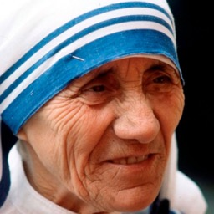
Saints in Caesar’s Household
The Catholic church error:
example: Mother Teresa
(1910-1997)

Slide 5
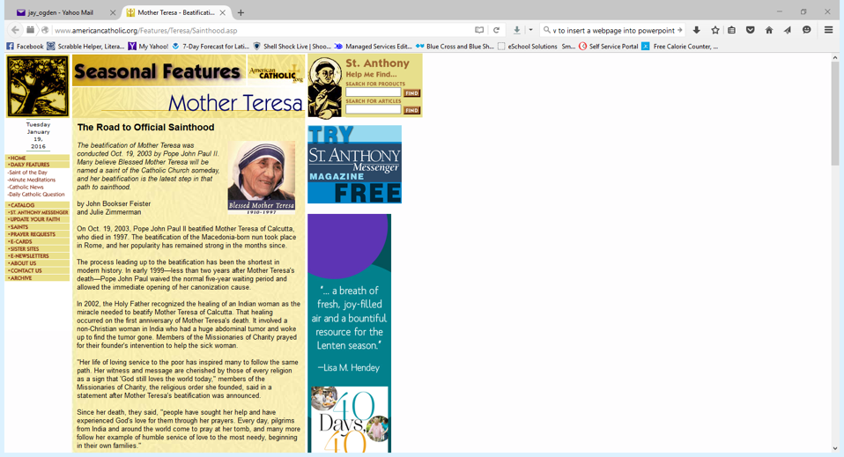
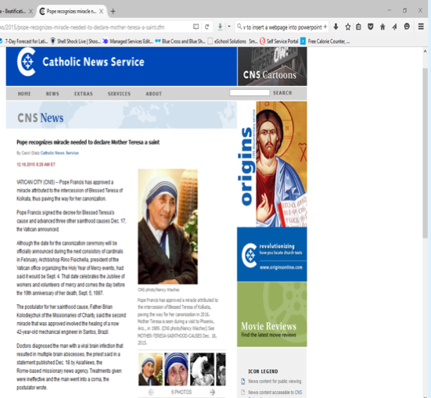

Slide 6
Saints in Caesar’s Household
If the Catholic church wrote Philippians 1:1
Paul and Timothy, bondservants of Jesus Christ, To all those in Christ Jesus who are in Philippi, [if the church is still there in 2 or 3 hundred years from at this point I’m writing to you. If miracles can be verified to have occurred after their deaths and can be attributed to them and they have withstood the test of time, then they shall be called saints], with the bishops and deacons:

Slide 7
Saints in Caesar’s Household
2 Thessalonians 2:13-14
“But we are bound to give thanks to God always for you, brethren beloved by the Lord, because God from the beginning chose you for salvation through sanctification by the Spirit and belief in the truth, to which He called you by our gospel, for the obtaining of the glory of our Lord Jesus Christ.”
1 Pet 1:15-16
“but as He who called you is holy, you also be holy in all your conduct, because it is written, “Be holy, for I am holy.”
*same word for ‘saint’ … is holy!

Slide 8
Saints in Caesar’s Household
1 Peter 2:9
“But you are a chosen generation, a royal priesthood, a holy nation, His own special people,” that you may proclaim the praises of Him who called you out of darkness into His marvelous light; who once were not a people but are now the people of God, who had not obtained mercy but now have obtained mercy.”
KJV – “a peculiar people”
Old Testament examples:
Noah
Joseph
Daniel

Slide 9
Saints in Caesar’s Household
New Testament Examples:
Rev. 2:13
“I know your works, and where you dwell, where Satan’s throne is. And you hold fast to My name, and did not deny My faith even in the days in which Antipas was My faithful martyr, who was killed among you, where Satan dwells.”
Where was Satan’s address? Pergamos!
Acts 13:1
“Now in the church that was at Antioch there were certain prophets and teachers: Barnabas, Simeon who was called Niger, Lucius of Cyrene, Manaen who had been brought up with Herod the tetrarch, and Saul.”

Slide 11
Saints in Caesar’s Household
Being a saint… Is it a challenge?
In the church?
Rev 3:1-4
““And to the angel of the church in Sardis write,
‘These things says He who has the seven Spirits of God and the seven stars: “I know your works, that you have a name that you are alive, but you are dead. Be watchful, and strengthen the things which remain, that are ready to die, for I have not found your works perfect before God. Remember therefore how you have received and heard; hold fast and repent. Therefore if you will not watch, I will come upon you as a thief, and you will not know what hour I will come upon you. You have a few names even in Sardis who have not defiled their garments; and they shall walk with Me in white, for they are worthy. “

Slide 12
Saints in Caesar’s Household
Rev 2:14-16
“But I have a few things against you, because you have there those who hold the doctrine of Balaam, who taught Balak to put a stumbling block before the children of Israel, to eat things sacrificed to idols, and to commit sexual immorality. Thus you also have those who hold the doctrine of the Nicolaitans, which thing I hate. Repent, or else I will come to you quickly and will fight against them with the sword of My mouth.”
Who were the Caesars?
Nero – one of the most ungodly rulers ever recorded in history.
In the midst of his ungodliness, there were saints in his household!

Slide 13
Saints in Caesar’s Household
What about our family background?
What about our work environment?
What about at school?
What about your closest friend?
Sometimes christians don’t behave in a saintly way.
You do it ANYWAY!
If there can be saints in Caesar’s household, there can be saints in yours.

