Slide 1
Time Between the Testaments

Slide 2
Xerxes and Daniel 11:2
“² And now I will tell you the truth: Behold, three more kings will arise in Persia, and the fourth shall be far richer than them all; by his strength, through his riches, he shall stir up all against the realm of Greece.”
Xerxes took the Persian empire at the peak of its power and attacked Greece intending to conquer.
He succeeded in starting a chain of events that would ultimately lead to the defeat of Persia by Alexander.

Slide 3
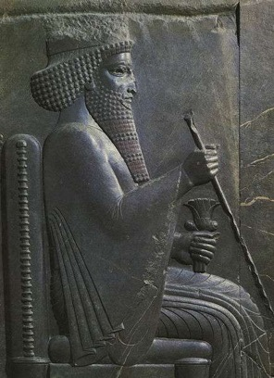
Xerxes and Esther
Xerxes (Ahasuerus in Esther) is sometimes portrayed as merciful because of his love for Esther.
Xerxes killed thousands attacking Greece for the sake of pride.
Approved plan for genocide based on the self-motivated request of one advisor. Esther 3:8,9

Slide 4
Artaxerxes I Logimanus 464-424 BC
Artaxerxes of Ezra 7-10 and Nehemiah
Sponsored Ezra’s return
Ordered construction of Jerusalem under Nehemiah’s direction.
Beginning of decline of Persian Empire.
End of Old Testament history.

Slide 5
Civil War 424 - 423 BC
Xerxes II reigns for 45 days killed by half-brother Sogdianus
Sogdianus reigns for 6 months, 15 days killed
Darius II comes to power
Married aunt and had two sons Artaxerxes (2) and Cyrus (3).
Each favored different son for successor.

Slide 6
Artaxerxes II “Mnemon” 404 - 359 BC
Almost killed by brother during his coronation.
Cyrus the Younger continues to challenge until killed in Battle of Cunaxa 401 BC.
Cyrus uses 13,000 Greek mercenaries who find that the Persians are no match for them.

Slide 7
Artaxerxes III “Ochus” 359 - 338 BC
Secures throne; kills brothers & sisters
Re-conquers Egypt
Makes alliance with Athens; plans to conquer Greece
Philip of Macedon defeats Athens 338 BC
A3 poisoned by Bagoas

Slide 8
Artaxerxes IV “Arses” 338 - 336 BC
Son of A3; spared by Bagoas
Started showing a mind of his own - Poisoned by Bagoas.

Slide 9
Darius III “Codomanus” 336 - 331 BC
Cousin of A3, picked by Bagoas
Poisons Bagoas
Came to throne same year as Alexander the Great

Slide 10
Macedonia

Slide 11
Delian League
After the Persian threat subsided, the Greek poleis had conflicts among themselves
The poleis formed an alliance called the Delian League
Athens supplied most of the military force and the other poleis provided financial support
Sparta did not join the league
In the absence of the Persian threat, eventually the other poleis came to resent financing Athens’s bureaucracy and construction projects
The resulting tensions led to the Peloponnesian War (431-404) in which the poleis divided up into two sides led by Athens and Sparta
Darius II uses Persian gold to incite Athens against Sparta.

Slide 12
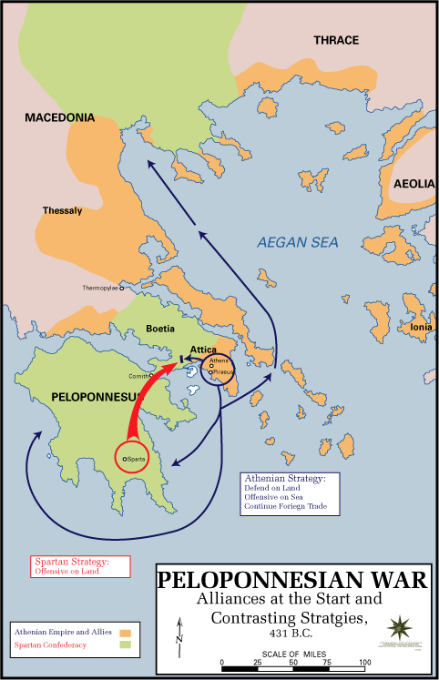
The Peloponnesian War (431-404 B.C.)
The war went back and forth until 404 when the Spartans and their allies forced Athens to surrender
Conflicts continued however and the world of the poleis steadily lost power

Slide 13
Philip II
Ruled Macedonia from 359-336 B.C. and transformed it into a powerful military machine
Moved into northern Greece and met little resistance due to residual effects of Peloponnesian War
By 338 he had Greece under his control

Slide 14
Alexander the Great
Philip intended to use Greece as a launching pad to invade Persia, but he was assassinated before he could begin his plan
Instead the invasion of Persia would be left for Philip’s son Alexander who was just 20 when Philip was assassinated
“Alexander inherited from his father the most perfectly organized, trained, and equipped army of ancient times.”
J.F.C. Fuller, The Generalship of Alexander the Great

Slide 15
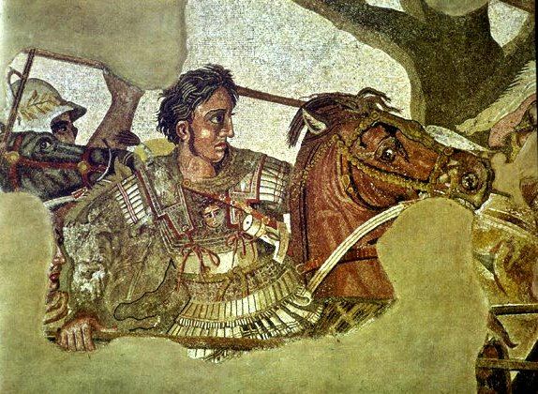
Alexander the Great
Daniel 11:3
“Then a mighty king shall arise, who shall rule with a great dominion, and do according to his will.”

Slide 16
Warfare in the Age of Alexander
Phalanx: A formation of infantry carrying overlapping shields and long spears, developed by Philip II and used by Alexander the Great

Slide 17
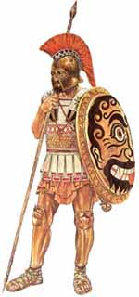
Warfare in the Age of Alexander
Hoplite
The main melee warrior of the Macedonian army.
Worked mainly in the tight phalanx formation, creating impregnable lines that often left the enemy demoralized.

Slide 18
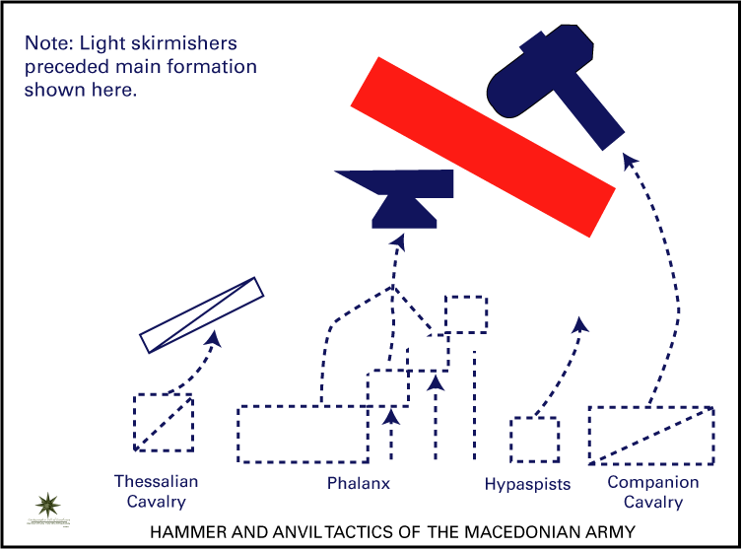
Warfare in the Age of Alexander
Companions
Alexander’s elite cavalry, the offensive arm of his army, and his elite guard.
They would be used in conjunction with the phalanx. The phalanx would fix the enemy in place and then the companion cavalry would attack on the flank.
Alexander would lead the charge with his cavalry, normally in a wedge formation.
These troops would also protect the flanks of the Macedonian line during battle.

Slide 19
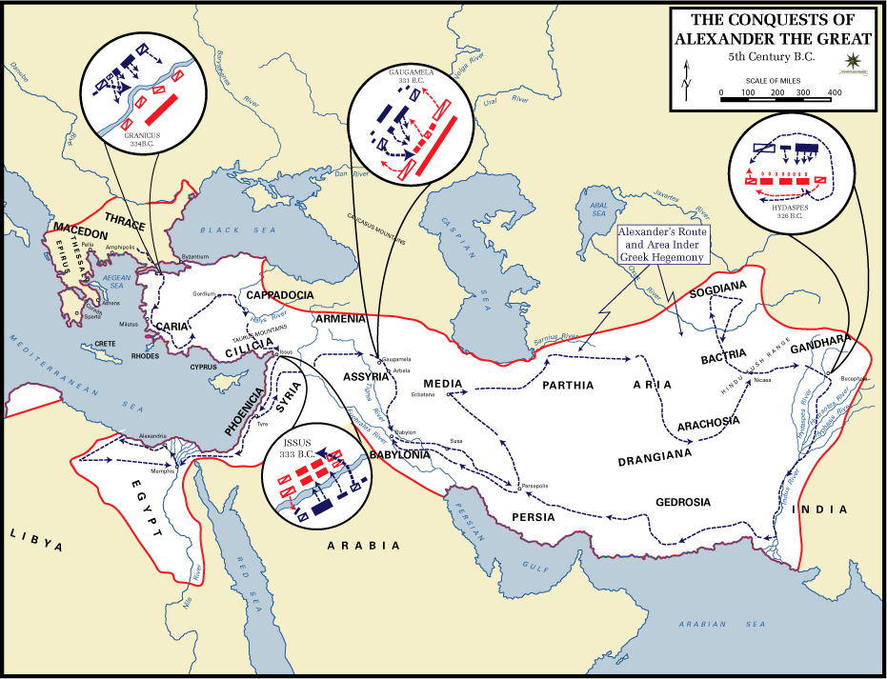

Slide 20
Alexander at Issus
Alexander had 35,000; Persians had 600,000.
Battle was dominated by Greeks and when Alexander and his Companions heavy cavalry broke through Darius III fled the battle.
Left behind his mother, wife, and son.

Slide 21
Tyre
Old city on the mainland was abandoned
New city built on an island two miles long and separated from the coast by a half mile channel
Walls were 150 feet high
Had two harbors (Sidonian and Egyptian)
Alexander originally had no ships so he built a mole across the channel

Slide 22
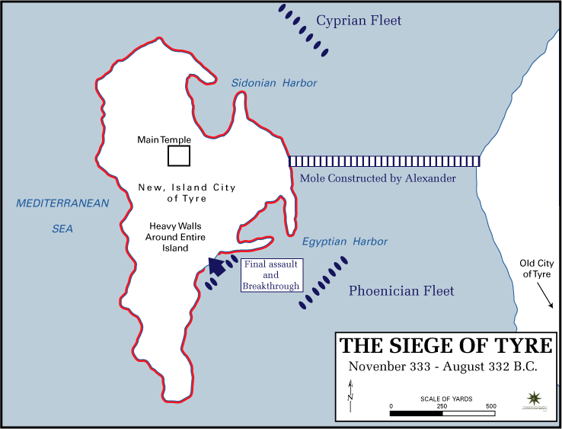

Slide 23
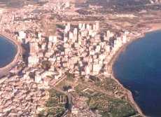
Tyre
Mole was designed to be 200 feet wide and was built by driving piles into the bottom and filling in the space with stones, earth, and wood
Entire trees --- branches, leaves, and all -– were thrown beside the piles to serve as a breakwall
Stone was hauled in from the old city
“A city and a forest were exhausted to build this wonderful mole.”
Theodore Dodge, Alexander, 330.
Alexander’s original mole has grown over the centuries and is now a broad landbridge with roads and buildings on it.

Slide 24
Tyre
Finally the engines penetrated the wall on the side toward Egypt
The fleet had captured the north and south fronts of the city
Ladders were thrown up against the walls and the Macedonians burst in
5th Century Greek Battering Ram

Slide 25
Tyre
After a seven month siege, Tyre fell
8,000 Tyrians were killed in the fighting
2,000 more were hung afterwards
400 Macedonians were killed in the siege and just 20 in the assault

Slide 26
Tyre
Isaiah 23 – Tyre would be destroyed by Chaldeans
Fulfilled by Nebuchadnezzar in 586 BC
Ezek 26:12-14 Ezekiel added that Tyre would be thrown in the water and end up a place for spreading nets.
Zech 9:4 “Behold, the Lord will cast her out; He will destroy her power in the sea…”

Slide 27
Alexander at Jerusalem
Recorded by Josephus in Book XI, Ch. 8, section 5.
“And when he went up into the temple, he offered sacrifice to God, according to the high priest's direction, and magnificently treated both the high priest and the priests. And when the Book of Daniel was showed him wherein Daniel declared that one of the Greeks should destroy the empire of the Persians, he supposed that himself was the person intended.”

Slide 28
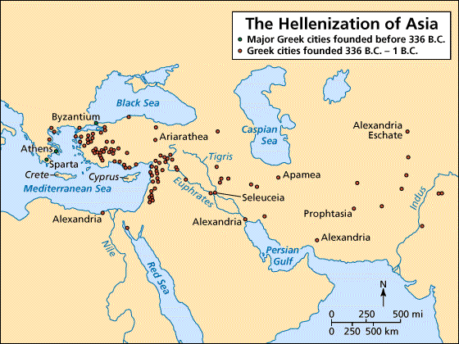
Alexander at Egypt
Received gladly by Egyptians
Built Alexandria as beginning of bringing Greek culture to the world.

Slide 29
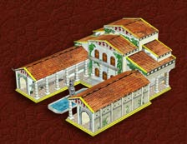
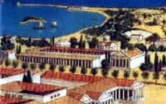
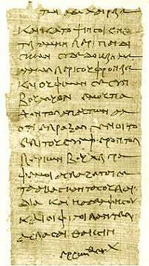
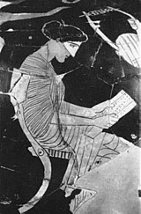
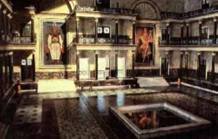
Library at Alexandria ~ 333 B.C

Slide 30
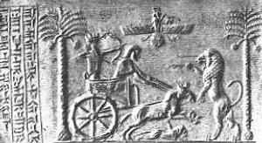
Gaugamela (Arbela)
At Issus, Alexander captured Darius’s family and was holding them hostage but treating them well
“Darius appeared to have lost the character for strength which he was thought at one time to possess. An excellent ruler in peace, he was his own worst enemy in war.”
Theodore Dodge, Alexander the Great, 360.
Seal of King Darius

Slide 31
Gaugamela (Arbela)
Darius had assembled a huge army from all the Persian nationalities
Estimates range from 200,000 to a million infantry and 45,000 to 100,000 cavalry
200 scythed chariots
15 elephants
Alexander had about 40,000 men
Darius III, King of Persia
336-330 B.C.

Slide 32
Gaugamela (Arbela)
Darius drew his army up on a large plain near Gaugamela
The ground was carefully leveled, obstacles removed, and brush cut down to allow free movement of his chariots and horses
Darius wanted to lure Alexander into a battlefield of his own choosing so Darius could employ his masses
Scythed chariot

