Slide 1
Time Between the Testaments

Slide 2
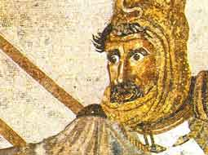
Gaugamela (Arbela)
Darius had assembled a huge army from all the Persian nationalities
Estimates range from 200,000 to a million infantry and 45,000 to 100,000 cavalry
200 scythed chariots
15 elephants
Alexander had about 40,000 men
Darius III, King of Persia
336-330 B.C.

Slide 3
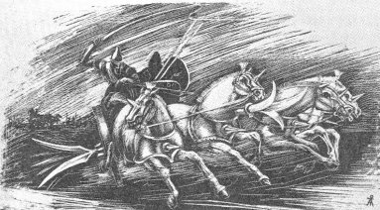
Gaugamela (Arbela)
Darius drew his army up on a large plain near Gaugamela
The ground was carefully leveled, obstacles removed, and brush cut down to allow free movement of his chariots and horses
Darius wanted to lure Alexander into a battlefield of his own choosing so Darius could employ his masses
Scythed chariot

Slide 4
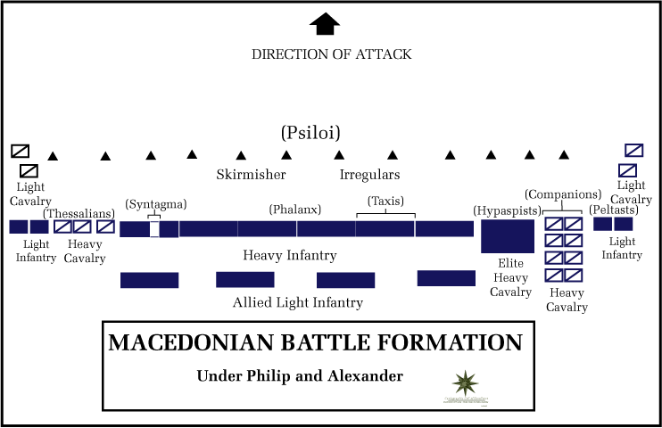
Gaugamela (Arbela)
Alexander advanced and camped within sight of Darius’s army on Sept 30, 331 B.C.
Darius feared a night attack and kept his men alert all night
When Alexander did attack the next day, Darius’s men were tired
In the opening moves, the Persians tried to outflank Alexander
Larger force had given them this capability

Slide 5
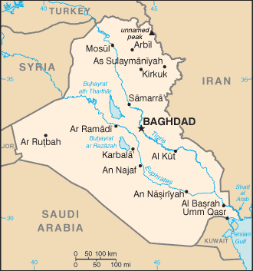
Gaugamela (Arbela)
Darius now feared for his own safety and fled the field
The entire Persian center and left also fled
The Persian army was dispersed
Alexander pursued for 70 miles to Arbela (modern day Arbil) but couldn’t catch Darius
The Persians lost 40,000 to 90,000
The Macedonians only 500

Slide 6
After Gaugamela
Darius’s escape frustrated Alexander because it prevented him from full claim to being king of Persia
Eventually Darius’s followers assassinated him
As Alexander became king of Persia and continued to advance east, he took on an increasingly Eastern attitude

Slide 7
The End of the Empire
Alexander
Married Roxanna and had his men also intermarry
Adopted Eastern dress and habits
Publicly insisted upon his descent from the gods
Began giving key positions to Persians
The Macedonians were tired of campaigning and resented the changes in Alexander’s behavior and become mutinous
Alexander planning new campaign to take Arabia and Carthage when he died.
Alexander died in June 323. The cause is still debated today. Disease, infection, alcoholism, or poisoning?

Slide 8
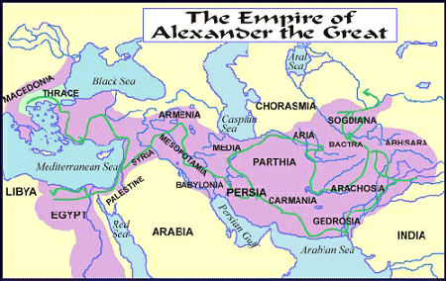

Slide 9
The Succession
Alexander died in 323 BC survived by:
Mother: Olympias
Brother: Phillip
Wife: Roxana
Son: Alexander (born after AtG’s death)
Perdiccas was guardian of the heirs, assassinated in 321.
Replaced by Antipater, assassinated in 318, replaced by Cassander.
Olympias arranged for Phillip to be killed. Cassander drowned Olympias, Roxana, and Alexander.

Slide 10
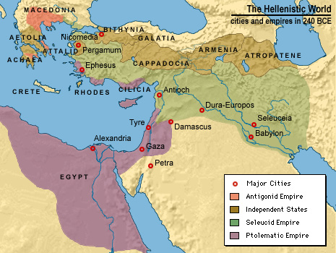
After Alexander
After Alexander died, his generals jockeyed for power and by 275 they had divided up his kingdom into three large states
Antigonus took Greece and Macedon
Ptolemy took Egypt
Seleuces took the former Achaemenid empire
The period of Alexander and his successors is called the Hellenistic period to reflect the broad influence of Greek culture beyond Greece’s borders

Slide 11
Daniel 11:5
⁵ “Also the king of the South shall become strong, as well as one of his princes; and he shall gain power over him and have dominion. His dominion shall be a great dominion.
323-283
Ptolemy I Soter was one of Alexander’s generals who took control of Egypt. One of his own generals was Seleucus who eventually rose to ascendancy over Mesopotamia and Syria

Slide 12
Daniel 11:6
And after some years they will form an alliance, and the daughter of the king of the South will come to the king of the North to carry out a peaceful arrangement. But she will not retain her position of power, nor will he remain with his power, but she will be given up, along with those who brought her in, and the one who sired her, as well as he who supported her in those times.
252 BC - Ptolemy I died in 285 and his son, Ptolemy II Philadelphus eventually arranged an alliance with the Seleucid king Antiochus II Theos in which Antiochus II was to marry Bernice, the daughter of Ptolemy II. However, Antiochus II already had a wife named Laodice and she did not take kindly to being divorced. She conspired to have both Bernice and her infant son assassinated. Antiochus II was subsequently poisoned. Laodice ruled as regent until her own son, Seleucus II Callinicus, was old enough to assume the throne of the Seleucid Empire.

Slide 13
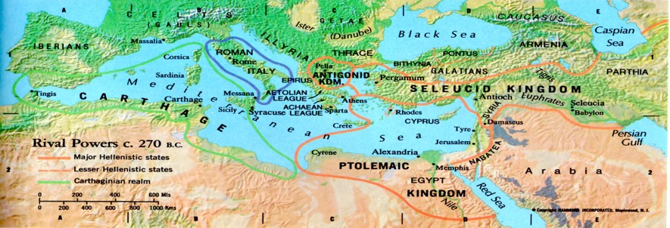
World powers c. 270 BC

Slide 14
Daniel 11:7
“But one of the descendants of her line will arise in his place, and he will come against their army and enter the fortress of the king of the North, and he will deal with them and display great strength.”
246-241 BC
Ptolemy III Euergetes organized a campaign to avenge the murder of his sister. He captured Antioch and marched all the way to Bactria and also defeated the Seleucid navy in the Aegean, recapturing the former conquests of his father in Asia Minor.

Slide 15
Daniel 11:8
“And he shall also carry their gods captive to Egypt, with their princes and their precious articles of silver and gold; and he shall continue more years than the king of the North.”
246-241 BC
Ptolemy III went on to recapture the treasures that had been looted from Egypt in the days of Cambyses.

Slide 16
Daniel 11;9
“Also the king of the North shall come to the kingdom of the king of the South, but shall return to his own land.”
240
Seleucus II marched against Egypt but was completely defeated.
Ptolemy III and Seleucus II eventually made a treaty in 240 B.C. and Ptolemy III returned home to Egypt where he was given the title by the Egyptians of Euergetes – “Good worker.”

Slide 17
Daniel 11:10
“However his sons shall stir up strife, and assemble a multitude of great forces; and one shall certainly come and overwhelm and pass through; then he shall return to his fortress and stir up strife.”
226-223 Seleucus II was succeeded by his son Seleucus III who only lived three years before being followed by his younger brother, Antiochus III (the Great).
Antiochus III set out on a battle of conquest, marching to the borders of Egypt where he was met by Ptolemy IV

Slide 18
Daniel 11:11
“And the king of the South shall be moved with rage, and go out and fight with him, with the king of the North, who shall muster a great multitude; but the multitude shall be given into the hand of his enemy.”
218 BC
Antiochus III was defeated by Ptolemy IV at the Battle of Raphia in 218 B.C. Antiochus III had to give up Palestine and Phoenicia to Egypt.
Over the next 15 years, Antioch III was busy fighting elsewhere and his conquests took him all the way to the Caspian Sea in the north and to the Indus River in the east.

Slide 19
Daniel 11:12
“When he has taken away the multitude, his heart will be lifted up; and he will cast down tens of thousands, but he will not prevail.”
Ptolemy IV did carry away a multitude but did not press his advantage but was content to return to Egypt.

Slide 20
Daniel 11:13
“For the king of the North will return and muster a multitude greater than the former, and shall certainly come at the end of some years with a great army and much equipment.”
202-201
Antiochus III returned to take up arms once more against Egypt, taking Gaza in 201 B.C.

Slide 21
Daniel 11:14
“Now in those times many shall rise up against the king of the South. Also, violent men of your people shall exalt themselves in fulfillment of the vision, but they shall fall.”
201 BC
A pro-Seleucid party rose up in Jerusalem, but it was put down by the Egyptian general Scopas who pushed up to the area north of Israel that would be known as Caesarea Philippi. These Jews hoped for greater independence under Antiochus the Great but would be disappointed.

Slide 22
Daniel 11:15
“So the king of the North shall come and build a siege mound, and take a fortified city; and the forces^{[e]} of the South shall not withstand him. Even his choice troops shall have no strength to resist.”
200
As Antiochus III counterattacked, Scopas retreated to Sidon and found himself under siege at that city by the Seleucid King, finally losing the city to him.

Slide 23
Daniel 11:16
“But he who comes against him shall do according to his own will, and no one shall stand against him. He shall stand in the Glorious Land with destruction in his power.”
198
Antiochus III moved southward into Palestine, taking Jerusalem in 198

Slide 24
Daniel 11:17
“He shall also set his face to enter with the strength of his whole kingdom, and upright ones with him; thus shall he do. And he shall give him the daughter of women to destroy it; but she shall not stand with him, or be for him.”
195
Antiochus III entered into an alliance with the young Ptolemy V who was still a boy. The alliance was sealed by Ptolemy V marrying Cleopatra, the daughter of Antiochus III.
Rather than being an influence on behalf of her father, Cleopatra became an ardent supporter of Egypt, even reigning a regent after the death of her husband in 181.

Slide 25
Daniel 11:18
“After this he shall turn his face to the coastlands, and shall take many. But a ruler shall bring the reproach against them to an end; and with the reproach removed, he shall turn back on him.”
192
Antiochus III had invaded Thrace and was now asked by a league of city states in central Greece to aid them in their fight against Macedonia and the Peloponnesians. Meanwhile, the Romans threw in their weight against Antiochus III and he was forced to withdraw from Greece

Slide 26
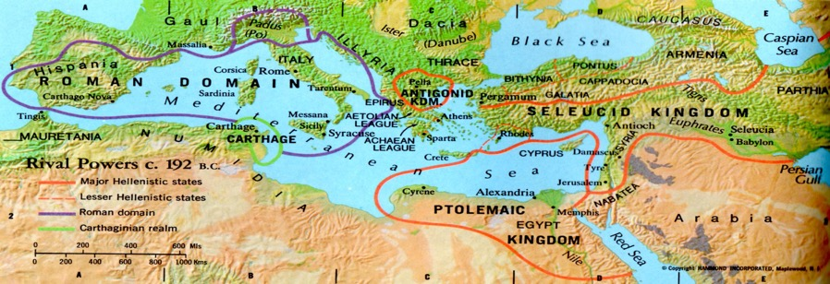
World powers c. 192 BC

