Slide 1
Time Between the Testaments

Slide 2
Apocrypha?
Ancient writings that are not part of the Bible.
More than one collection
Literally books of unknown or doubtful origin
Some from the time between the testaments
Included as separate section in some Anglican, Eastern Orthodox, and old Catholic Bibles
Included for preservation of ancient writings
Considered useful for historical reference and encouragement, but not to be used as doctrine.
I Maccabees (or Maccabaica) is useful historical reference to compare with events prophesied in Daniel 10.

Slide 3
The Empire Visions of Daniel
Chapter 2: Nebuchadnezzar's dream
The Image and the Stone
Chapter 7: The Beasts Out of the Sea
Kings , Judgment, and the Saints of the Most High
Chapter 8: The Ram and the He-goat
The Big Horn and the Little Horn

Slide 4
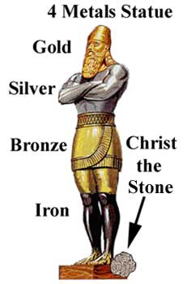
Daniel chapter 2 ~604 BC
Daniel 2 | Meaning | Why?
Head of Gold | Babylonian Kingdom | Daniel 2:38 Nebuchadnezzar
Chest of Silver | Second Kingdom
Belly & Thighs of Bronze | Third Kingdom
Legs of Iron | Fourth Kingdom | Mixed
Stone | Everlasting Kingdom | Daniel 2: 44

Slide 5
Daniel chapter 2 ~604 BC
Second year of Nebuchadnezzar's reign
Date may vary based on calendar and customs.
Head of gold is Nebuchadnezzar-Babylonian kingdom
Iron is fourth kingdom. Mixed feet and toes are details of fourth kingdom nature, not another kingdom.
Stone that fills the Earth is Everlasting kingdom set up “in the days of these kings”

Slide 6
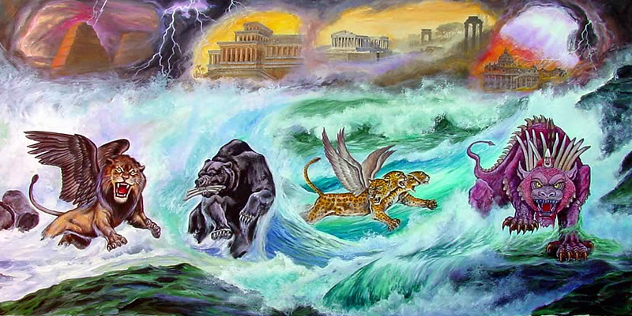
Daniel chapter 7 ~549 BC

Slide 7
Belshazzar ~ 553?-539 BC
Son of Nabonidus (556-539 BC)
Made King of Babylon under Nabonidus.
This is why he offered to make Daniel “third in the kingdom” in chapter 5.
Died when Cyrus took Babylon in 539 BC.
Nabonidus later made satrap.

Slide 8
Daniel chapter 7 ~ 549 BC
Daniel 2 | Daniel 7 | Meaning | Why?
Head of Gold | Lion w/ wings | Babylonian Kingdom | Daniel 2:38
Chest of Silver | Bear | Second Kingdom
Belly & Thighs of Bronze | Leopard w/ 4 heads and wings | Third Kingdom
Legs of Iron | Beast w/ 10 horns | Fourth Kingdom
Stone destroys image, fills Earth | Judgment & Coronation | Everlasting Kingdom & King | Daniel 2: 44 Daniel 7: 13,14

Slide 9
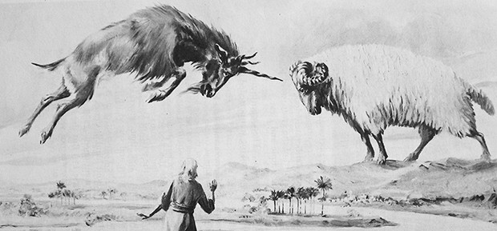
Daniel chapter 8 ~547 BC

Slide 10
Daniel 2 | Daniel 7 | Daniel 8 | Meaning | Why?
Head of Gold | Lion w/ wings |  | Babylonian Kingdom | Daniel 2:38
Chest of Silver | Bear – raised up on one side | Ram – Uneven horns | Persian Kingdom | Daniel 8: 20
Belly & Thighs of Bronze | Leopard w/ 4 heads and wings | He-goat, One horn/four horns | Greek Kingdom | Daniel 8:21
Legs of Iron | Beast w/ 10 horns |  | Fourth Kingdom | Next power over Israel
Stone destroys image, fills Earth | Judgment & Coronation | Everlasting King & Kingdom |  | Daniel 2: 44 Daniel 7: 13,14

