Slide 1
Time Between the Testaments

Slide 2
The Empire Visions of Daniel
Chapter 2: Nebuchadnezzar's dream
The Image and the Stone
Chapter 7: The Beasts Out of the Sea
Kings , Judgment, and the Saints of the Most High
Chapter 8: The Ram and the He-goat
The Big Horn and the Little Horn

Slide 3
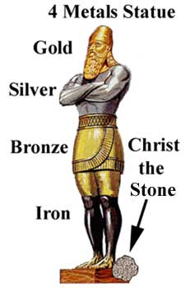
Daniel chapter 2 ~604 BC
Daniel 2 | Meaning | Why?
Head of Gold | Babylonian Kingdom | Daniel 2:38 Nebuchadnezzar
Chest of Silver | Second Kingdom
Belly & Thighs of Bronze | Third Kingdom
Legs of Iron | Fourth Kingdom | Mixed
Stone | Everlasting Kingdom | Daniel 2: 44

Slide 4
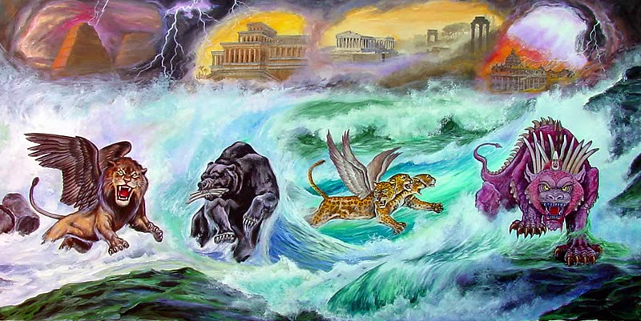
Daniel chapter 7 ~549 BC

Slide 5
Daniel chapter 7 ~ 549 BC
Daniel 2 | Daniel 7 | Meaning | Why?
Head of Gold | Lion w/ wings | Babylonian Kingdom | Daniel 2:38
Chest of Silver | Bear | Second Kingdom
Belly & Thighs of Bronze | Leopard w/ 4 heads and wings | Third Kingdom
Legs of Iron | Beast w/ 10 horns | Fourth Kingdom
Stone destroys image, fills Earth | Judgment & Coronation | Everlasting Kingdom & King | Daniel 2: 44 Daniel 7: 13,14

Slide 6
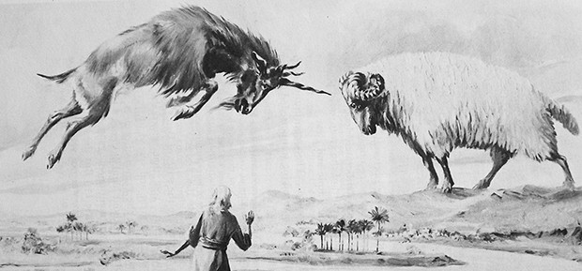
Daniel chapter 8 ~547 BC

Slide 7
Daniel 2 | Daniel 7 | Daniel 8 | Meaning | Why?
Head of Gold | Lion w/ wings |  | Babylonian Kingdom | Daniel 2:38
Chest of Silver | Bear – raised up on one side | Ram – Uneven horns | Medo-Persian Kingdom | Daniel 8: 20
Belly & Thighs of Bronze | Leopard w/ 4 heads and wings | He-goat, One horn/four horns | Greek Kingdom | Daniel 8:21
Legs of Iron | Beast w/ 10 horns |  | Fourth Kingdom
Stone destroys image, fills Earth | Judgment & Coronation |  | Everlasting King & Kingdom | Daniel 2: 44 Daniel 7: 13,14

Slide 8
The Empire Visions of Daniel
Daniel 7:28 “This is the end of the account.^{[a]} As for me, Daniel, my thoughts greatly troubled me, and my countenance changed; but I kept the matter in my heart.”
Daniel 8:27 “And I, Daniel, fainted and was sick for days; afterward I arose and went about the king’s business. I was astonished by the vision, but no one understood it.”

Slide 9
Daniel 2 | Daniel 7 | Daniel 8 | Historical Fulfillment | When over Israel?
Gold | Lion |  | Babylonian Empire | 605 – 539 BC
Silver | Bear | Ram | Medo-Persian Empire | 539 – 331 BC
Bronze | Leopard | He-goat | Greek Empire | 331 – 135 BC
Iron | Beast |  | Roman Empire | 63 BC – 70 AD
Stone | New King |  | Christ and the church | 32ad →

