Slide 1
Time Between the Testaments

Slide 2
Empire Visions of Daniel
Daniel 2 | Daniel 7 | Daniel 8 | Historical Fulfillment | When over Israel?
Gold | Lion |  | Babylonian Empire | 605 – 539 BC
Silver | Bear | Ram | Medo-Persian Empire | 539 – 331 BC
Bronze | Leopard | He-goat | Greek Empire | 331 – 135 BC
Iron | Beast |  | Roman Empire | 63 BC – 70 AD
Stone | New King |  | Christ and the church | 32ad →

Slide 3
Daniel 10- 12 ~ 537 BC (Third year of Cyrus)
Chapter 10: Introduction of the vision
Identity of the messenger not given.
Princes probably angels.
Michael mentioned as “one of the chief princes” and also called “the archangel” in Jude 9; Rev. 12:7-9.
We need to be content that the Bible does not give detailed explanation nature and function of angels.
What is clear: God is at work in the nations of men.

Slide 4
Daniel 10:21 - 11:1,2
“²¹ But I will tell you what is noted in the Scripture of Truth. (No one upholds me against these, except Michael your prince. ¹ Also in the first year of Darius the Mede, I, even I, stood up to confirm and strengthen him.) ² And now I will tell you the truth: Behold, three more kings will arise in Persia, and the fourth shall be far richer than them all; by his strength, through his riches, he shall stir up all against the realm of Greece.”

Slide 5
Persians
Names can be confusing.
Multiple Cyrus, Darius, Artaxerxes, Ahasuerus
Some names seem to be titles or office names
Example: Darius the Mede “Darius” may have been Persian name as servant of Cyrus. “Gubaru” appears in some records from this time may have been Median name?
Remember Daniel, Hananiah, Mishael, and Azariah were called Belteshazzar, Shadrach, Me-shach, and Abed-nego for their official Babylonian names.

Slide 6
Daniel under the Persians
Dan. 5:31;
6: 1,2,28; 9:1:
Cyrus
Darius the Mede
Other gov
Daniel
Other gov

Slide 7
Which Darius?
Darius the Mede (539 - ?) (Gubaru?)
Appointed over Babylon by Cyrus, Persian Emperor
Exact extent of realm unclear
Darius I - Third king of all Persia (521 – 486 BC)
Darius of Ezra ch. 5&6 that commands that Temple re- construction may resume per Cyrus’ original decree.
Darius III - Last king of Persia (336 – 331 BC)
Defeated by Alexander the Great

Slide 8
Cyrus II (the Great) ~ 539–530 BC
Fulfillment of many prophesies : Isaiah 13:7; 44:26-28; 45:1-13; Jeremiah 25:11-12; 29:10
Ezra 1:1-4 Cyrus commanded by God to let Jews return to Jerusalem and build the house of the Lord.
Unclear how Cyrus came to know God’s will.
Appears he allowed all captive peoples to return and restore their individual “gods” worship.

Slide 9
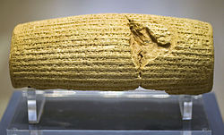
Cyrus Cylinder
“I am Cyrus, king of the universe, the great king, the powerful king, king of Babylon, king of Sumer and Akkad, king of the four quarters of the world,…”
“May all the gods that I returned to their sanctuaries, every day before Marduk and Nabu, ask for a long life for me, and mention my good deeds, and say to Marduk, my lord…”

Slide 10
Cambyses (530-522 BC)
Son of Cyrus.
Ahasuerus of Ezra 4:6 and/or Artaxerxes of Ezra 4:11-24). Ordered construction stopped.
Added Egypt to Persian Empire.
While returning from Egypt he learned of revolt.
Died on the way back, either by accidently wounding himself or by suicide.

Slide 11
Darius (521-486 BC)
Not direct descendant of Cyrus.
Darius of Ezra 5 & 6 - Ordered construction of Temple to be supported per Cyrus’ decree.
Built roads, postal system, Persian fleet on Mediterranean Sea.
Took Persian Empire to largest extent. Esther 1:1, 10:1
Attacked Greece and was defeated at Marathon.

Slide 12
Xerxes (486 - 465 BC)
Ahasuerus of Esther
Attacked Greece to avenge Darius and was defeated.
Huge army held up at Thermopylae
Large portion of Persian fleet destroyed by a storm, the rest was defeated off the island of Salamis.
Xerxes did take Athens and burn the Acropolis.

Slide 13
Artaxerxes I Logimanus 464-424 BC
Artaxerxes of Ezra 7-10 and Nehemiah
Sponsored Ezra’s return
Ordered construction of Jerusalem under Nehemiah’s direction.
Beginning of decline of Persian Empire.

Slide 14
Return of the Jews from Captivity
536 - Zerubbabel and Joshua return to Judea with 49,897 and begin to rebuild temple.
457 - Ezra leads 1,754 men to return and support worship.
444 – Nehemiah comes to rebuild the walls of Jerusalem.
535 – Work on Temple stopped.
520 – God sends Haggai and Zechariah. Work on Temple resumes.
479 – Esther becomes queen.
516 – Temple finished.
Nehemiah
Ezra (1-6)
Esther
Ezra (7-10)
Haggai
Zechariah
Malachi ?
630 | 620 | 610 | 600 | 590 | 580 | … | 540
Cyrus (539 – 529) |  | Darius I (521 – 486) | Xerxes (486 - 464) | Artaxerxes I (464 – 424)
Smerdis (Guamata?)
Ahasuerus of Esther
432 – Nehemiah returns to Susa for a short time then goes back to Jerusalem.
Cambyses (529 – 522) Ahasuerus of Ezra 4:6 or Artaxerxes of Ezra 4:11-24)
538 – Cyrus issues decree granting the Jews freedom to return to Judea and rebuild the Temple. Ezra 1:1-4

Slide 15
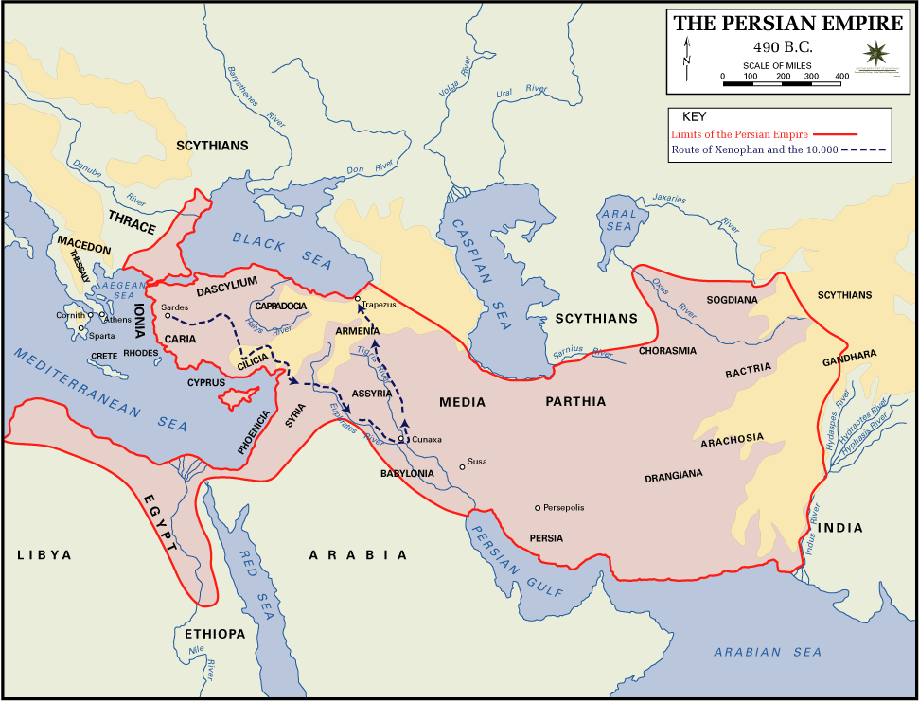

Slide 16
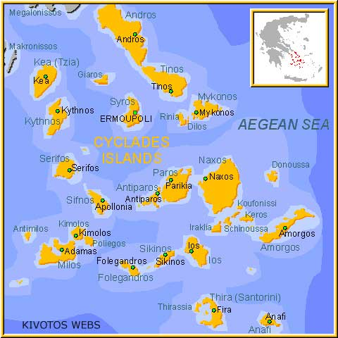
Ionian Rebellion
As Persian emperors Cyrus and Darius tightened their grip on Anatolia, the Greek cities on the Ionian coast became increasingly restless
In 500 B.C., they revolted and expelled the Achaemenid administrators
Athens sent a fleet in support of their fellow Greeks and commercial partners
In 493, Darius repressed the rebellion
Cyclades Islands

Slide 17
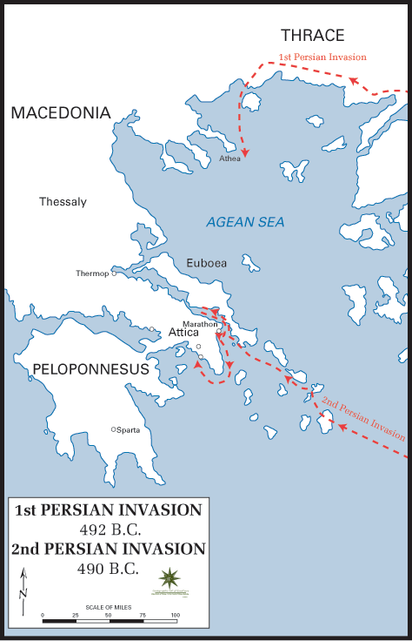
Persian Wars
To punish the Athenians and discourage future interference, Darius attacked Athens in 490
The Athenians repelled the invasion
Marathon

Slide 18
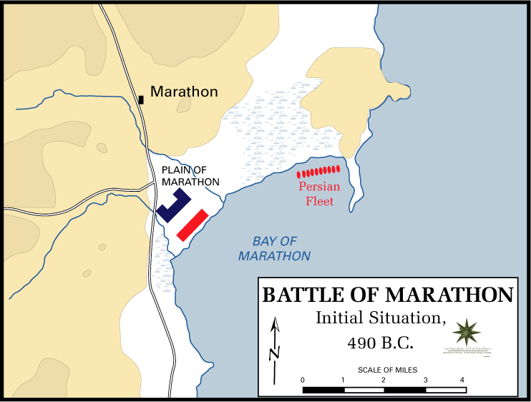
Battle of Marathon
The Persians landed at the Plains of Marathon on September 9, 490
For eight days, the two armies faced each other
On the ninth day, the Persians started to advance, forcing Miltiades, the commander in chief of the Athenian army, to deploy his army of 10,000 Athenians and 1,000 Plataeans for battle

Slide 19
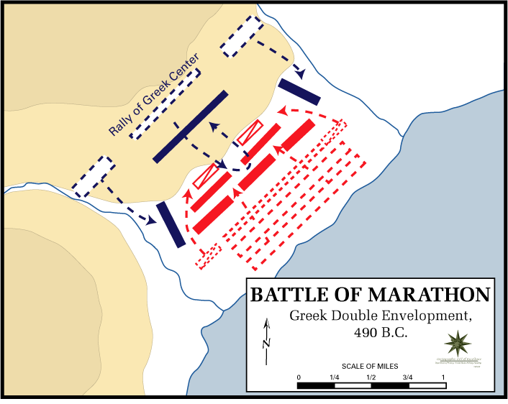
Battle of Marathon
The Athenians surrounded the Persians in a double envelopment
Although the Athenians were outnumbered, their spears were superior to the Persians’ bows and short lances
The Persians fled to their ships
Persians lost 6,400 men and seven ships
Athenians lost 192

Slide 20
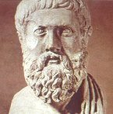
Battle of Marathon
However, Miltiades realized that the Persian fleet could sail and attack the undefended city of Athens
According to legend, he called upon Phidippides to run to Athens to tell them of the victory and warn them of the approaching Persian ships
Phidippides ran the 26 miles from Marathon to Athens in about three hours, successfully warning the Athenians who repelled the Persian invasion
Phidippides was exhausted from the fight at Marathon and the 26 mile run and died upon announcing the warning
Miltiades

Slide 21
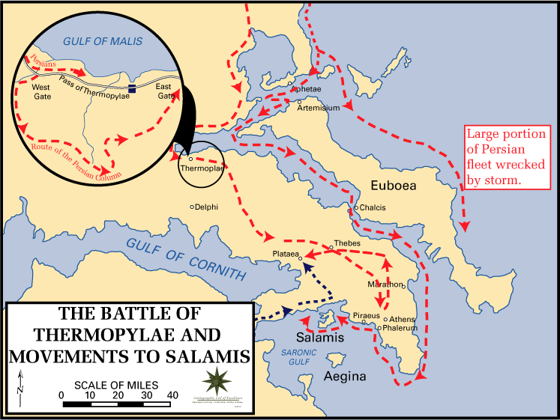
Xerxes
Darius’s successor Xerxes tried to avenge the Persian losses by launching another attack in 480
Thermopylae

Slide 22
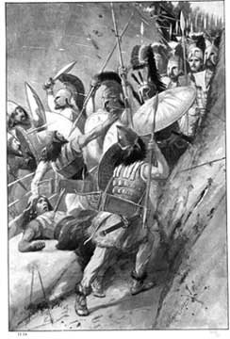
Thermopylae
The Greeks sent an allied army under the Spartan king Leonidas to Thermopylae, a narrow mountain pass in northeastern Greece
The point was to stall the Persians long enough that the city states could prepare for later major battles after the Persians broke through
Persians attempting to force the pass at Thermopylae

Slide 23
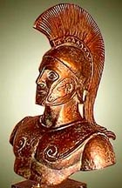
Thermopylae
Twice the Greeks repelled the Persians
Then Ephialtes, a local farmer, traitorously led a force of Persian infantry through a mountain passage and the next morning they appeared behind the Greek lines
Leonidas ordered the rest of the army to withdraw and held the passage with just 300 Spartans
As true Spartans, they chose death over retreat
All died but they did hold off the Persians long enough to ensure the safe withdrawal of the rest of the Greek army.
Leonidas

Slide 24
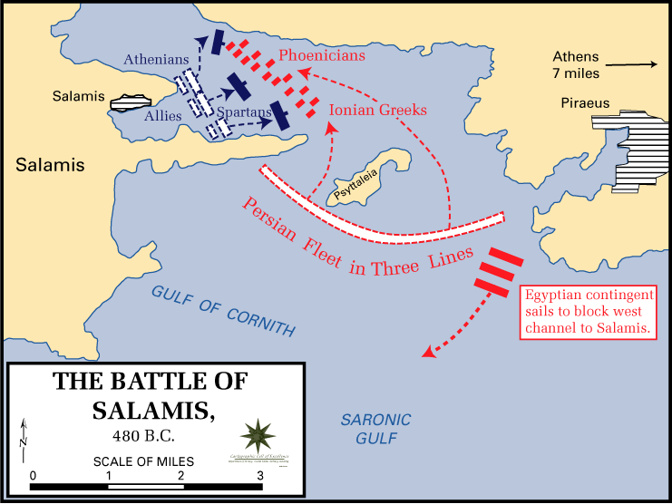
After Thermopylae
The Persians captured and burned Athens but were defeated by the Athenian navy at Salamis
In 479 the Persians were defeated at Plataea and forced back to Anatolia

