Slide 1
Time Between the Testaments

Slide 2
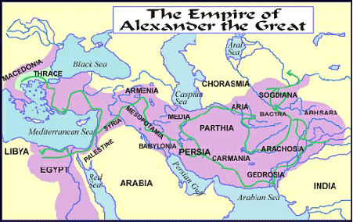

Slide 3
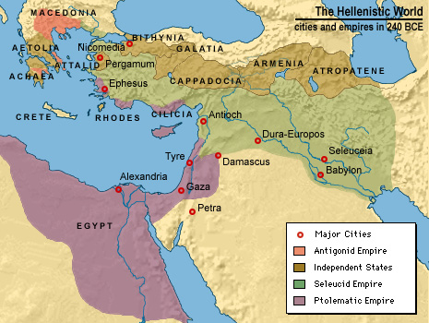
After Alexander
After Alexander died, his generals jockeyed for power and by 275 they had divided up his kingdom into three large states
Antigonus took Greece and Macedon
Ptolemy took Egypt
Seleuces took the former Achaemenid empire
The period of Alexander and his successors is called the Hellenistic period to reflect the broad influence of Greek culture beyond Greece’s borders

