Slide 1
Time Between the Testaments

Slide 2
The Abomination of Desolation
Daniel 8:13 “… How long will the vision be, concerning the daily sacrifices and the transgression of desolation, the giving of both the sanctuary and the host to be trampled underfoot?”
Dan 11:31 “Forces sent by him shall occupy and profane the temple and fortress. They shall abolish the regular burnt offering and set up the abomination that makes desolate.”
If these apply to Antiochus (IV) Epiphanes desecrating the Temple with idolatry…

Slide 3
The Abomination of Desolation
Matt 24:15 “Therefore when you see the ‘abomination of desolation,’ spoken of by Daniel the prophet, standing in the holy place” (whoever reads, let him understand),”
Jesus states that the “‘abomination of desolation,’ spoken of by Daniel…” is still to come in the future and is a sign of the end of the age.

Slide 4
The Abomination of Desolation
Both are prophesied in Daniel:
Dan 9:27 “he shall make sacrifice and offering cease; and in their place shall be an abomination that desolates, until the decreed end is poured out upon the desolator.”
End of the “70 weeks” prophecy.
Luke 21:20 “But when you see Jerusalem surrounded by armies, then know that its desolation is near.”
Compare parallel accounts: Matt 24 – Mark 13 – Luke 21

Slide 5
Daniel 11:32-35
“³² Those who do wickedly against the covenant he shall corrupt with flattery; but the people who know their God shall be strong, and carry out great exploits. ³³And those of the people who understand shall instruct many; yet for many days they shall fall by sword and flame, by captivity and plundering. ³⁴ Now when they fall, they shall be aided with a little help; but many shall join with them by intrigue. ³⁵ And some of those of understanding shall fall, to refine them, purify them, and make them white, until the time of the end; because it is still for the appointed time”

Slide 6
Judas Maccabeus
Mattathias and his sons were supported my many godly Jews including the Hasidim or Pious Ones.
Syrian forces encountered about a thousand “Pious Ones”
on the Sabbath. The Jews refused to fight and were slaughtered. Mattathias instructed his followers that, if attacked, they must fight, even on the Sabbath day.
Mattathias did not live long after this and appointed his son Judas to be military commander.
Judas conducted many successful attacks against superior Greek forces with support from local villagers.

Slide 7
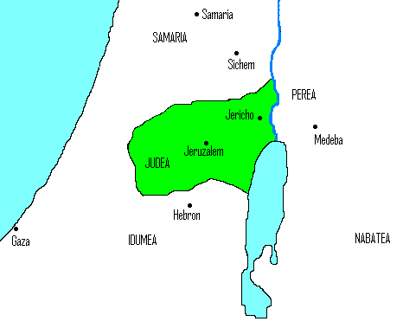
Judah “the Hammer”
167-160 BC
Led the revolt against the Seleucids
Purified the Temple in 164 BC

Slide 8
II Maccabees 10
Now Maccabeus and his followers, the Lord leading them on, recovered the temple and the city; 2. they tore down the altars that had been built in the public square by the foreigners, and also destroyed the sacred precincts. 3. They purified the sanctuary, and made another altar of sacrifice; then, striking fire out of flint, they offered sacrifices, after a lapse of two years, and they offered incense and lighted lamps and set out the bread of the Presence.
4. When they had done this, they fell prostrate and implored the Lord that they might never again fall into such misfortunes, but that, if they should ever sin, they might be disciplined by him with forbearance and not be handed over to blasphemous and barbarous nations. 5. It happened that on the same day on which the sanctuary had been profaned by the foreigners, the purification of the sanctuary took place, that is, on the twenty-fifth day of the same month, which was Chislev.

Slide 9
II Maccabees 10
6. They celebrated it for eight days with rejoicing, in the manner of the festival of booths, remembering how not long before, during the festival of booths, they had been wandering in the mountains and caves like wild animals. 7. Therefore, carrying ivy-wreathed wands and beautiful branches and also fronds of palm, they offered hymns of thanksgiving to him who had given success to the purifying of his own holy place. 8. They decreed by public edict, ratified by vote, that the whole nation of the Jews should observe these days every year. 9. Such then was the end of Antiochus, who was called Epiphanes.

Slide 10
Josephus: Feast of Dedication
Josephus, Antiquities of the Jews 12:7
Now Judas celebrated the festival of the restoration of the sacrifices of the temple for eight days, and omitted no sort of pleasures thereon; but he feasted them upon very rich and splendid sacrifices; and he honored God, and delighted them by hymns and psalms. Nay, they were so very glad at the revival of their customs, when, after a long time of intermission, they unexpectedly had regained the freedom of their worship, that they made it a law for their posterity, that they should keep a festival, on account of the restoration of their temple worship, for eight days. And from that time to this we celebrate this festival, and call it Lights.

Slide 11
Miracle of Lights?
And they sought after pure olive oil to light the lamps therewith, but could not find any, except one bowl that was sealed with the signet ring of the High Priest from the days of Samuel the prophet and they knew that it was pure. There was in it [enough oil] to light [the lamps therewith] for one day, but the God of heaven whose name dwells there put therein his blessing and they were able to light from it eight days. Therefore, the sons of Ḥashmonai made this covenant and took upon themselves a solemn vow, they and the sons of Israel, all of them, to publish amongst the sons of Israel, [to the end] that they might observe these eight days of joy and honour, as the days of the feasts written in [the book of] the Law; [even] to light in them so as to make known to those who come after them that their God wrought for them salvation from heaven. Scroll of Antiochus ~ 200 AD

Slide 12
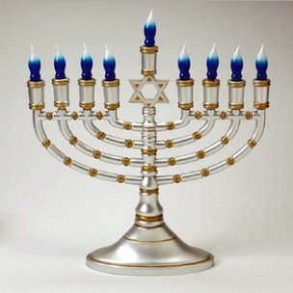
The Feast of Dedication Festival of Lights Hanukkah

Slide 13
Jesus and the Feast of Dedication:
John 10: 22-23 records, " ²² Now it was the Feast of Dedication in Jerusalem, and it was winter. ²³ And Jesus walked in the temple, in Solomon’s porch." (NKJV) As a Jew, Jesus may have participated in the Feast of Dedication but there is no clear endorsement.
Was God with Judas Maccabeas?
Did God perform a miracle at the rededication of the Temple?
We have no prophet to confirm that these events are the fulfillment of Daniel’s prophesy.

Slide 14
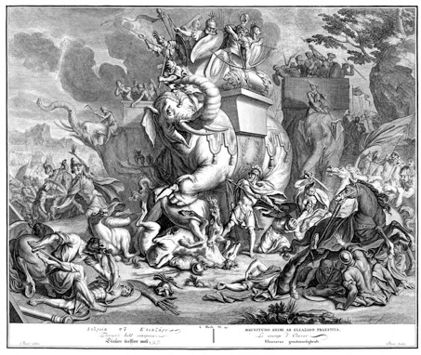
Eleazar
In 163 BC, during a battle where Antiochus IV was rumored to be present, Eleazar saw a richly decorated war elephant. Thinking the king was there he ran up to the elephant and killed it by stabbing it from underneath. The elephant collapsed, killing Eleazar.

Slide 15
Jonathan
Judas and John were killed in an overwhelming battle in 160.
Jonathan assumed leadership.
Trypho invited Jonathan for parley, but then took him hostage.
When Simon came with an army, Trypho demanded a ransom.
Simon paid the ransom, but Trypho had Jonathan slain anyway.

Slide 16
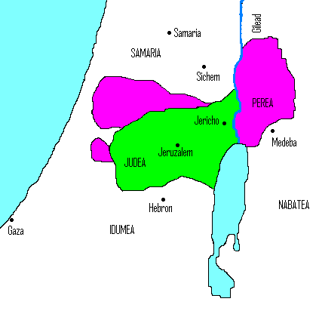
Jonathan
Ruler 161-143 BC
first Hasmonean to be High Priest in 153 BC

Slide 17
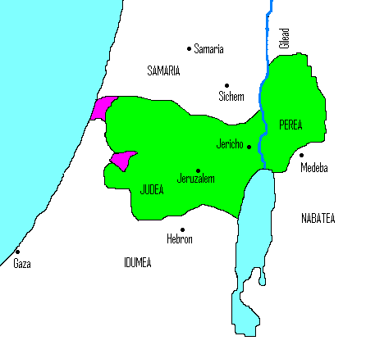
Simon
Ethnarch and High Priest
142-135 BC
Is granted tax exemption from Demetrius II
Removes Seleucid garrison in Jerusalem
Gains total political independence
Murdered by his son-in-law together with two older sons

Slide 18
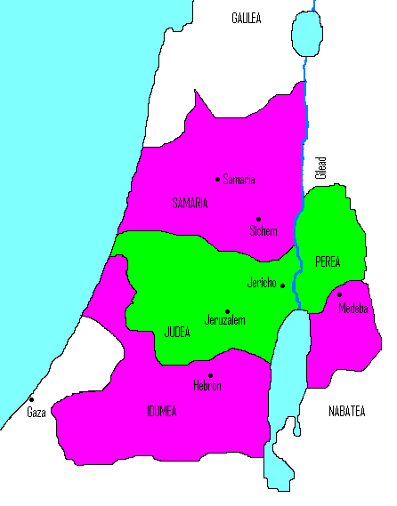
John Hyrcanus
Ethnarch and High Priest
134-104 BC
Forced the Idumeans (Edomites) to convert (including Antipater’s father, grandfather of Herod)
Destroys Samaritan Temple in 128BC

