Slide 1
Time Between the Testaments

Slide 2
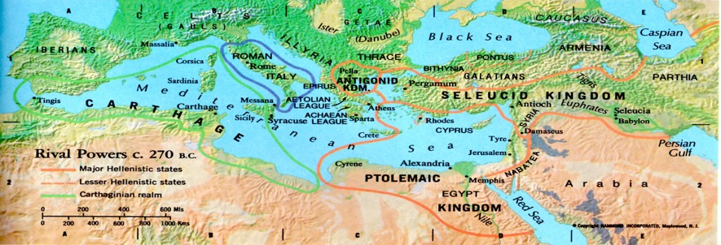
Rise of Rome

Slide 3
First Punic War (264–241 BC)
Sicily controlled by Carthage, but Rome desiring to expand beyond Italy.
Rome builds first major fleet copying captured Carthagian ships.
Over 23 years of battle with hundreds of thousands dead on both sides and three fleets of ships lost.
Carthage surrenders Sicily and Rome emerges as new world power.
Rome soon after annexes Corsica and Sardinia.

Slide 4
Second Punic War (218–201 BC)
The war against Hannibal
Hannibal made commander at 26.
Solidifies control of Spain and builds army.
Leads 40-50k army plus cavalry and 50-60 elephants over Alps in winter takes northern Italy in two months
Fought successfully in Italy for years.
Scipio Africanus takes Roman fleet to attack Carthage.
Hannibal recalled, but defeated outside Carthage.
Rather than be taken prisoner, Hannibal poisons himself.

Slide 5
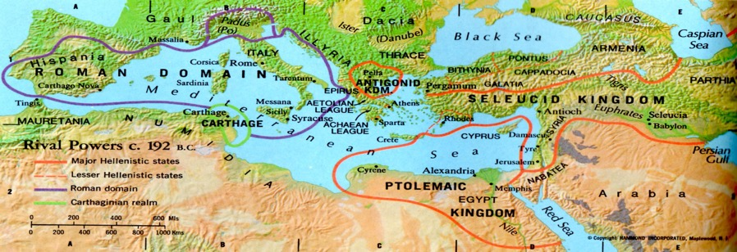
World powers c. 192 BC

Slide 6
Third Punic War (149–146 BC)
Cato the Elder argues that Carthage could rise again.
Defensive move by Carthage used to claim they had violated the peace treaty.
Roman army invades Carthage for last time.
Destroyed the walls and burned the city
Surviving Cathagians sold into slavery
Sowed surrounding area with salt so that crops could no longer grow.

Slide 7
Matthias Hasmoneas and Sons
Judas Maccabeus (167 – 161) regained control of Jerusalem in 164 BC and cleansed the Temple – Feast of Dedication.
Eleazar died slaying a war elephant in battle in 163.
Judas and John were killed in an overwhelming battle in 160.
Jonathan (161-143) continued the revolt and added territory to Israel before he was taken hostage and murdered. First Hasmonean High Priest in 153.
Simon (142-135 BC) finished gaining full independence. Made Ethnarch (~governor) and High Priest.

Slide 8
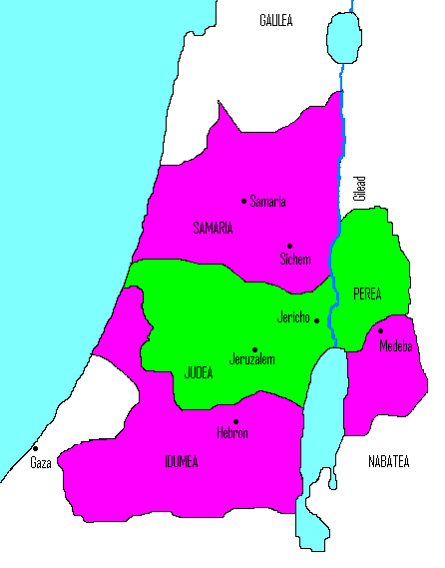
John Hyrcanus
Ethnarch and High Priest
134-104 BC
Forced the Idumeans (Edomites) to convert (including Antipater’s father, grandfather of Herod)
Destroys Samaritan Temple in 128BC

Slide 9
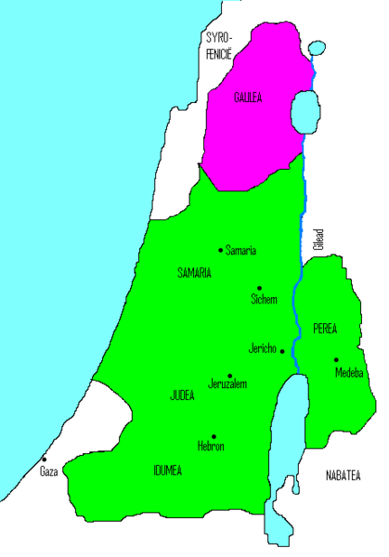
Aristobulus I
King and High Priest
104-103BC
First to call himself king
Imprisons mother and three brothers. Kills another brother.
Married to Salome Alexandra

Slide 10
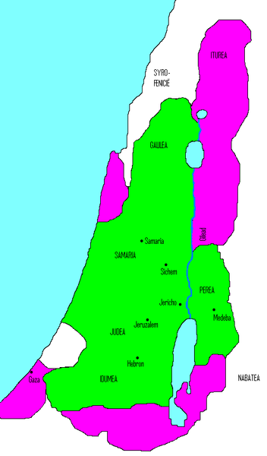
Alexander Jannaeus (Yannai)
King and High Priest
103-76 BC
Married Salome Alexandra, his brother’s widow
Practiced Sadducean law and was pelted with Etrogim. Kills 6,000 Jews in retaliations.
Killed 50,000 in civil war.
Crucified 800 Pharisees
Advises his wife before dying to make peace with the Pharisees!

Slide 11
Salome Alexandra & Sons
Salome is queen of Judea 76-67 BC
Her two sons Hyrcanus II and Aristobulus II fight over the crown. Both appeal for help from the Romans.
Pompey imprisons Aristobulus II and makes Hyrcanus II high priest in 63BC.
Hyrcanus serves 63-40BC
Antignos serves 40-37BC

Slide 12
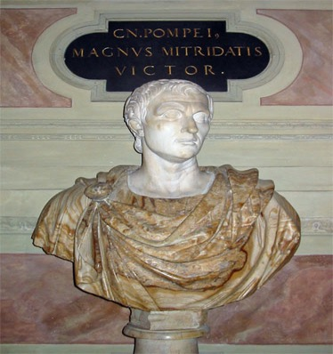
Pompey
Organized Asia Minor as Roman Province.
Directed by Senate to take Eastern coast of Mediterranean.
Takes Jerusalem and enters the Most Holy Place – 63BC.

Slide 13
Josephus on Pompey
No small enormities were committed about the temple itself, which, in former ages, had been inaccessible, and seen by none; for Pompey went into it, and not a few of those that were with him also, and saw all that which it was unlawful for any other men to see but only for the high priests.
There were in that temple the golden table, the holy candlestick, and the pouring vessels, and a great quantity of spices; and besides these there were among the treasures two thousand talents of sacred money: yet did Pompey touch nothing of all this, on account of his regard to religion; and in this point also he acted in a manner that was worthy of his virtue.
The next day he gave order to those that had the charge of the temple to cleanse it, and to bring what offerings the law required to God; and restored the high priesthood to Hyrcanus, both because he had been useful to him in other respects, and because he hindered the Jews in the country from giving Aristobulus any assistance in his war against him
Antiquities 14.4

Slide 14
Pompey Enters the Holy of Holies
The first Roman to subdue the Jews and set foot into their Temple by right of conquest was Gnaeus Pompey: thereafter it was a matter of common knowledge that there were no representations of the gods within, but that the place was empty and the secret shrine contained nothing.
Tacitus Histories 5.11-12

Slide 15
Antipater the Idumean
Supported Hyrcanus II as High Priest but knew that his future lay in supporting the Roman Empire.

