Slide 1
Time Between the Testaments

Slide 2
Antipater
Supported Hyrcanus II as High Priest but knew that his future lay in supporting the Roman Empire.
When Julius Caesar pursued Pompey to Egypt and his life was threatened, Antipater came to his aid.
Caesar responded by making him Procurator of Judea.
Made his son Herod military prefect in Galilee and Phasael prefect in Judea.
Poisoned by Hyrcanus’ butler in 43 BC.

Slide 3
Herod
Mark Antony makes Herod and Phasael joint rulers of Judea.
Antigonus (son of Aristobulus) invaded Judea with Parthian help. High Priest 40-37BC.
Hyrcanus mutilated, Phasael is imprisoned and commits suicide, but Herod escapes to Rome.
Rome declares Herod King of Judea.
Herod eventually gains control of all of Judea.
Antigonus taken to Rome and executed.
Takes title of Herod the Great and rules 37 – 4 BC.

Slide 4
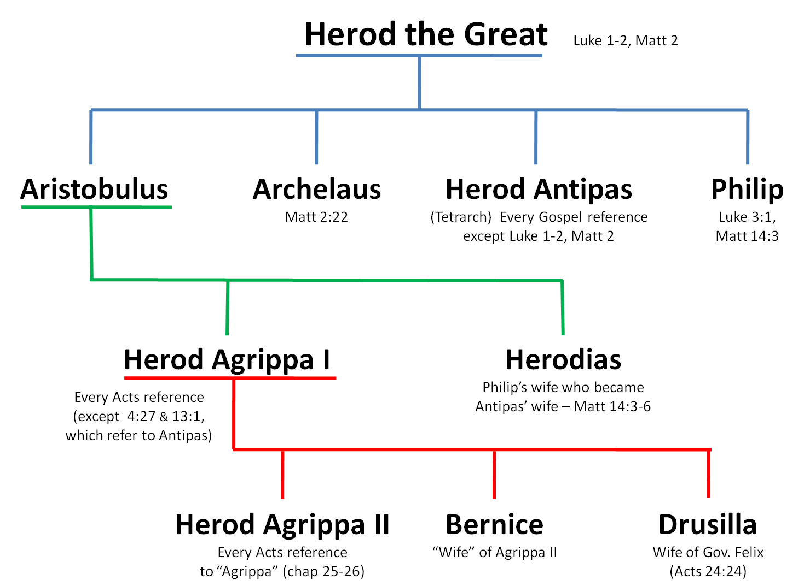

Slide 5
Book of Daniel: Prophecy or Fraud?
Prophesies of Daniel 7-12 are so detailed and clear that critics argue it must have been written after the time of Antiochus IV.
Some critics claimed Daniel included words that were new to 2nd century BC and had later style.
Words later shown to be common in 6th century BC and style actually more fitting for that time.

Slide 6
Book of Daniel: Prophecy or Fraud?
Oldest manuscript of Daniel dates back to at least 100BC.
The oldest manuscript of Daniel by far is 4QDanc, which Cross dated in 1961 to the “late second century BC” (Cross 1961:43).
4QDanc = Cave 4 of Qumran, Daniel, copy “c”
At least 8 copies of Daniel in Dead Sea Scrolls
Did Daniel become universally accepted “canon” in 50 years or less?

Slide 7
Book of Daniel: Prophecy or Fraud?
Other Daniel related works produced in this time but kept separate from scripture.
Song of the Three Young Men (Prayer of Azariah)
Susanna
Bel and the Dragon
If prophesies written in this time, why were they accepted but not these other additions?
http://www.biblearchaeology.org/post/2012/07/31/New-Light-on-the-Book-of-Daniel-from-the-Dead-Sea-Scrolls.aspx#Article

Slide 8
Sects of the Jews - Pharisees
The name Pharisee means “separated ones”.
May have developed from some of the Hasidim.
Most numerous of the sects.
Accepted entire Old Testament (Law, Prophets, and other writings in Hebrew Bible.
Believed in angels and resurrection.
Sought to keep the Law carefully, but eventually added traditions and rituals that they treated as essentially equal to the Law.
Some became prideful and self-righteous.

Slide 9
Sects of the Jews - Sadducees
The name Sadducee means “righteous ones” and is derived from the sons of Zadok.
Did not seek proselytes. Only members of High Priestly families could be members of the sect.
Accepted only Mosaic Law and rejected traditions of the Pharisees.
Did not believe in angels and resurrection.
Seemed to believe that their strict keeping of the Temple service made them righteous while at the same time accepting Greek culture in their private and political lives.
Some became aristocratic and focused on political power.

Slide 10
Sects of the Jews - Essenes
The name probably derived from Greek word meaning “holy”. Possibly some Hasidim went this way.
Did not marry. (Most did not, but some colonies may have.)
Lived simply in secluded communes.
Believed in resurrection to comfort or torment.
Considered Pharisees too liberal.
Sought to keep themselves pure, but did so by withdrawing from society.
Probably preserved the writings known as the Dead Sea Scrolls. Not mentioned in the Bible.

Slide 11
Sects of the Jews - Zealots
May have come from Pharisees that became more nationalistic .
More political party than religious sect.
Believed in overthrow of Roman authority by force.
Some believed that God would support them militarily and usher in a glorious Messianic kingdom in Jerusalem.
At least one of the apostles – Simon the Zealot was (at least at some time) a part of this movement. Luke 6:15.
Some Zealots were active in sabotage and assassinations.
Zealots eventually inspire revolt which results in the destruction of Jerusalem in AD 70.

Slide 12
Sects of the Jews - Herodians
The opposite of the Zealots; they supported the Herods and Roman authority.
Many were Sadducees from powerful families.

Slide 13
Synagogue
Uncertain origin probably during the Babylonian captivity.
Greek word for gathering or congregation. Hebrew word is Keneseth.
Reading from a scroll the speaker stood. To preach, he sat down.
For prayer, everyone stood.
Singing was unaccompanied.

Slide 14
Sanhedrin
Various councils supported political position of High Priest during much of time between the testaments.
Sanhedrin formalized in religious freedom under Roman rule.
71 Members: 1 High Priest and 70 Sadducees and Pharisees.
Usually dominated by aristocratic Sadducees.

Slide 15
Septuagint (LXX)
Begun during reign of Ptolemy Philadelphus (285-246).
Greek account claims translation done by 72 Jewish scholars in 72 days.
Jesus and apostles quoted from LXX.
Most quotes of OT in NT are from LXX.

Slide 16
Fullness of the times
Greek language the universal language of the Mediterranean world.
Hebrew Old Testament translated into Greek.
Synagogues in every city with enough Jews.
Roman enforced peace and infrastructure.
Travel by land or sea easier and safer than ever before.

