Slide 1
Revelation Defending God and Encouraging His Saints
Lesson 21 – The Millennium and Eternal Judgment

Slide 2
The Millennium
Revelation 20:1-6

Slide 3
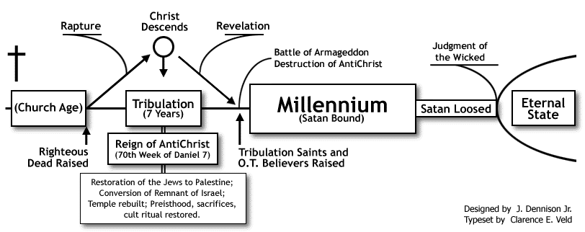
Best Explanation of the Millennium?
Which of the millennial views best fit the context? Why?
Premillennial (Dispensational and Historical) – Jesus returns before literal 1000 year reign. Can be dispensational (i.e., Jews are restored as special nation again).

Slide 4
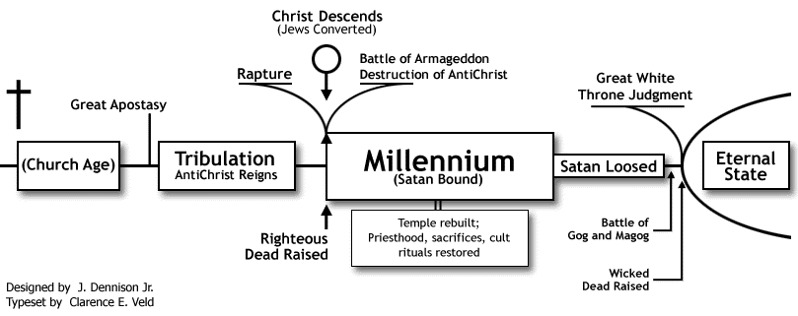
Best Explanation of the Millennium?
Which of the millennial views best fit the context? Why?
Premillennial (Dispensational and Historical) – Jesus returns before literal 1000 year reign. May be dispensational (i.e., Jews are restored as special nation again).

Slide 5
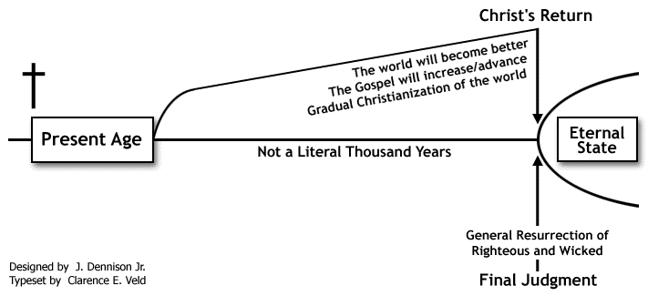
Best Explanation of the Millennium?
Which of the millennial views best fit the context? Why?
Postmillennial – Jesus returns after literal 1000 year reign – utopia to heaven.

Slide 6
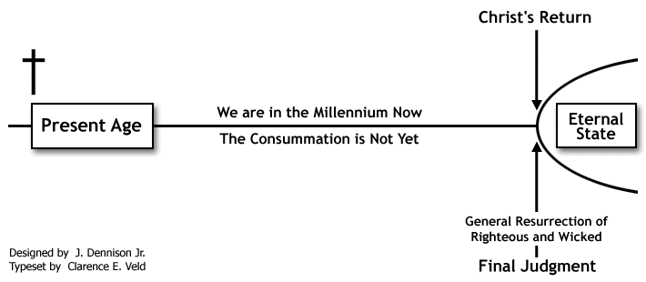
Best Explanation of the Millennium?
Which of the millennial views best fit the context? Why?
Amillennial – 1000 year reign is symbolic, long, indefinite time.

Slide 7
Best Explanation of the Millennium?
Which of the millennial views best fit the context? Why?
Premillennial (Dispensational and Historical) – Jesus returns before literal 1000 year reign. May be dispensational (i.e., Jews are restored as special nation again).
Principally literal interpretation ignores that book introduces itself as symbolic (1:1).
Arbitrarily switches between literal and figurative interpretations, abandoning consistency.
Principally futurist application ignores that the book’s events “must shortly take place” (1:1).
Future application of “tribulation” and “kingdom” ignores immediate association (1:9).
Overlooks Jews are no longer God’s special people (Rom. 9:6; 11:1-32; Zec. 11:6-14; Acts 10:34).
Ignores that the church is the kingdom of God and saints are in it now (Col. 1:13).
Passage does not mention essential elements: (1) Second coming of Christ (2) Bodily resurrection (3) Reign of Christ on earth (4) Literal throne of David (5) Jerusalem of Palestine (6) Conversion of Jews (7) Church on earth.
Not to mention it makes almost all major prophets, minor prophets, Jesus, and the apostles to be false prophets (Matthew 4:12-17; 10:1-7).
It also depicts God as less than Sovereign since Jews could thwart His promise.

Slide 8
Best Explanation of the Millennium?
Which of the millennial views best fit the context? Why?
Premillennial (Dispensational and Historical) – Jesus returns before literal 1000 year reign. May be dispensational (i.e., Jews are restored as special nation again).
Postmillennial – Jesus returns after literal 1000 year reign – utopia to heaven.
Shares the same fundamental failures of the Premillennial position because of its literal interpretation and postponed fulfillments of the prophets, including Jesus and the apostles.
Additionally, ignores many NT passages saying that things will generally get worse over time, not better (2 Timothy 3:1-13; 4:1-4; Luke 13:23-24; Matthew 7:13-14).
Furthermore, ignores the immediate context which indicates that Satan will have control of the vast majority of the world. Christians will be in the stark minority, not dominating majority (20:8-9).
Amillennial – 1000 year reign is symbolic, long, indefinite time.
Best fits symbolic nature of the book and matches immediate fulfillment of OT & NT prophets.

Slide 9
Best Explanation of the Millennium?
Early saints and martyrs overcame the Devil through the martyr spirit (12:11).
Based on Jesus’ victory and the saints overcoming through Him (12:11), God made a judgment in favor of Christ and His saints (Dan. 7; compare, Job 1-2, 42; Zec. 3).
Resulted in the destruction of the Devil’s agents – Roman capital, religion, and empire – and reduced power to deceive the nations (Daniel 7; Revelation 17-19).
As long as Christians maintain that martyr spirit, they can continue to overcome and be a godly influence in the world (Matthew 5:13-15).
However, when mankind’s potential is fully tapped (symbolic of millennium) – Christians can no longer influence the world – there is “no remedy” (2 Chr. 36:15-16; Gen. 15:16; Jer. 7:13-16; Eze. 14:13-23) – the time will come for the end.
Compare to Noah (Genesis 6:5-7:1) and Lot (Genesis 18:20-32; 19:16-29).
The Devil will have one last chance to prove himself when loosed.
But, it will be God and His people who are again sanctified (Ezekiel 38-39).

Slide 10
Timeline of Revelation
Heaven
Jesus Ascends
Dragon Cast Down
Seals Opened
Judgment Day
Devil is Bound for 1000 years
Victorious Martyrs Reign with Christ for 1000 years
Eternity
“a little season”
War in Heaven
1000 years (symbolic)
1260 days = 42 months = 3½ years
“time, times, and half a time”
Radiant Woman
Dragon is Loosed
Armageddon
Dragon Wars against Saints
Woman → Children
Beasts Persecutes Saints
Holy City Trodden Underfoot
Ministry & Death of Two Witnesses
7 Seals → 7 Trumpets → 7 Bowls
Escalating Warning
Period of Patience
Harlot Destroyed
Beast & False Prophet Destroyed
Dragon is Imprisoned
Heart, Religion & Empire of Rome are Destroyed
Gog & Magog
Dragon Fails
Hell
Jesus Returns

Slide 11
The Devil’s Last Rebellion
Revelation 20:7-10

Slide 12
Satan & the World …
Who will the Devil enlist to help him in his final rebellion? What is the significance of this symbol?
Now when the thousand years have expired, Satan will be released from his prison and will go out to deceive the nations which are in the four corners of the earth, Gog and Magog, to gather them together to battle, whose number is as the sand of the sea. (Revelation 20:7-8)
“Nations in the four corners of the earth” – Indicates nations from all over the earth, the remotest regions.
“Number is as the sand of the sea” – Additionally indicates that it is virtually everyone who is not a Christian aligns themselves with the Devil in this war.

Slide 13
Gog and Magog – Ezekiel 38-39
Follows judgment of nations (25-32), restoration of Israel, and Messianic rule (37).
“Gog”, probably play on “Magog”, is only mentioned in Ez. 38-39 and Rev. 20:8.
“‘Thus says the Lord GOD: “Are you he of whom I have spoken in former days by My servants the prophets of Israel, who prophesied for years in those days that I would bring you against them?”’” (Ezekiel 38:17)
Ancient genealogy of Gentiles, those opposed to God’s people:
Chief prince of Magog, Meshech, and Tubal (38:2-3; 39:1) – sons of Japheth (Gen. 10:2).
Allies include Gomer and Togarmah (38:6) – son and grandson of Japheth (Gen. 10:3).
Additional allies include Persia (38:5) – possible descendant of Madai, son of Japheth (Gen. 10:2).
Other allies are Ethiopia and Libya (38:5) and Sheba and Dedan - descendants of Ham (Gen.10:6-7).
Tarshish (38:13) is also a descendant of Japheth (Genesis 10:4).
No descendant of Shem is mentioned! … Represents rebellious, unregenerate Gentiles.

Slide 14
Gog and Magog – Ezekiel 38-39
Follows judgment of nations (25-32), restoration of Israel, and Messianic rule (37).
“Gog”, probably play on “Magog”, is only mentioned in Ez. 38-39 and Rev. 20:8.
“‘Thus says the Lord GOD: “Are you he of whom I have spoken in former days by My servants the prophets of Israel, who prophesied for years in those days that I would bring you against them?”’” (Ezekiel 38:17)
Gog would attack in the “latter years” and “latter days” (38:8, 16) …
… Reference to Messianic era (Isaiah 2:2; Micah 4:1; Daniel 2:28; 10:14).
Gog would seek to plunder defenseless “unwalled” people (38:10-13) …
… Reference to Messianic kingdom, the church (Zechariah 2:2-12).
Represents God’s triumph over massive Gentile coalition in the Messianic era.
Ezekiel seems to point to future Roman persecution from yet undeveloped tribes.
Revelation adapts the symbol to point to the final coalition against God.

Slide 15
… versus Christianity
Who will the Devil and the army attack this last time? Should this be interpreted literally? If not, who and what are represented by this symbol?
They went up on the breadth of the earth and surrounded the camp of the saints and the beloved city. And fire came down from God out of heaven and devoured them. (Revelation 20:9)
Represents the church, pictured as the “beloved city”, as in 11:1-2.
Not a literal attack (1:1), but one last spiritual confrontation, but again using a massive world empire and possibly false religion – once again allowed to “deceive the nations”.
Lesson: Critical to teach the lessons of Revelation to ourselves, our children, and for many generations because 12:11 will be required again for many Christians.

Slide 16
Ends in Fire
What is the result of this battle?
They went up on the breadth of the earth and surrounded the camp of the saints and the beloved city. And fire came down from God out of heaven and devoured them. (Revelation 20:9)
There is no delay, no stand-off, no battle – just fiery judgment.
Then the LORD rained brimstone and fire on Sodom and Gomorrah, from the LORD out of the heavens. So He overthrew those cities, all the plain, all the inhabitants of the cities, and what grew on the ground. (Genesis 19:24-25)

Slide 17
Ends in Fire
What is the result of this battle?
They went up on the breadth of the earth and surrounded the camp of the saints and the beloved city. And fire came down from God out of heaven and devoured them. (Revelation 20:9)
There is no delay, no stand-off, no battle – just fiery judgment.
… since it is a righteous thing with God to repay with tribulation those who trouble you, and to give you who are troubled rest with us when the Lord Jesus is revealed from heaven with His mighty angels, in flaming fire taking vengeance on those who do not know God, and on those who do not obey the gospel of our Lord Jesus Christ. These shall be punished with everlasting destruction from the presence of the Lord and from the glory of His power, when He comes, in that Day, to be glorified in His saints and to be admired among all those who believe, because our testimony among you was believed. (2 Thessalonians 1:6-10)

Slide 18
Ends in Fire
But the heavens and the earth which are now preserved by the same word, are reserved for fire until the day of judgment and perdition of ungodly men. But, beloved, do not forget this one thing, that with the Lord one day is as a thousand years, and a thousand years as one day. The Lord is not slack concerning His promise, as some count slackness, but is longsuffering toward us, not willing that any should perish but that all should come to repentance. But the day of the Lord will come as a thief in the night, in which the heavens will pass away with a great noise, and the elements will melt with fervent heat; both the earth and the works that are in it will be burned up. Therefore, since all these things will be dissolved, what manner of persons ought you to be in holy conduct and godliness, looking for and hastening the coming of the day of God, because of which the heavens will be dissolved, being on fire, and the elements will melt with fervent heat? Nevertheless we, according to His promise, look for new heavens and a new earth in which righteousness dwells. (2 Peter 3:7-13)

Slide 19
The Devil’s Fate
Does this represent a temporary or eternal judgment? How do you know? Please provide supporting Scriptures to reinforce your conclusion.
The devil, who deceived them, was cast into the lake of fire and brimstone where the beast and the false prophet are. And they will be tormented day and night forever and ever. (Revelation 20:10)
Eternal – not imprisoned, but cast into lake of fire – no return – “forever and ever”.
Why would anyone want to share such a place – such a sentence – with the Devil?
“‘And cast the unprofitable servant into the outer darkness. There will be weeping and gnashing of teeth.’ When the Son of Man comes in His glory, and all the holy angels with Him, then He will sit on the throne of His glory. … Then He will also say to those on the left hand, ‘Depart from Me, you cursed, into the everlasting fire prepared for the devil and his angels’ … And these will go away into everlasting punishment, but the righteous into eternal life.” (Matthew 25:30-46)

