Slide 1
Revelation Trust God
Lesson 21 – The Millennium and Eternal Judgment

Slide 2
The Millennium
Revelation 20:1-6

Slide 3
The Binding of the Dragon
How was the Devil restrained after his loss at Armageddon?
Then I saw an angel coming down from heaven, having the key to the bottomless pit and a great chain in his hand. He laid hold of the dragon, that serpent of old, who is the Devil and Satan, and bound him for a thousand years; and he ¹cast him into the bottomless pit, and ²shut him up, and ³set a seal on him, so that he should deceive the nations no more till the thousand years were finished. But after these things he must be released for a little while. (20:1-3)
During binding period the Devil’s authority, influence, or power is diminished.
Specifically, represents reduced deceptive influence on global scale (“kings of the earth and the whole world”, 16:14; 17:2, 18; 18:3, 9; 19:9).
Like a dog on a chain, he still wanders within bounds (1 Peter 5:8-9; James 4:4-8).
We’ll identify other events occurring during millennium before identifying it …

Slide 4
The Saints’ Reigning with Christ
And I saw thrones, and they sat on them, and judgment was committed to them. Then I saw the souls of those who had been beheaded for their witness to Jesus and for the word of God, who had not worshiped the beast or his image, and had not received his mark on their foreheads or on their hands. And they lived and reigned with Christ for a thousand years. … “but they shall be priests of God and of Christ, and shall reign with Him a thousand years.” (20:4, 6)
What other Scriptures refer to persecuted saints reigning with Christ?
“have made us kings and priests to our God; And we shall reign on the earth.” (5:10)
6:9-11 – Souls under the altar who had been slain.
13:15-17 – Those who would not worship the beast were persecuted, killed.
Dan. 7:14-27 – 4th beast is destroyed, Jesus receives the kingdom, saints possess it.
Although dead (“beheaded”), they still judge, reign, and serve as priest.
Reign is from heaven (with Christ), but on earth and occurring during millennium.

Slide 5
Fulfillment of Daniel 7?
Please compare the account up to this point with Daniel 7:8-28. What has not been fulfilled at this point in Revelation?
Fourth Beast – the Roman Empire
Terrible, exceedingly strong, iron teeth.
Trampling the residue with its feet.
Ten Horns – Pompous, blasphemous
Jesus’ ascension, coronation. He is given everlasting kingdom and dominion.
Beast & his horns made war against the saints, persecuting them.
Beast was slain – body destroyed in fire.
The kingdom and dominion given to the saints of the Most High to possess.
Notice, Daniel does not foretell anything after kingdom is turned over to the saints!
Daniel 7, the most far reaching prophecy of OT, has been wholly fulfilled!

Slide 6
The First Resurrection
… And they lived and reigned with Christ for a thousand years. But the rest of the dead did not live again until the thousand years were finished. This is the first resurrection. Blessed and holy is he who has part in the first resurrection. Over such the second death has no power, but they shall be priests of God and of Christ, and shall reign with Him a thousand years. (20:4-6)
Should we interpret this resurrection literally? How could this be described as a “resurrection”? In what way would it be the “first resurrection”?
Terrible mistake to take literally. This is a book of symbols, signs (1:1).
OT precedent for symbolically using a resurrection to represent a resurgence of power, influence, cause, or mission (Isaiah 26:19; Hosea 13:14). …

Slide 7
The Valley of Dry Bones
The hand of the LORD came upon me and brought me out in the Spirit of the LORD, and set me down in the midst of the valley; and it was full of bones. Then He caused me to pass by them all around, and behold, there were very many in the open valley; and indeed they were very dry. And He said to me, “Son of man, can these bones live?” ...“Surely I will cause breath to enter into you, and you shall live. I will put sinews on you and bring flesh upon you, cover you with skin and put breath in you; and you shall live. Then you shall know that I am the LORD. … Come from the four winds, O breath, and breathe on these slain, that they may live. … Son of man, these bones are the whole house of Israel. They indeed say, ‘Our bones are dry, our hope is lost, and we ourselves are cut off!’ Therefore prophesy and say to them, ‘Thus says the Lord GOD: “Behold, O My people, I will open your graves and cause you to come up from your graves, and bring you into the land of Israel. Then you shall know that I am the LORD, when I have opened your graves, O My people, and brought you up from your graves. I will put My Spirit in you, and you shall live, and I will place you in your own land. Then you shall know that I, the LORD, have spoken it and performed it,” says the LORD.’” (Ezekiel 37:1-14)
The Jews’ physical return from national captivity was symbolized as a resurrection.

Slide 8
The First Resurrection
… And they lived and reigned with Christ for a thousand years. But the rest of the dead did not live again until the thousand years were finished. This is the first resurrection. Blessed and holy is he who has part in the first resurrection. Over such the second death has no power, but they shall be priests of God and of Christ, and shall reign with Him a thousand years. (20:4-6)
Should we interpret this resurrection literally? How could this be described as a “resurrection”? In what way would it be the “first resurrection”?
Terrible mistake to take literally. This is a book of symbols, signs (1:1).
OT precedent for using a resurrection to refer to resurgence of power, influence, or one’s cause (Isaiah 26:19; Hosea 13:14; Ezekiel 37:1-14).
Same symbol already used of “two witnesses” to represent the resurgence of strength, validity, and confirmation in apostolic testimony despite their martyrdom (11:7-12).
The unmentioned final resurrection alludes to bodily, preceding judgment (20:12).
The faithful are exempt from the “second death”, eternal condemnation in hell (20:14-15).
Alternatively, “rest of the dead” may refer to resurrection of wicked people’s cause, who died in Armageddon (19:21; 20:7-9), but seems overly complicated, not emphasized.

Slide 9
How Do They Reign?
And I saw thrones, and they sat on them, and judgment was committed to them. Then I saw the souls of those who had been beheaded for their witness to Jesus and for the word of God … And they lived and reigned with Christ for a thousand years. (20:4)
Primarily, this reign refers to the martyred saints who are now in heavenly realms, but …
… “You are worthy to take the scroll, And to open its seals; For You were slain, And have redeemed us to God by Your blood Out of every tribe and tongue and people and nation, And have made us kings and priests to our God; And we shall reign on the earth.” (5:9-10)
How do these “beheaded” saints “reign on earth” from heaven, “with Christ”?
Generally, the righteous indirectly judge, condemn the wicked through obedience, stripping their excuse (John 15:18-25; Hebrews 11:6-7; Romans 2:27; Matthew 12:41-42).
Specifically, although personally in heavenly realms, the martyred saints’ examples of extreme faithfulness, victory “reigns”, influences, raises expectations for those still on earth.
Example not only strips excuse of rebellious, but also inspires humble (Hebrews 11:39-12:3).

Slide 10
How Do They Reign?
And I saw thrones, and they sat on them, and judgment was committed to them. Then I saw the souls of those who had been beheaded for their witness to Jesus and for the word of God … And they lived and reigned with Christ for a thousand years. (20:4)
Primarily, this reign refers to the martyred saints who are now in heavenly realms, but …
… “You are worthy to take the scroll, And to open its seals; For You were slain, And have redeemed us to God by Your blood Out of every tribe and tongue and people and nation, And have made us kings and priests to our God; And we shall reign on the earth.” (5:9-10)
How do these “beheaded” saints reign “on earth” from heaven, “with Christ”?
Figuratively every time someone far from God considers their example, takes encouragement, and strives to be more like them, move closer to God, the dead again fulfill role of “priest”.
How many people were converted – in some measure – by the influence of their example?
Almost 2000 years later, still talking about them, admiring, trying to live up to their example!
This “martyr spirit” (12:11; Mat. 5:13-16), epitomized by the “beheaded”, is a key spiritual characteristic of saints that has “reigned”, which we must uphold!

Slide 11
What, When is the Millennium?
What determines the beginning, ending, and duration of the millennium? What does it represent?
Represents long period of time with the following identified attributes:
Began after the Devil’s defeat at Armageddon, when:
“Sea beast” and “false prophet” were “cast alive into the lake of fire” (19:19-20; Daniel 7:7-11).
Roman Empire’s attempt to overthrow Christ and His kingdom utterly failed (19:15-19).
Instead, Roman Empire was destroyed.
During which, the Devil is restrained, unable to “deceive the nations” (20:2-3).

Slide 12
What, When is the Millennium?
What determines the beginning, ending, and duration of the millennium? What does it represent?
Represents long period of time with the following identified attributes:
Despite their “beheading”, the martyrs are “resurrected” with their message that Jesus is “King of Kings, Lord of Lords” (19:15-19).
Their message and extreme example “reigns” on the earth, resulting in conversion and enduring faithfulness (12:11; 20:4-6), figuratively, spiritually serving as “judges” and “priests”.
Generally, Christ’s kingdom is “delivered to the saints” (Daniel 7:13-14, 18, 22, 25-27) for them to reign, oversee, invest (Luke 19:11-28).
… over a thousand years something happens, something changes … what???
Ends with Devil’s release, which is followed by a “little while” , Devil resumes global deception, and then maybe (?) the end of the world (20:3, 7-15).

Slide 13
What, When is the Millennium?
What determines the beginning, ending, and duration of the millennium? What does it represent?
“Thousand years” is by far longest period of time mentioned in the Bible, much less prophetic texts.
By comparison, Daniel’s visions of “seventy weeks” represent time from period of Return from Captivity to Destruction of Jerusalem – about 600 years (Daniel 9:24-27). No prophetic time period comes close to being so long.
Symbolically, what might the “1000 years” represent, 10 x 10 x 10 (10³)?
10 – Full capacity, power of man
3 – Extreme emphasis (4:8; 8:13; Isaiah 6:3; Jeremiah 22:29)
7 – Complete work, bestowment of God, inherently limited by Him
10 x 10 x 10 (10³): Complete and utter end of mankind’s full potential, capacity – extreme emphasis.

Slide 14
What, When is the Millennium?
What determines the beginning, ending, and duration of the millennium? What does it represent?
10 x 10 x 10 (10³): Complete and utter end of mankind’s full potential, capacity – extreme emphasis.
Notice the complete absence of 7. God is is not directly setting the end time.
The end is determined by the capacity, power, strength of man!
Reappropriating description of the end of Jewish people to all people, the millennium ends “when the power of the holy people has been completely shattered, all these things shall be finished” (Daniel 12:7)
Does not end when no Christians remain, not when “martyr spirit” is exhausted, because end occurs when, “the camp of the saints and the beloved city” are “surrounded” upon the “breadth of the earth” (20:9).
Reinforcing conclusion can be derived by examining God’s revealed nature …

Slide 15
When Does God End Kingdoms?
When sin, wickedness reach a certain level:
But in the fourth generation they shall return here, for the iniquity of the Amorites is not yet complete. (Genesis 15:16)
Moreover all the leaders of the priests and the people transgressed more and more, according to all the abominations of the nations, and defiled the house of the LORD which He had consecrated in Jerusalem. And the LORD God of their fathers sent warnings to them by His messengers, rising up early and sending them, because He had compassion on His people and on His dwelling place. But they mocked the messengers of God, despised His words, and scoffed at His prophets, until the wrath of the LORD arose against His people, till there was no remedy. (2 Chr. 36:14-16)
The Lord is not slack concerning His promise, as some count slackness, but is longsuffering toward us, not willing that any should perish but that all should come to repentance. (2 Peter 3:9)

Slide 16
When Does God End Kingdoms?
What happens when the time comes, when longer time can no longer help?
Generically, principally, for nations, kingdoms, peoples, what is that level?
Then a white robe was given to each of them; and it was said to them that they should rest a little while longer, until both the number of their fellow servants and their brethren, who would be killed as they were, was completed. (6:11)
God’s goal for all nations, societies, creation is to produce saints (Rom. 8:19-23).
God has historically preserved some nations past such times to serve as tools to judge, destroy other nations (Isaiah 10:5-15; Habakkuk 1:5-11; Jer. 13:14).
But, what happens when there are no other nations left, when this dreadful state characterizes all nations, the entire world?
What happens when the whole world “wages war” on the Lamb and His army?

Slide 17
When Does God End Kingdoms?
What happens when Christians “love not their lives to death” (12:11) around the world, but no one cares? No one notices? No one is swayed or affected? No one is converted?
What happens when the “number is completed” (6:11) of those than can be redeemed from the world? When the world can no longer produce saints?
What happens when all the spiritual strength and value of mankind is exhausted?

Slide 18
When Does God End Kingdoms?
Son of man, when a land sins against Me by persistent unfaithfulness, I will stretch out My hand against it; I will cut off its supply of bread, send famine on it, and cut off man and beast from it. Even if these three men, Noah, Daniel, and Job, were in it, they would deliver only themselves by their righteousness,” says the Lord GOD. “If I cause wild beasts to pass through the land, and they empty it, and make it so desolate that no man may pass through because of the beasts, even though these three men were in it, as I live,” says the Lord GOD, “they would deliver neither sons nor daughters; only they would be delivered, and the land would be desolate. Or if I bring a sword on that land, … Or if I send a pestilence into that land and pour out My fury on it in blood … they would deliver neither son nor daughter; they would deliver only themselves by their righteousness.” For thus says the Lord GOD: “How much more it shall be when I send My four severe judgments on Jerusalem – the sword and famine and wild beasts and pestilence – to cut off man and beast from it?” (Ezekiel 14:13-21)

Slide 19
Lessons? Applications
God has turned over the kingdom to the saints! How are you reigning?
But, the burden also falls on the lost, the world! How long before the martyr’s example no longer touches the heart of the sinner?
Only the gospel has regenerative power to bring true, eternal life to individuals, peoples, societies, nations, the world (Romans 1:16; 2 Timothy 3:16-17; Ephesians 3:3-5).
Are we about our Father’s kingdom, His business (Matthew 6:33; Luke 2:49)?
What must we do? Use God’s armor, cast our cares on Him, grow in Him, and resist the Devil (Eph. 6:10-20; 1 Peter 5:6-10; 2 Peter 3:14-18; James 4:5-8; Psa. 119:30-46).
Don’t assume burdens not your own (Ecclesiastes 7:16-18; Daniel 12:9, 13).
Jesus has already won the war (19:11-21; 20:9-15). We’re redeeming the lost.
“All authority has been given to Me in heaven and on earth. Go therefore and make disciples of all the nations, baptizing them in the name of the Father and of the Son and of the Holy Spirit, teaching them to observe all things that I have commanded you; and lo, I am with you always, even to the end of the age.” Amen. (Matthew 28:18-20)

Slide 20
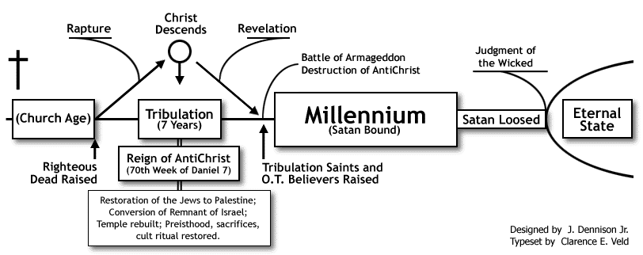
Best Explanation of the Millennium?
Which of the millennial views best fit the context? Why?
Premillennial (Dispensational and Historical) – Jesus returns before literal 1000 year reign. May be dispensational (i.e., Jews are restored as special nation again).

Slide 21
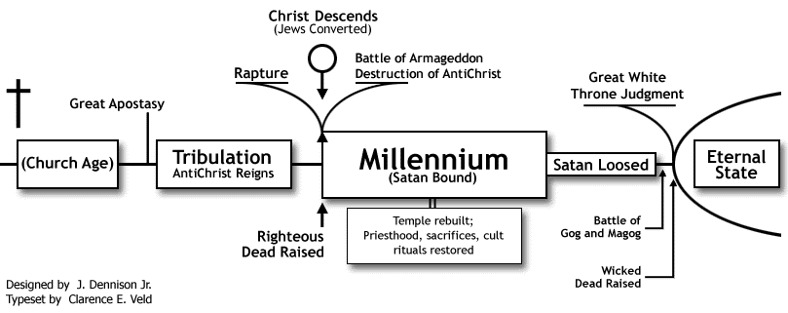
Best Explanation of the Millennium?
Which of the millennial views best fit the context? Why?
Premillennial (Dispensational and Historical) – Jesus returns before literal 1000 year reign. May be dispensational (i.e., Jews are restored as special nation again).

Slide 22
Best Explanation of the Millennium?
Which of the millennial views best fit the context? Why?
Premillennial (Dispensational and Historical) – Jesus returns before literal 1000 year reign. May be dispensational (i.e., Jews are restored as special nation again).
Primarily adopts literal interpretation ignores that book introduces itself as symbolic (1:1).
Arbitrarily switches between literal and figurative interpretations, abandoning consistency.
Principally futurist application ignores that the book’s events “must shortly take place” (1:1).
Future application of “tribulation” and “kingdom” ignores immediate association (1:9).
Overlooks Jews are no longer God’s special people (Rom. 9:6; 11:1-32; Zec. 11:6-14; Acts 10:34).
Ignores that the church is the kingdom of God and saints are in it now (Col. 1:13).
Passage does not mention essential elements: (1) Second coming of Christ (2) Bodily resurrection (3) Reign of Christ on earth (4) Literal throne of David (5) Jerusalem of Palestine (6) Conversion of Jews (7) Church on earth.
Not to mention it makes almost all major prophets, minor prophets, Jesus, and the apostles to be false prophets (Matthew 4:12-17; 10:1-7).
It also depicts God as less than Sovereign since Jews could thwart His promise.

Slide 23
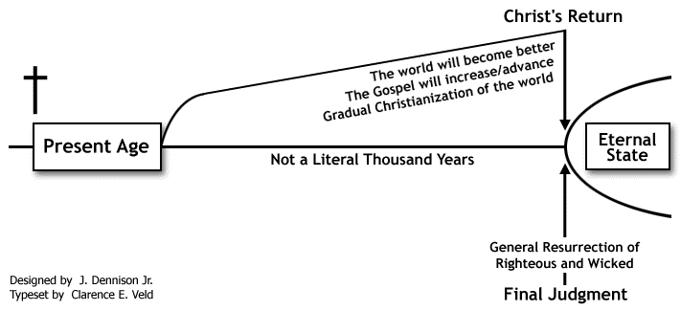
Best Explanation of the Millennium?
Which of the millennial views best fit the context? Why?
Postmillennial – Jesus returns after literal 1000 year reign – utopia to heaven.

Slide 24
Best Explanation of the Millennium?
Which of the millennial views best fit the context? Why?
Premillennial (Dispensational and Historical) – Jesus returns before literal 1000 year reign. May be dispensational (i.e., Jews are restored as special nation again).
Postmillennial – Jesus returns after literal 1000 year reign – utopia to heaven.
Shares the same fundamental failures of the Premillennial position because of its literal interpretation and postponed fulfillments of the prophets, including Jesus and the apostles.
Additionally, ignores many NT passages saying that things will generally get worse over time, not better, and relatively few saved (2 Timothy 3:1-13; 4:1-4; Luke 13:23-24; Matthew 7:13-14).
Furthermore, ignores the immediate context which indicates that Satan will have control of the vast majority of the world. Christians will be in the stark minority, not dominating majority (20:8-9).

Slide 25
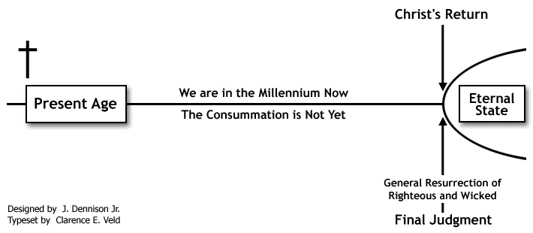
Best Explanation of the Millennium?
Which of the millennial views best fit the context? Why?
Amillennial – 1000 year reign is symbolic, long, indefinite time.
Best fits symbolic nature of the book and matches immediate fulfillment of OT & NT prophets.

Slide 26
The Devil’s Last Rebellion
Revelation 20:7-10

