Slide 1
Matthew 7:23
Finishing Lesson 21
(pp. 155-157, [147-149])

Slide 2
Review: Sermon on the Mount Outline
5:1-16 – Intro: Nature of the Kingdom (Citizen)
5:17-20 – Theme: Excelling, True Righteousness
5:21-48 – Truly, “Love thy neighbor as thyself”.
6:1-18 – Serving God or our Pride?
6:19-34 – Serving God or Riches?
7:1-28 – Conclusion: Overcoming Barriers to Success

Slide 3
Review: Outline
7:1-28 – Conclusion: Overcoming Barriers
7:1-6 – Focus on your faults, not other’s faults
7:7-12 – Don’t give up trying – Loving Father awaits
7:13-14 – Don’t be discouraged – way is difficult
7:15-20 – Beware false prophets who deceive
7:21-23 – Beware self-deception
7:24-29 – YOU MUST OBEY JESUS’ WORDS

Slide 4
How Can I Know That I Am Saved?
How can we be sure we are not going to get a judgment surprise and be told to depart?
“These things I have written … that you may know you have eternal life” (I John 5:13) … “that your joy may be full” (I John 1:2-4)
“written to you who believe” (I John 5:13) … “I write … because your sins are forgiven you … you have known Him … you are strong, and the word of God abides in you and you have overcome the wicked one.” (I John 2:12-14)

Slide 5
4 Marks of Eternal Life: #1) Obedience
“Now by this we know that we know Him, if we keep His commandments. He who says, “I know Him,” and does not keep His commandments, is a liar, and the truth is not in him. But whoever keeps His word, truly the love of God is perfected in him. By this we know that we are in Him.” (I John 2:3-5; also, I John 3:6-10)
“If we confess our sins, He is faithful and just to forgive us our sins and to cleanse us from all unrighteousness.” (I John 1:9)

Slide 6
4 Marks of Eternal Life: #2) Truth
“Beloved, do not believe every spirit, but test the spirits, whether they are of God; because many false prophets have gone out into the world. ... They are of the world. Therefore they speak as of the world, and the world hears them. We are of God. He who knows God hears us; he who is not of God does not hear us. By this we know the spirit of truth and the spirit of error.” (I John 2:12-14)

Slide 7
4 Marks of Eternal Life: #3) Love
“We know that we have passed from death to life, because we love the brethren. He who does not love his brother abides in death. … By this we know love, because He laid down His life for us. And we also ought to lay down our lives for the brethren. … My little children, let us not love in word or in tongue, but in deed and in truth. And by this we know that we are of the truth, and shall assure our hearts before Him.” (I John 3:14-19)

Slide 8
4 Marks of Eternal Life: #4) Faith
“Whoever believes that Jesus is the Christ is born of God, and everyone who loves Him who begot also loves him who is begotten of Him. By this we know that we love the children of God, when we love God and keep His commandments. For this is the love of God, that we keep His commandments. And His commandments are not burdensome. For whatever is born of God overcomes the world. And this is the victory that has overcome the world – our faith.” (I John 5:1-4)

Slide 9
Matthew 7:24-27
Lesson 22
(pp. 158-166, [150-158])

Slide 10
The Wisdom of Obedience
“Therefore whoever hears these sayings of Mine, and does them, I will liken him to a wise man who built his house on the rock: and the rain descended, the floods came, and the winds blew and beat on that house; and it did not fall, for it was founded on the rock. But everyone who hears these sayings of Mine, and does not do them, will be like a foolish man who built his house on the sand: and the rain descended, the floods came, and the winds blew and beat on that house; and it fell. And great was its fall.” (Matthew 7:24-27)

Slide 11
Questions
In the conclusion to the sermon, Jesus challenged His listeners:
To choose the ___________ gate and the __________ way to _________.
Not to merely call Him Lord, but to _______ the will of the Father.
To what kind of builder did Jesus compare the one who heard His sayings and did them?
What happened to the first builder’s house, when the floods came?
To hear the sayings of Jesus and then not obey them is to be like what kind of builder?
What happens to the second builder’s house, when the storm comes?

Slide 12
The Storm
What does the storm represent in this “parable”?
“Not everyone who says to Me, ‘Lord, Lord,’ shall enter the kingdom of heaven, but he who does the will of My Father in heaven. Many will say to Me in that day, ‘Lord, Lord, have we not prophesied in Your name, cast out demons in Your name, and done many wonders in Your name?’ And then I will declare to them, ‘I never knew you; depart from Me, you who practice lawlessness!’ Therefore whoever hears these sayings of Mine, and does them, I will liken him to a wise man who built his house on the rock: …” (Matthew 7:21-24)

Slide 13
Digging Deep versus Doing Nothing
“Whoever comes to Me, and hears My sayings and does them, I will show you whom he is like: He is like a man building a house, who dug deep and laid the foundation on the rock. And when the flood arose, the stream beat vehemently against that house, and could not shake it, for it was founded on the rock. But he who heard and did nothing is like a man who built a house on the earth without a foundation, against which the stream beat vehemently; and immediately it fell. And the ruin of that house was great.” (Luke 6:47-49)
Jesus presents no middle ground.
We will either “dig deep” or “do nothing” (MAT 13:1-23; 21:28-31).

Slide 14
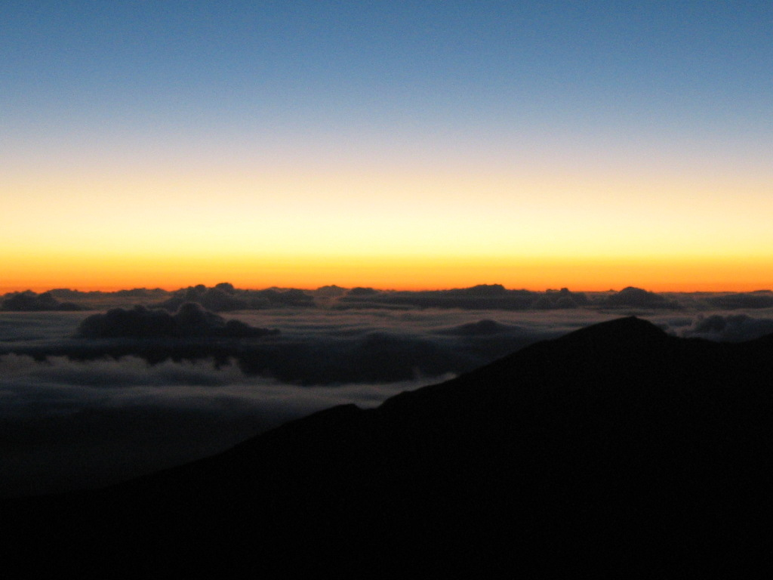
Sunrise? Or, Sunset?

Slide 15
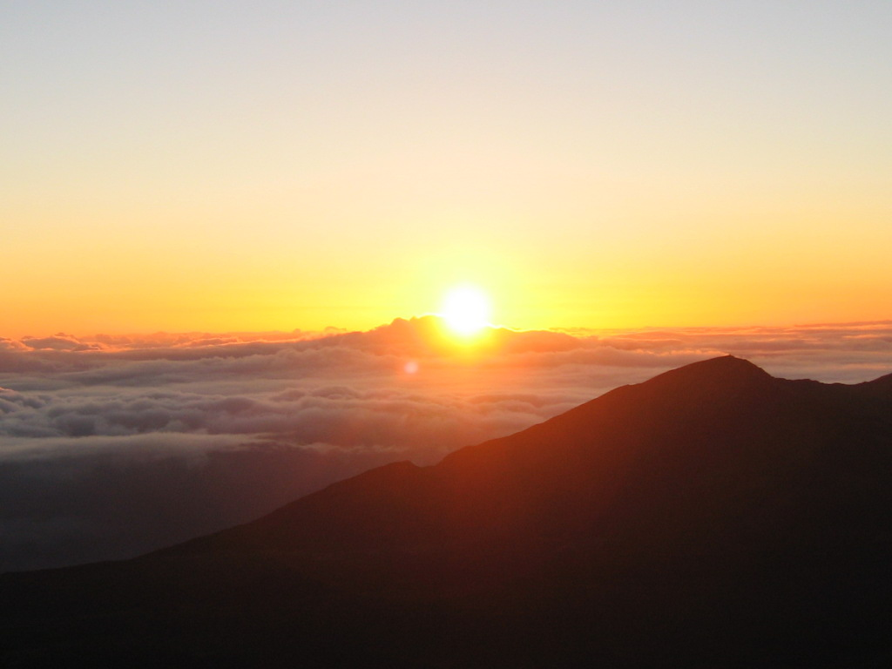
Sunrise!
30 Minutes Later

Slide 16
“Wisdom is justified by her children”
“But the path of the just is like the shining sun, That shines ever brighter unto the perfect day. The way of the wicked is like darkness; They do not know what makes them stumble.” (Proverbs 4:18-19)
“The Son of Man will send out His angels, and they will gather out of His kingdom all things that offend, and those who practice lawlessness, and will cast them into the furnace of fire. There will be wailing and gnashing of teeth. Then the righteous will shine forth as the sun in the kingdom of their Father. He who has ears to hear, let him hear!” (Matthew 13:41-43)

Slide 17
Justification by Faith Only?
How would you answer those, who say:
John 3:16 is all you need to know about salvation?
James ___:14-26 makes it clear that faith without _______ cannot justify.
Read Hebrews 11:4, 7-8, 17. How was the faith of Abel, Noah, and Abraham demonstrated?

Slide 18
Obedience = Legalism?
How would you answer those, who say:
To insist upon strict obedience to the Scriptures is Pharisaic legalism?
No one who abides in him keeps on sinning; no one who keeps on sinning has either seen him or known him. Little children, let no one deceive you. Whoever practices righteousness is righteous, as he is righteous. (I John 3:6-7 ESV)
See also: Romans 6:12-18

Slide 19
Obedience = Legalism?
How would you answer those, who say:
To insist upon strict obedience to the Scriptures is Pharisaic legalism?
Since we are saved by grace, it doesn’t matter if we obey the details of God’s law?
“Woe to you, scribes and Pharisees, hypocrites! For you pay tithe of mint and anise and cummin, and have neglected the weightier matters of the law: justice and mercy and faith. These you ought to have done, without leaving the others undone. Blind guides, who strain out a gnat and swallow a camel!” (Matthew 23:23-24)

Slide 20
Justification by Faith Only?
How would you answer those, who say:
John 3:16 is all you need to know about salvation?
James ___:14-26 makes it clear that faith without _______ cannot justify.

Slide 21
Justification by Faith Only?
What does it profit, my brethren, if someone says he has faith but does not have works? Can faith save him? If a brother or sister is naked and destitute of daily food, and one of you says to them, “Depart in peace, be warmed and filled,” but you do not give them the things which are needed for the body, what does it profit? Thus also faith by itself, if it does not have works, is dead. But someone will say, “You have faith, and I have works.” Show me your faith without your works, and I will show you my faith by my works. (James 2:14-18)
Is this dealing with our confirmation before men?

Slide 22
Justification by Faith Only?
You believe that there is one God. You do well. Even the demons believe – and tremble! But do you want to know, O foolish man, that faith without works is dead? Was not Abraham our father justified by works when he offered Isaac his son on the altar? Do you see that faith was working together with his works, and by works faith was made perfect? And the Scripture was fulfilled which says, “Abraham believed God, and it was accounted to him for righteousness.” And he was called the friend of God. (James 2:19-23)
What kind of life and death is under consideration?
Whose judgment is under consideration? God’s or man’s?

Slide 23
Justification by Faith Only?
You see then that a man is justified by works, and not by faith only. Likewise, was not Rahab the harlot also justified by works when she received the messengers and sent them out another way? For as the body without the spirit is dead, so faith without works is dead also. (James 2:22-26)
Can man please God or be saved with a “dead faith”?
But without faith it is impossible to please Him, for he who comes to God must believe that He is, and that He is a rewarder of those who diligently seek Him. (Hebrews 11:6)
See also: I Timothy 1:19-20

Slide 24
Lessons
Everyone is building a “house”.
The time to act is before the storm falls.
We will eventually either “dig deep” or “do nothing”.
Ignoring Jesus’ may appear to provide some short-term benefits. (It’s easier to build on sand, than dig down to the bedrock.)
The result of obeying Jesus’, thereby “building on the rock”, may not be readily apparent until the very end.
Wisdom hears and obeys.
Obedience is an indication of faith and grace, not exclusive.
May we each let this sermon sink deep into our hearts and obey!

