Slide 1
“Convicting Those Who Contradict”
Helping Saints Prepare to Answer and Persuade Those in Error

Slide 2
Calvinism
Section #3

Slide 3
What is Calvinism?
Sovereignty of God (The Soil of TULIP)
Total Inherited Depravity
Unconditional Election
Limited Atonement
Irresistible Grace
Perseverance of the Saints

Slide 4
Overview of Calvinism
Sovereignty – God is absolutely powerful, knowledgeable, and authoritative. All things exist in and by Him. He is the Sovereign ruler of all things. Therefore, He makes all decisions to the smallest detail. Who could choose contrary to Him?
Total Inherited Depravity – God has chosen that Adam, our federal head, would sin, thereby corrupting himself and his offspring, such that we are incapable of even willing good, much less doing good. We are wholly evil, wicked, and depraved from birth.
Unconditional Election – God has chosen by His secret, good pleasure to save some. Since we are wholly corrupt, there is obviously nothing good in us by which we can satisfy any condition; therefore, His choice is without condition.

Slide 5
Overview of Calvinism
Limited Atonement – Since God has chosen only a subset of humanity to be saved, Jesus’ atoning death was necessarily limited to the elect.
Irresistible Grace – Since the elect cannot thwart God’s will, and since they cannot save themselves, God graciously works directly on the elect before hearing the gospel to regenerate them and provide them an agreeable will through the direct operation of the Holy Spirit (aka, efficacious grace).
Perseverance of the Saints – Since God’s grace is sufficient to save the sinner, it is more than sufficient to maintain the saint. God’s will cannot be thwarted; therefore, the elect will persevere and be saved at last. (aka, “once saved, always saved”.)
Transferred (Imputed) Sin and Righteousness

Slide 6
Notable Names
Introduction

Slide 7
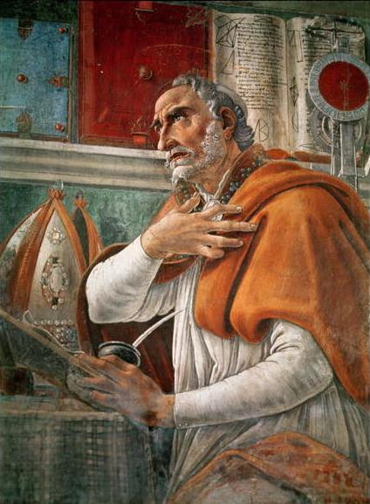
Augustine of Hippo
Bishop of North African city, Hippo
Lived 354 – 430 A.D. (75-years)
Raised Christian, lived pagan, converted to Manichaeism, and finally Catholic Christianity, 387
Saint, pillar, and doctor of the Catholic Church.
Original sin, man’s depravity, infant baptism, efficacious grace, predestination, and God’s Supremacy.

Slide 8
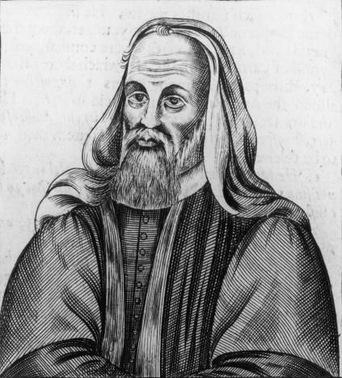
Pelagius
Briton, lived 354–420/440 A.D.
Quoted by Augustine.
Condemned heretic, 431 A.D.
Strict ascetic.
Free will and responsibility.
Disavowed inherited depravity.
Said man is basically good.
Believed Jesus’ death was exemplary, not atoning.
Taught possibility of choosing good apart from grace.

Slide 9
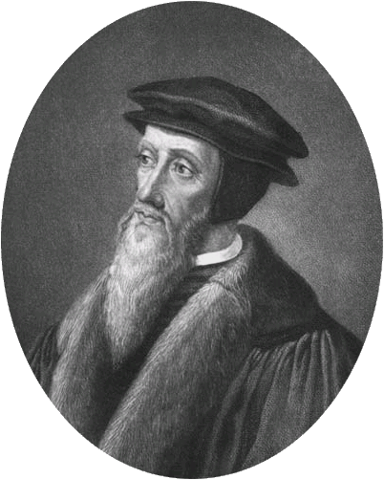
John Calvin
Lived 1509-1564.
French, but lived in Geneva.
Converted in 1533.
Crystallized Augustine’s views, formalizing a more self-consistent theology.
Institutes of the Christian Religion, 1536 (age 27)
Key to Protestant Reformation
Presbyterian and Reformed Church.

Slide 10
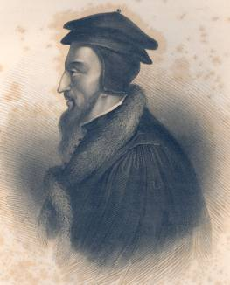
John Calvin
Expanded but never revised.
Prolific writer and speaker.
His teaching used as basis for:
Puritans’ Westminster Confession (used by Presbyterians)
Used government to enforce doctrine.
Notable, redeemable beliefs:
Sola Scriptura (Bible only)
Regulative Principle (vs. Normative)
Along with Augustine and Aquinas, identified as “Orthodoxy”.

Slide 11
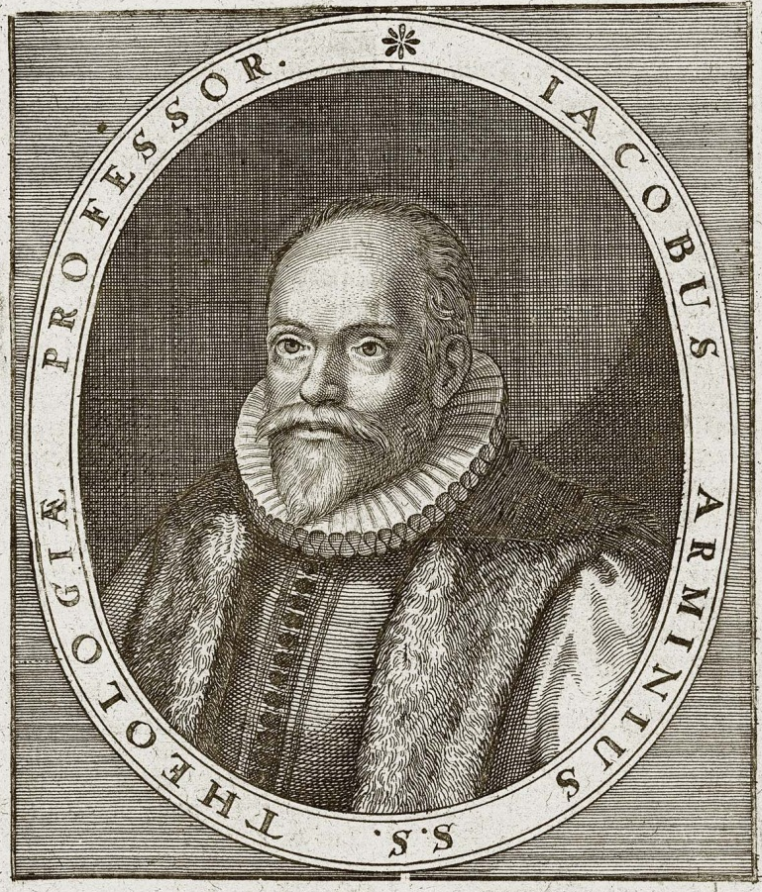
Jacobius Arminius
Dutch, Lived 1560-1609.
Taught by Theodore Beza.
Teachings were formalized by his followers, the Remonstrants in 1610:
Original sin
Conditional predestination
Universal intention of atonement.
Man cannot exercise saving faith.
Necessary grace, but resistible.
Can fall from grace.
Expelled at Synod of Dordrecht 1618.

Slide 12
Other Notable People
Thomas Aquinas, Summa Theologica (1225-1274)
Martin Luther, 95 Theses, Justification by Faith Alone (1483-1546) – Began “Protestant Reformation”
Theodore Beza, Calvin’s successor (1519-1604)
Luis Molina, Catholic attempt to reconcile free-will with predestination (1535-1600)
Simon Episcopius, Arminius’ successor (1583-1643)
John and Charles Wesley were Armenian (1703, 1707 – 1791, 1788), instrumental in founding Methodist Church.
R. C. Sproul, modern theologian and proponent of Hyper Calvinism (1939-), founder of Ligonier Ministries.

Slide 13
“Axe Laid to the Root …”
“Give me six hours to chop down a tree and I will spend the first four sharpening the axe.” – Abraham Lincoln
“If the ax is dull, And one does not sharpen the edge, Then he must use more strength; But wisdom brings success.” (Ecclesiastes 10:10)
Luke 3:9

Slide 14
Overcoming Barriers to Unity
Calvinism

Slide 15
Calvinism Is Orthodoxy?
“Calvin’s theology has been the definition of orthodoxy since the early church! How can you believe such a heretical, liberal view?”
“Soft answer turns away wrath” (Proverbs 15:1).
“What is our standard for truth?”
Opinions of majority (Luke 13:23-30; Matt. 7:13-14)?
Traditions of men (Matthew 15:1-9)?
“If continuity is standard, then why Reformation?”
“Is there really continuity?”
Logical Fallacy: Appeal to Authority

Slide 16
Earliest Uninspired Voices - #1
“Let some suppose, from what has been said by us, that we say that whatever occurs happens by a fatal necessity, because it is foretold as known beforehand, this too we explain. We have learned from the prophets, and we hold it to be true, that punishments, chastisements, and good rewards, are rendered according to the merit of each man’s actions. Now, if this is not so, but all things happen by fate, then neither is anything at all in our own power. For if it is predetermined that this man will be good, and this other man will be evil, neither is the first one meritorious nor the latter man to be blamed. And again, unless the human race has the power of avoiding evil and choosing good by free choice, they are not accountable for their actions.” (Justin Martyr, AD 100-165)

Slide 17
Earliest Uninspired Voices - #2
“I have proved in what has been said that those who were foreknown to be unrighteous, whether men or angels, are not made wicked by God’s fault. Rather, each man is what he will appear to be through his own fault.” (Justin Martyr, AD 100-165)
“We…have believed and are saved by voluntary choice.” (Clement of Alexandria, AD 150-211/216)

Slide 18
Earliest Uninspired Voices - #3
“We were not created to die. Rather, we die by our own fault. Our free will has destroyed us. We who were free have become slaves. We have been sold through sin. Nothing evil has been created by God. We ourselves have manifested wickedness. But we, who have manifested it, are able again to reject it.” (Tatian, AD 120-180)
“‘Let your light so shine before men, that they may see your good deeds’…And ‘Why call me, Lord, Lord, and do not do the things that I say?’ … All such passages demonstrate the independent will of man … For it is in man’s power to disobey God and to forfeit what is good.” (Irenaeus, AD 115/142-202)

Slide 19
Earliest Uninspired Voices - #4
“I find, then, that man was constituted free by God. He was master of his own will and power…For a law would not be imposed upon one who did not have it in his power to render that obedience which is due to law. Nor again, would the penalty of death be threatened against sin, if a contempt of the law were impossible to man in the liberty of his will … Man is free, with a will either for obedience or resistance.” (Tertullian, c.a. AD 160-220)
“If a man were created evil, he would not deserve punishment, since he was not evil of himself, being unable to do anything else than what he was made for.” (Justin Martyr, AD 100-165)

Slide 20
Earliest Uninspired Voices - #5
“The Scriptures … emphasize the freedom of the will. They condemn those who sin, and approve those who do right… We are responsible for being bad and worthy of being cast outside. For it is not the nature in us that is the cause of the evil; rather, it is the voluntary choice that works evil.” (Origen, AD 185-254)
“If anyone is truly religious, he is a man of God; but if he is irreligious, he is a man of the devil, made such, not by nature, but by his own choice.” (Ignatius, AD 35/50 – 98/117)

Slide 21
Earliest Uninspired Voices - #6
“Those who do not do it [good] will receive the just judgment of God, because they had not worked good when they had it in their power to do so. But if some had been made by nature bad, and others good, these latter would not be deserving of praise for being good, for they were created that way. Nor would the former be reprehensible, for that is how they were made. However, all men are of the same nature. They are all able to hold fast and to go what is good. On the other hand, they have the power to cast good from them and not to do it.” (Irenaeus, AD 115/142-202)

Slide 22
Indiscernible Mystery?
“God is absolutely sovereign, but man is absolutely responsible for his sins. This is a divine paradox and mystery. It cannot be understood or reconciled by our limited human mind, but it must be accepted and believed. Who are we to question God (Romans 9:20)?”
Not questioning God, rather one man’s definition of God.
Claim denies rational nature of God and objective truth (Isaiah 1:18; 41:21; Acts 17:17; 26:25).
Claim denies God’s Word can be understood (Eph. 3:4)

Slide 23
Demonstration of Just Nature
“… being justified freely by His grace through the redemption that is in Christ Jesus, whom God set forth as a propitiation by His blood, through faith, to demonstrate His righteousness, because in His forbearance God had passed over the sins that were previously committed, to demonstrate at the present time His righteousness, that He might be just and the justifier of the one who has faith in Jesus.” (Romans 3:24-26; see also, verse 4)
Intended to see righteous and just nature in cross.
Failure means we have our eyes closed. ☺

Slide 24
Only Academic?
“Ahhh, pshaw, this is a completely academic discussion. People have been arguing about this for hundreds of years. We will never be able to settle this. We can ask God to explain this when we get to heaven, but otherwise, don’t worry about it.”
Embraces division, which God condemns (I Corinthians 1:10-13; Ephesians 4:1-6).
Overlooks that justification is the means of our salvation (Acts 19:1-5; Hebrews 6:1-2; I Peter 3:21).
Overlooks danger of speaking wrongly about God …

Slide 25
“Not Spoken of Me … Right”
… the LORD said to Eliphaz the Temanite, “My wrath is aroused against you and your two friends, for you have not spoken of Me what is right, as My servant Job has. Now therefore, take for yourselves seven bulls and seven rams, go to My servant Job, and offer up for yourselves a burnt offering; and My servant Job shall pray for you. For I will accept him, lest I deal with you according to your folly; because you have not spoken of Me what is right, as My servant Job has.” So Eliphaz the Temanite and Bildad the Shuhite and Zophar the Naamathite went and did as the LORD commanded them; for the LORD had accepted Job. (Job 42:7-9)

Slide 26
References
Brents, T. W., The Gospel Plan of Salvation, 1874. Reprinted: 17th Edition, Guardian of Truth Foundation, Bowling Green, Kentucky, 1987.
Harkrider, Robert, Basic Bible Doctrine, Book 3, Impressive Image Production, Russellville, Alabama, 1987.
Roberts, Tom, Neo-Calvinism In The Churches of Christ, Cogdill Foundation, Fairmount, Indiana, 1980.
Shank, Robert, Elect in the Son: A Study of the Doctrine of Election, Bethany House Publishers, Bloomington, Minnesota, 1970, 1989.
Shank, Robert, Life in the Son: A Study of the Doctrine of Perseverance, Bethany House Publishers, Bloomington, Minnesota, 1960, 1961, 1989.
Waldron, Bob, Lesson Book on Calvinism, Unpublished & Incomplete Draft, February 2009.
Whiteside, Robertson L, A New Commentary on Paul’s Letter to the Saints at Rome, Guardian of Truth Press, Dallas, TX, 1976.

