Slide 1
Greetings, Blessings, and Confidence
Lesson 2 – II Corinthians 1:1-14

Slide 2
Why II Corinthians?
I Corinthians was a difficult letter to write and receive.
Judaizing, false apostles had infiltrated Corinth.
Discouraged Corinthians needed strengthening.
Compromised Corinthians needed correcting.
False teachers needed to be sent packing.
Paul’s authority needed to be reestablished, and relationship rebuilt.
Quick Review: II Corinthians 1:1-11 …

Slide 3
Mutual Boasting
What was the subject of Paul’s boasting? Explain this mutual boasting.
For our boasting is this: the testimony of our conscience that we conducted ourselves in the world in ¹simplicity and ²godly sincerity, not with fleshly wisdom but ³by the grace of God, and more abundantly toward you. For we are not writing any other things to you than what you read or understand. Now I trust you will understand, even to the end (as also you have understood us in part), that we are your boast as ⁴you also are ours, in the day of the Lord Jesus. (1:12-14)
Our conscience testifies to us and God (Rom. 2:15; I Cor. 4:5).

Slide 4
Mutual Boasting
What was the subject of Paul’s boasting? Explain this mutual boasting.
How can you boast in that which you have no option?
Paul chose the path of transparency, sincerity, integrity, and faith.
He chose to persuade using God’s wisdom and power, not human.
When judged by Jesus, the Corinthians would defend their actions based on Paul’s gospel and teaching (I John 1:1-3).
Paul’s faithfulness would be proven by his work with the Corinthians (Matthew 25:14-30).
What should our motives be? Might we have to defend our motives?

Slide 5
Confident … But Concerned
For we are not writing any other things to you than what you read or understand. Now I trust you will understand, even to the end (as also you have understood us in part), that we are your boast as you also are ours, in the day of the Lord Jesus. (1:13-14)
How could Paul have been confident in them, given the correction already delivered in I Corinthians and that which was still to be delivered in II Corinthians?
Concerned they were being “deceived” by false teachers (11:3-4).
Confident they would repent and persevere, if taught accurately.
Similar to parent’s trust in child’s heart, despite foreseen pitfalls.

Slide 6
Review
Through Paul’s sufferings and comfort, the Corinthians could be saved and comforted by Paul’s teaching and example of hope.
Paul learned (and we should too) to trust in God no matter what – even if he thought he would die!
The Corinthians’ care was expressed through prayers for deliverance, which should have strengthened common bond.
Paul had operated according transparency, sincerity, and spiritual wisdom – not the tactics of men. Not writing deceitfully.
Paul had begun to express confidence in the Corinthians. Would they share the same confidence in themselves and him?

Slide 7
Defense of Paul’s Character
Lesson 3 – II Corinthians 1:15-2:13

Slide 8
Defending Change in Plans
Based on Paul’s defense found in 1:15-17, what apparent event did he have to explain?
And in this confidence I intended to come to you before, that you might have a second benefit – to pass by way of you to Macedonia, to come again from Macedonia to you, and be helped by you on my way to Judea. Therefore, when I was planning this, did I do it lightly? Or the things I plan, do I plan according to the flesh, that with me there should be Yes, Yes, and No, No? (1:15-17)
Change in plans regarding his double-visit to Corinth.
No equivocation, deceit, or fickleness with Paul’s speech.

Slide 9
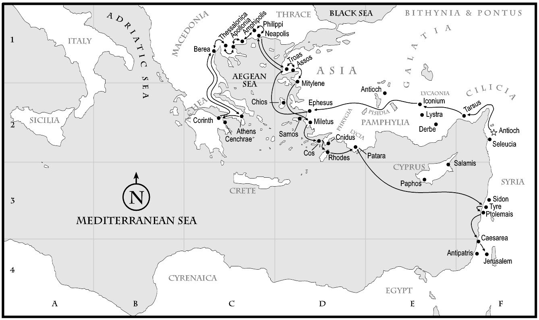
Paul’s 3rd Missionary Journey

Slide 10
Defending Dependability of Gospel
How might this have affected the Corinthians’ faith, based upon Paul’s continued apology?
But as God is faithful, our word to you was not Yes and No. For the Son of God, Jesus Christ, who was preached among you by us – by me, Silvanus, and Timothy – was not Yes and No, but in Him was Yes. For all the promises of God in Him are Yes, and in Him Amen, to the glory of God through us. (1:18-20)
Apparently, disappointment in Paul’s personal promises weakened the credibility of God’s promises spoken by Paul.
Paul distinguishes the two, destroying attempts to link the two.

Slide 11
“Spirit … given us … in our hearts”
What purpose was served by the “Spirit … given us … in our hearts” (1:22)? How does it fit in the context?
For all the promises of God in Him are Yes, and in Him Amen, to the glory of God through us. Now He who establishes us with you in Christ and has anointed us is God, who also has sealed us and given us the Spirit in our hearts as a guarantee. (1:20-22)
It was provided “as a guarantee” – not from Paul, but from God.
Figurative indication of commitment through downpayment, pledge.
Instill confidence in God’s promises: Paul was established with them!
Given distinction between “us” and “you”, may be apostolic gift.

Slide 12
Appendix A – “The Guarantee of the Spirit”, 1:22, 5:5
Possibly Discuss Identity Later

Slide 13
Purpose of “God as witness”
What is the purpose of Paul’s curious statement in 1:23? Did Paul use an oath by “calling God into witness”?
Moreover I call God as witness against my soul, that to spare you I came no more to Corinth. (1:23)
Contextual Point: Be certain (“moreover”, continuing point) that Paul’s reluctance was for the Corinthians’ benefit (“to spare you”)!
How could Paul’s statement generate confidence and certainty?
Depended upon God examining his otherwise unverifiable motives and testifying for Paul to the Corinthians. … How testify?

