Slide 1
LESSONS FROM PAUL

Slide 2
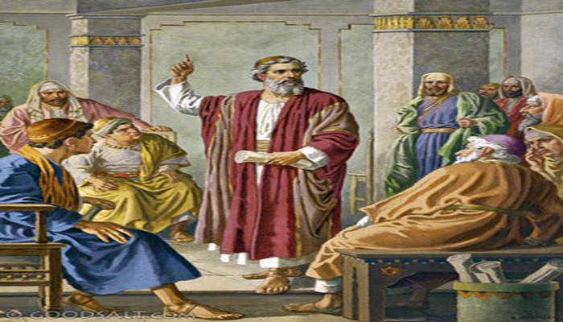
Lessons from Paul
Paul was a dedicated, hard worker
Instilled to study hard. Acts 22:3 ; 5:34

Slide 3
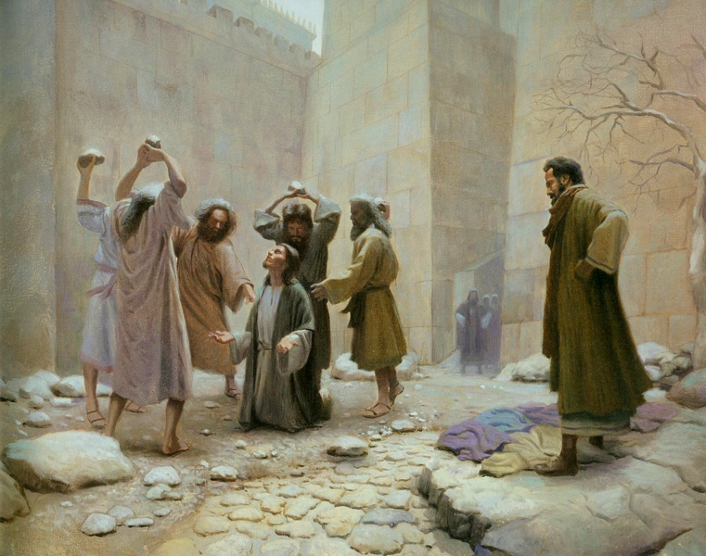
Lessons from Paul
Paul was a dedicated, hard worker
Instilled to study hard. Acts 22:3 ; 5:34
Zealous young man. Acts 7:57,58

Slide 4
Lessons from Paul
Paul was a dedicated, hard worker
Instilled to study hard. Acts 22:3 ; 5:34
Zealous young man. Acts 7:57,58
REMEMBER NOW THY CREATOR
ECCL. 12:1

Slide 5
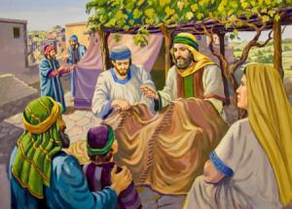
Lessons from Paul
Labored with his hands. Acts 20:33-35; 18:1-3
Eccl.9:10

Slide 6
Glory in Tribulations….Romans 5:3-4

Slide 7
Imprisonment…Acts 16:23

Slide 8
Shipwrecked…. Acts 27,28

Slide 9
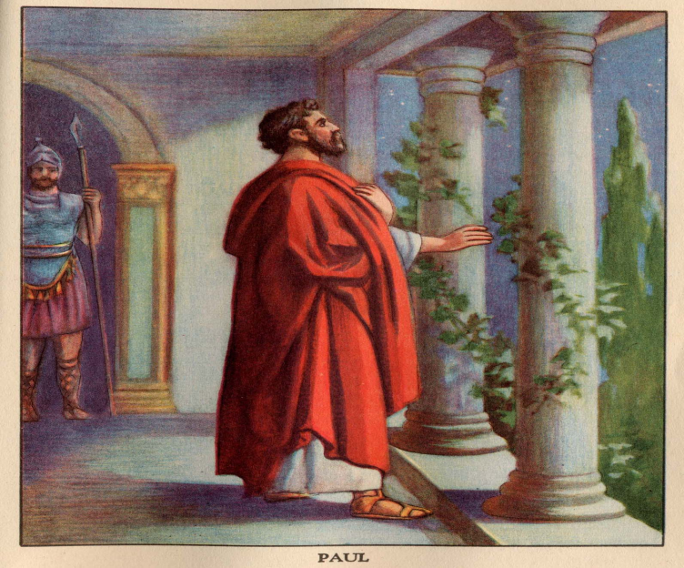
Thankfulness for the brethren. Phil. 1:3; Col.1:3

Slide 10
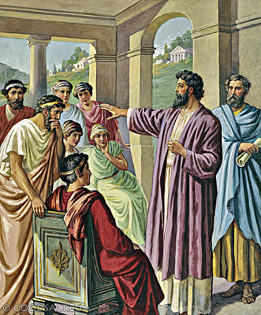
Taught,
and many
believed.
Acts 17:1-5

Slide 11
Lessons from Paul
Never give up: press on to the goal. Phil.3:12-16

Slide 12
Lessons from Paul
“Imitate me, just as I also imitate Christ.” I Cor. 11:1

Slide 13
Conclusion
Remember, Paul was a man.
Paul was content. Phil. 4:11-13
Paul’s admonition to Christians. Rom.12:9-12
Paul’s determination. II Cor. 4: 7-15

