Slide 1
Galatians

Slide 2
Galatians
Written by Paul
Acts 16:6 Now when they had gone through Phrygia and the region of Galatia, they were forbidden by the Holy Spirit to preach the word in Asia.
Acts 18:23 After he had spent some time there, he departed and went over the region of Galatia and Phrygia in order, strengthening all the disciples.
Likely written from Ephesus or Corinth around 52-53 A.D.

Slide 3
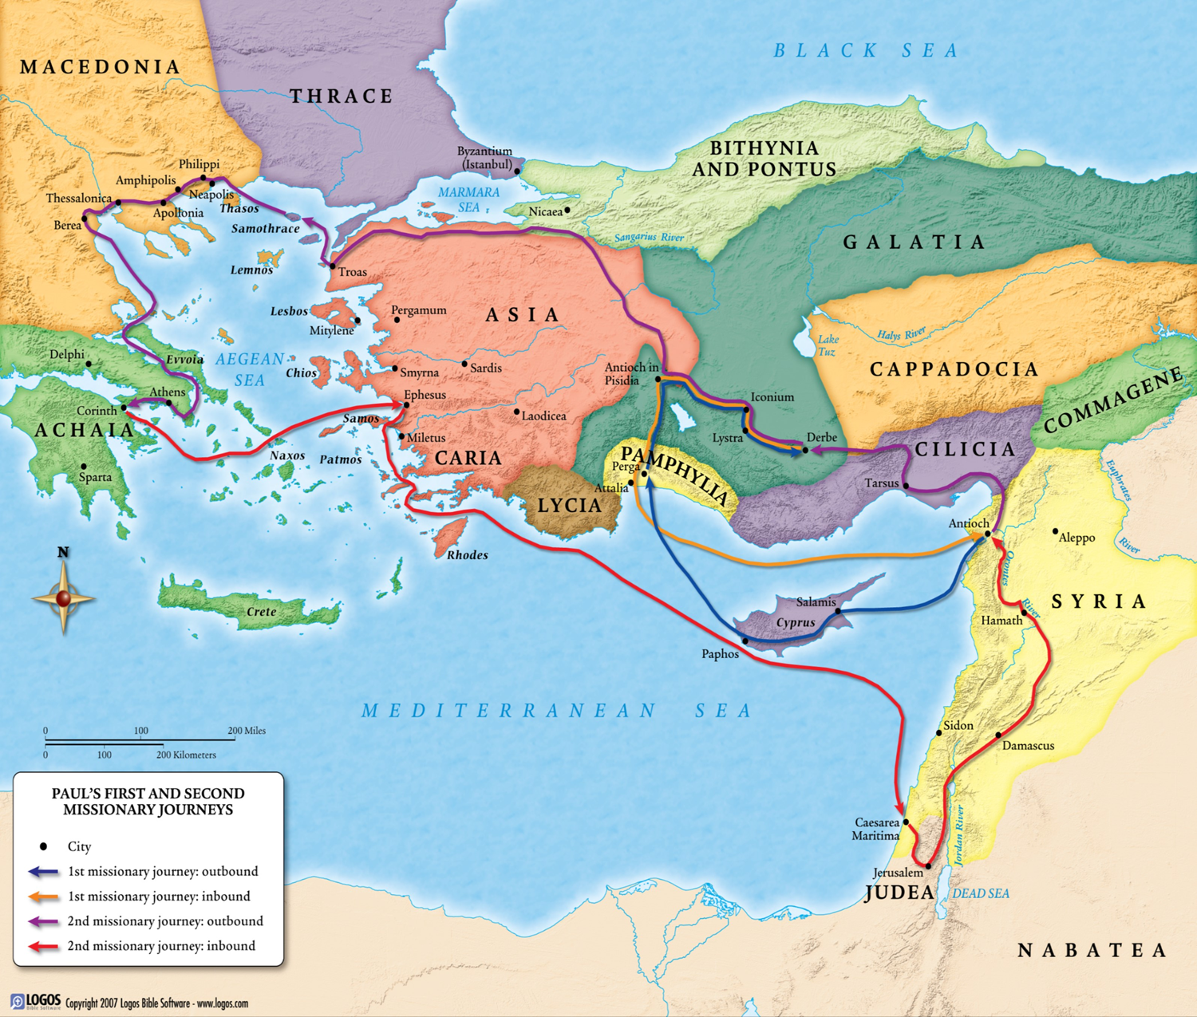

Slide 4
Galatians
Chapter 1
  Greeting
  Warning about another gospel
  Paul's call and history
Chapter 2
  Paul's mission to the gentiles
  Conflict over the old law
  Freedom from the old law

Slide 5
Galatians
Chapter 3
  Faith and the Law
  The seed of Abraham
Chapter 4
  Sons of God
  Children of Promise

Slide 6
Galatians
Chapter 5
  Liberty, love and the Spirit
Chapter 6
  Love and Generosity

Slide 7
Chapter 1
1 Paul, an apostle (not from men nor through man, but through Jesus Christ and God the Father who raised Him from the dead), 2 and all the brethren who are with me,
To the churches of Galatia:
3 Grace to you and peace from God the Father and our Lord Jesus Christ, 4 who gave Himself for our sins, that He might deliver us from this present evil age, according to the will of our God and Father, 5 to whom be glory forever and ever. Amen.

Slide 8
Chapter 1
6 I marvel that you are turning away so soon from Him who called you in the grace of Christ, to a different gospel, 7 which is not another; but there are some who trouble you and want to pervert the gospel of Christ. 8 But even if we, or an angel from heaven, preach any other gospel to you than what we have preached to you, let him be accursed. 9 As we have said before, so now I say again, if anyone preaches any other gospel to you than what you have received, let him be accursed.

Slide 9
Perverting the Gospel
Trying to fuse the old law with Christianity
A lot of criticism of Christianity is not at what it really is but at what it was perverted to become

Slide 10
The finality of the Gospel
Jude 3 Beloved, while I was very diligent to write to you concerning our common salvation, I found it necessary to write to you exhorting you to contend earnestly for the faith which was once for all delivered to the saints.

Slide 11
Chapter 1
10 For do I now persuade men, or God? Or do I seek to please men? For if I still pleased men, I would not be a bondservant of Christ.
11 But I make known to you, brethren, that the gospel which was preached by me is not according to man. 12 For I neither received it from man, nor was I taught it, but it came through the revelation of Jesus Christ.
13 For you have heard of my former conduct in Judaism, how I persecuted the church of God beyond measure and tried to destroy it. 14 And I advanced in Judaism beyond many of my contemporaries in my own nation, being more exceedingly zealous for the traditions of my fathers.

Slide 12
Chapter 1
15 But when it pleased God, who separated me from my mother’s womb and called me through His grace, 16 to reveal His Son in me, that I might preach Him among the Gentiles, I did not immediately confer with flesh and blood, 17 nor did I go up to Jerusalem to those who were apostles before me; but I went to Arabia, and returned again to Damascus.

Slide 13
Qualification of Apostles
Acts 1:21 “Therefore, of these men who have accompanied us all the time that the Lord Jesus went in and out among us, 22 beginning from the baptism of John to that day when He was taken up from us, one of these must become a witness with us of His resurrection.”

Slide 14
Chapter 1
18 Then after three years I went up to Jerusalem to see Peter, and remained with him fifteen days. 19 But I saw none of the other apostles except James, the Lord’s brother. 20 (Now concerning the things which I write to you, indeed, before God, I do not lie.)
21 Afterward I went into the regions of Syria and Cilicia. 22 And I was unknown by face to the churches of Judea which were in Christ. 23 But they were hearing only, “He who formerly persecuted us now preaches the faith which he once tried to destroy.” 24 And they glorified God in me.

Slide 15
Chapter 2
1 Then after fourteen years I went up again to Jerusalem with Barnabas, and also took Titus with me. 2 And I went up by revelation, and communicated to them that gospel which I preach among the Gentiles, but privately to those who were of reputation, lest by any means I might run, or had run, in vain. 3 Yet not even Titus who was with me, being a Greek, was compelled to be circumcised. 4 And this occurred because of false brethren secretly brought in (who came in by stealth to spy out our liberty which we have in Christ Jesus, that they might bring us into bondage), 5 to whom we did not yield submission even for an hour, that the truth of the gospel might continue with you.

Slide 16
Acts 15
And certain men came down from Judea and taught the brethren, “Unless you are circumcised according to the custom of Moses, you cannot be saved.” 2 Therefore, when Paul and Barnabas had no small dissension and dispute with them, they determined that Paul and Barnabas and certain others of them should go up to Jerusalem, to the apostles and elders, about this question.

Slide 17
Chapter 2
6 But from those who seemed to be something—whatever they were, it makes no difference to me; God shows personal favoritism to no man—for those who seemed to be something added nothing to me. 7 But on the contrary, when they saw that the gospel for the uncircumcised had been committed to me, as the gospel for the circumcised was to Peter 8 (for He who worked effectively in Peter for the apostleship to the circumcised also worked effectively in me toward the Gentiles), 9 and when James, Cephas, and John, who seemed to be pillars, perceived the grace that had been given to me, they gave me and Barnabas the right hand of fellowship, that we should go to the Gentiles and they to the circumcised. 10 They desired only that we should remember the poor, the very thing which I also was eager to do.

Slide 18
Chapter 2
11 Now when Peter had come to Antioch, I withstood him to his face, because he was to be blamed; 12 for before certain men came from James, he would eat with the Gentiles; but when they came, he withdrew and separated himself, fearing those who were of the circumcision. 13 And the rest of the Jews also played the hypocrite with him, so that even Barnabas was carried away with their hypocrisy.

Slide 19
Chapter 2
14 But when I saw that they were not straightforward about the truth of the gospel, I said to Peter before them all, “If you, being a Jew, live in the manner of Gentiles and not as the Jews, why do you compel Gentiles to live as Jews? 15 We who are Jews by nature, and not sinners of the Gentiles, 16 knowing that a man is not justified by the works of the law but by faith in Jesus Christ, even we have believed in Christ Jesus, that we might be justified by faith in Christ and not by the works of the law; for by the works of the law no flesh shall be justified.

Slide 20
Chapter 2
We are not under the old law
You should not act like the old law is in force
Lessons in confronting error
  Sometimes things need to be done publicly
  Matt 18

Slide 21
Confronting error
Matt. 18:15 “Moreover if your brother sins against you, go and tell him his fault between you and him alone. If he hears you, you have gained your brother. 16 But if he will not hear, take with you one or two more, that ‘by the mouth of two or three witnesses every word may be established.’ 17 And if he refuses to hear them, tell it to the church. But if he refuses even to hear the church, let him be to you like a heathen and a tax collector.

Slide 22
Confronting error
Gal. 6:1 Brethren, if a man is overtaken in any trespass, you who are spiritual restore such a one in a spirit of gentleness, considering yourself lest you also be tempted.

Slide 23
Confronting error
Titus 1:8 but hospitable, a lover of what is good, sober-minded, just, holy, self-controlled, 9 holding fast the faithful word as he has been taught, that he may be able, by sound doctrine, both to exhort and convict those who contradict.
10 For there are many insubordinate, both idle talkers and deceivers, especially those of the circumcision, 11 whose mouths must be stopped, who subvert whole households, teaching things which they ought not, for the sake of dishonest gain.

Slide 24
Confronting error
2 Thess. 3:14 And if anyone does not obey our word in this epistle, note that person and do not keep company with him, that he may be ashamed. 15 Yet do not count him as an enemy, but admonish him as a brother.

Slide 25
Reconciliation
2 Peter 3:15 and consider that the longsuffering of our Lord is salvation—as also our beloved brother Paul, according to the wisdom given to him, has written to you,

Slide 26
Chapter 2
14 But when I saw that they were not straightforward about the truth of the gospel, I said to Peter before them all, “If you, being a Jew, live in the manner of Gentiles and not as the Jews, why do you compel Gentiles to live as Jews? 15 We who are Jews by nature, and not sinners of the Gentiles, 16 knowing that a man is not justified by the works of the law but by faith in Jesus Christ, even we have believed in Christ Jesus, that we might be justified by faith in Christ and not by the works of the law; for by the works of the law no flesh shall be justified.

Slide 27
Chapter 2
16 Knowing that a man is not justified by the works of the law, but by the faith of Jesus Christ, even we have believed in Jesus Christ, that we might be justified by the faith of Christ, and not by the works of the law: for by the works of the law shall no flesh be justified. KVJ

Slide 28
Chapter 2
17 “But if, while we seek to be justified by Christ, we ourselves also are found sinners, is Christ therefore a minister of sin? Certainly not! 18 For if I build again those things which I destroyed, I make myself a transgressor. 19 For I through the law died to the law that I might live to God. 20 I have been crucified with Christ; it is no longer I who live, but Christ lives in me; and the life which I now live in the flesh I live by faith in the Son of God, who loved me and gave Himself for me. 21 I do not set aside the grace of God; for if righteousness comes through the law, then Christ died in vain.”

Slide 29
Chapter 3
1 O foolish Galatians! Who has bewitched you that you should not obey the truth, before whose eyes Jesus Christ was clearly portrayed among you as crucified? 2 This only I want to learn from you: Did you receive the Spirit by the works of the law, or by the hearing of faith? 3 Are you so foolish? Having begun in the Spirit, are you now being made perfect by the flesh? 4 Have you suffered so many things in vain—if indeed it was in vain?

Slide 30
Chapter 3
5 Therefore He who supplies the Spirit to you and works miracles among you, does He do it by the works of the law, or by the hearing of faith?— 6 just as Abraham “believed God, and it was accounted to him for righteousness.” 7 Therefore know that only those who are of faith are sons of Abraham. 8 And the Scripture, foreseeing that God would justify the Gentiles by faith, preached the gospel to Abraham beforehand, saying, “In you all the nations shall be blessed.” 9 So then those who are of faith are blessed with believing Abraham.
  Genesis 15:6; Genesis 12:3; 18:18; 22:18; 26:4; 28:14

Slide 31
Chapter 3
10 For as many as are of the works of the law are under the curse; for it is written, “Cursed is everyone who does not continue in all things which are written in the book of the law, to do them.” 11 But that no one is justified by the law in the sight of God is evident, for “the just shall live by faith.” 12 Yet the law is not of faith, but “the man who does them shall live by them.”
13 Christ has redeemed us from the curse of the law, having become a curse for us (for it is written, “Cursed is everyone who hangs on a tree”), 14 that the blessing of Abraham might come upon the Gentiles in Christ Jesus, that we might receive the promise of the Spirit through faith.
  Deuteronomy 27:26;Habakkuk 2:4;Leviticus 18:5;Deuteronomy 21:23

Slide 32
Chapter 3
15 Brethren, I speak in the manner of men: Though it is only a man’s covenant, yet if it is confirmed, no one annuls or adds to it. 16 Now to Abraham and his Seed were the promises made. He does not say, “And to seeds,” as of many, but as of one, “And to your Seed,” who is Christ. 17 And this I say, that the law, which was four hundred and thirty years later, cannot annul the covenant that was confirmed before by God in Christ, that it should make the promise of no effect. 18 For if the inheritance is of the law, it is no longer of promise; but God gave it to Abraham by promise.
15 –ESV- To give a human example, brothers:6 even with a man-made covenant, no one annuls it or adds to it once it has been ratified.
Genesis 12:7; 13:15; 24:7

Slide 33
Chapter 3
19 What purpose then does the law serve? It was added because of transgressions, till the Seed should come to whom the promise was made; and it was appointed through angels by the hand of a mediator. 20 Now a mediator does not mediate for one only, but God is one.
21 Is the law then against the promises of God? Certainly not! For if there had been a law given which could have given life, truly righteousness would have been by the law. 22 But the Scripture has confined all under sin, that the promise by faith in Jesus Christ might be given to those who believe. 23 But before faith came, we were kept under guard by the law, kept for the faith which would afterward be revealed. 24 Therefore the law was our tutor to bring us to Christ, that we might be justified by faith. 25 But after faith has come, we are no longer under a tutor.

Slide 34
By angels
Acts 7:51 “You stiff-necked and uncircumcised in heart and ears! You always resist the Holy Spirit; as your fathers did, so do you. 52 Which of the prophets did your fathers not persecute? And they killed those who foretold the coming of the Just One, of whom you now have become the betrayers and murderers, 53 who have received the law by the direction of angels and have not kept it.”

Slide 35
παιδαγωγός
a tutor i.e. a guardian and guide of boys. Among the Greeks and the Romans the name was applied to trustworthy slaves who were charged with the duty of supervising the life and morals of boys belonging to the better class. The boys were not allowed so much as to step out of the house without them before arriving at the age of manhood.
Romans 15:4 For whatever things were written before were written for our learning, that we through the patience and comfort of the Scriptures might have hope.
Heb 8:13 In that He says, “A new covenant,” He has made the first obsolete. Now what is becoming obsolete and growing old is ready to vanish away.

Slide 36
Chapter 3
26 For you are all sons of God through faith in Christ Jesus. 27 For as many of you as were baptized into Christ have put on Christ. 28 There is neither Jew nor Greek, there is neither slave nor free, there is neither male nor female; for you are all one in Christ Jesus. 29 And if you are Christ’s, then you are Abraham’s seed, and heirs according to the promise.

Slide 37
Chapter 4
1 Now I say that the heir, as long as he is a child, does not differ at all from a slave, though he is master of all, 2 but is under guardians and stewards until the time appointed by the father. 3 Even so we, when we were children, were in bondage under the elements of the world. 4 But when the fullness of the time had come, God sent forth His Son, born of a woman, born under the law, 5 to redeem those who were under the law, that we might receive the adoption as sons.
6 And because you are sons, God has sent forth the Spirit of His Son into your hearts, crying out, “Abba, Father!” 7 Therefore you are no longer a slave but a son, and if a son, then an heir of God through Christ.

Slide 38
Chapter 4
Col. 2:8 Beware lest anyone cheat you through philosophy and empty deceit, according to the tradition of men, according to the basic principles of the world, and not according to Christ.
“Fullness of the time….”
Abba Father

Slide 39
Chapter 4
8 But then, indeed, when you did not know God, you served those which by nature are not gods. 9 But now after you have known God, or rather are known by God, how is it that you turn again to the weak and beggarly elements, to which you desire again to be in bondage? 10 You observe days and months and seasons and years. 11 I am afraid for you, lest I have labored for you in vain.

Slide 40
Chapter 4
Col. 2:16 So let no one judge you in food or in drink, or regarding a festival or a new moon or sabbaths, 17 which are a shadow of things to come, but the substance is of Christ.

Slide 41
Chapter 4
12 Brethren, I urge you to become like me, for I became like you. You have not injured me at all. 13 You know that because of physical infirmity I preached the gospel to you at the first. 14 And my trial which was in my flesh you did not despise or reject, but you received me as an angel of God, even as Christ Jesus. 15 What then was the blessing you enjoyed? For I bear you witness that, if possible, you would have plucked out your own eyes and given them to me. 16 Have I therefore become your enemy because I tell you the truth?

Slide 42
Paul’s infirmity
6:11 See with what large letters I have written to you with my own hand!
Acts 23:1 Then Paul, looking earnestly at the council, said, “Men and brethren, I have lived in all good conscience before God until this day.” 2 And the high priest Ananias commanded those who stood by him to strike him on the mouth. 3 Then Paul said to him, “God will strike you, you whitewashed wall! For you sit to judge me according to the law, and do you command me to be struck contrary to the law?”
4 And those who stood by said, “Do you revile God’s high priest?”
5 Then Paul said, “I did not know, brethren, that he was the high priest; for it is written, ‘You shall not speak evil of a ruler of your people.’”

Slide 43
Paul’s infirmity
2 Cor. 12:7 And lest I should be exalted above measure by the abundance of the revelations, a thorn in the flesh was given to me, a messenger of Satan to buffet me, lest I be exalted above measure. 8 Concerning this thing I pleaded with the Lord three times that it might depart from me. 9 And He said to me, “My grace is sufficient for you, for My strength is made perfect in weakness.” Therefore most gladly I will rather boast in my infirmities, that the power of Christ may rest upon me. 10 Therefore I take pleasure in infirmities, in reproaches, in needs, in persecutions, in distresses, for Christ’s sake. For when I am weak, then I am strong.

Slide 44
Chapter 4
12 Brethren, I urge you to become like me, for I became like you. You have not injured me at all. 13 You know that because of physical infirmity I preached the gospel to you at the first. 14 And my trial which was in my flesh you did not despise or reject, but you received me as an angel of God, even as Christ Jesus. 15 What then was the blessing you enjoyed? For I bear you witness that, if possible, you would have plucked out your own eyes and given them to me. 16 Have I therefore become your enemy because I tell you the truth?

Slide 45
Chapter 4
17 They zealously court you, but for no good; yes, they want to exclude you, that you may be zealous for them. 18 But it is good to be zealous in a good thing always, and not only when I am present with you. 19 My little children, for whom I labor in birth again until Christ is formed in you, 20 I would like to be present with you now and to change my tone; for I have doubts about you.

Slide 46
Chapter 4
21 Tell me, you who desire to be under the law, do you not hear the law? 22 For it is written that Abraham had two sons: the one by a bondwoman, the other by a freewoman. 23 But he who was of the bondwoman was born according to the flesh, and he of the freewoman through promise, 24 which things are symbolic. For these are the two covenants: the one from Mount Sinai which gives birth to bondage, which is Hagar— 25 for this Hagar is Mount Sinai in Arabia, and corresponds to Jerusalem which now is, and is in bondage with her children— 26 but the Jerusalem above is free, which is the mother of us all.

Slide 47
Our Mother Church
Heb. 12:22 But you have come to Mount Zion and to the city of the living God, the heavenly Jerusalem, to an innumerable company of angels, 23 to the general assembly and church of the firstborn who are registered in heaven, to God the Judge of all, to the spirits of just men made perfect, 24 to Jesus the Mediator of the new covenant, and to the blood of sprinkling that speaks better things than that of Abel.

Slide 48
Chapter 4
27 For it is written:
“Rejoice, O barren,
You who do not bear!
Break forth and shout,
You who are not in labor!
For the desolate has many more children
Than she who has a husband.”
28 Now we, brethren, as Isaac was, are children of promise. 29 But, as he who was born according to the flesh then persecuted him who was born according to the Spirit, even so it is now. 30 Nevertheless what does the Scripture say? “Cast out the bondwoman and her son, for the son of the bondwoman shall not be heir with the son of the freewoman.” 31 So then, brethren, we are not children of the bondwoman but of the free.
  Isaiah 54:1;Genesis 21:10

Slide 49
Flesh and Spirit
1 John 3:13 Do not marvel, my brethren, if the world hates you.

Slide 50
Chapter 5
1 Stand fast therefore in the liberty by which Christ has made us free, and do not be entangled again with a yoke of bondage. 2 Indeed I, Paul, say to you that if you become circumcised, Christ will profit you nothing. 3 And I testify again to every man who becomes circumcised that he is a debtor to keep the whole law. 4 You have become estranged from Christ, you who attempt to be justified by law; you have fallen from grace. 5 For we through the Spirit eagerly wait for the hope of righteousness by faith. 6 For in Christ Jesus neither circumcision nor uncircumcision avails anything, but faith working through love.

Slide 51
Chapter 5
7 You ran well. Who hindered you from obeying the truth? 8 This persuasion does not come from Him who calls you. 9 A little leaven leavens the whole lump. 10 I have confidence in you, in the Lord, that you will have no other mind; but he who troubles you shall bear his judgment, whoever he is.
11 And I, brethren, if I still preach circumcision, why do I still suffer persecution? Then the offense of the cross has ceased. 12 I could wish that those who trouble you would even cut themselves off!

Slide 52
Chapter 5
13 For you, brethren, have been called to liberty; only do not use liberty as an opportunity for the flesh, but through love serve one another. 14 For all the law is fulfilled in one word, even in this: “You shall love your neighbor as yourself.”[b] 15 But if you bite and devour one another, beware lest you be consumed by one another!
16 I say then: Walk in the Spirit, and you shall not fulfill the lust of the flesh. 17 For the flesh lusts against the Spirit, and the Spirit against the flesh; and these are contrary to one another, so that you do not do the things that you wish. 18 But if you are led by the Spirit, you are not under the law.

Slide 53
Chapter 5
19 Now the works of the flesh are evident, which are: adultery,[c] fornication, uncleanness, lewdness, 20 idolatry, sorcery, hatred, contentions, jealousies, outbursts of wrath, selfish ambitions, dissensions, heresies, 21 envy, murders,[d] drunkenness, revelries, and the like; of which I tell you beforehand, just as I also told you in time past, that those who practice such things will not inherit the kingdom of God.

Slide 54
Chapter 5
22 But the fruit of the Spirit is love, joy, peace, longsuffering, kindness, goodness, faithfulness, 23 gentleness, self-control. Against such there is no law. 24 And those who are Christ’s have crucified the flesh with its passions and desires. 25 If we live in the Spirit, let us also walk in the Spirit. 26 Let us not become conceited, provoking one another, envying one another.
Footnotes:
Galatians 5:1 NU-Text reads For freedom Christ has made us free; stand fast therefore.
Galatians 5:14 Leviticus 19:18

Slide 55
Chapter 6
6 Brethren, if a man is overtaken in any trespass, you who are spiritual restore such a one in a spirit of gentleness, considering yourself lest you also be tempted. 2 Bear one another’s burdens, and so fulfill the law of Christ. 3 For if anyone thinks himself to be something, when he is nothing, he deceives himself. 4 But let each one examine his own work, and then he will have rejoicing in himself alone, and not in another. 5 For each one shall bear his own load.

Slide 56
Chapter 6
Be Generous and Do Good
6 Let him who is taught the word share in all good things with him who teaches.
7 Do not be deceived, God is not mocked; for whatever a man sows, that he will also reap. 8 For he who sows to his flesh will of the flesh reap corruption, but he who sows to the Spirit will of the Spirit reap everlasting life. 9 And let us not grow weary while doing good, for in due season we shall reap if we do not lose heart. 10 Therefore, as we have opportunity, let us do good to all, especially to those who are of the household of faith.

Slide 57
Chapter 6
Glory Only in the Cross
11 See with what large letters I have written to you with my own hand! 12 As many as desire to make a good showing in the flesh, these would compel you to be circumcised, only that they may not suffer persecution for the cross of Christ. 13 For not even those who are circumcised keep the law, but they desire to have you circumcised that they may boast in your flesh. 14 But God forbid that I should boast except in the cross of our Lord Jesus Christ, by whom[a] the world has been crucified to me, and I to the world. 15 For in Christ Jesus neither circumcision nor uncircumcision avails anything, but a new creation.

Slide 58
Chapter 6
Blessing and a Plea
16 And as many as walk according to this rule, peace and mercy be upon them, and upon the Israel of God.
17 From now on let no one trouble me, for I bear in my body the marks of the Lord Jesus.
18 Brethren, the grace of our Lord Jesus Christ be with your spirit. Amen.

