Slide 1
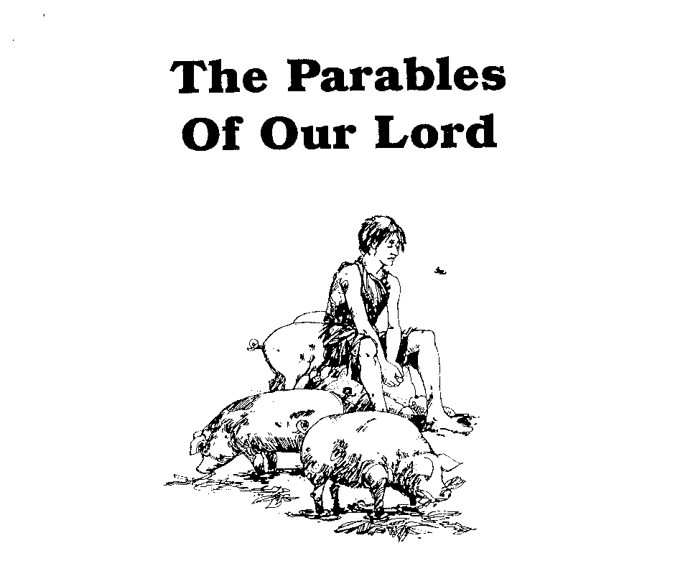
Parables of Jesus
He who has ears,
let him hear

Slide 2
5. When Jesus spoke in parables was He revealing to or concealing truth from His hearers?
YES

Slide 3
5. When Jesus spoke in parables was He revealing to or concealing truth from His hearers?
Jesus’ use of parables began in the 2nd year of ministry
It appears to take disciples by surprise.
Matthew 13:10; 34-35

Slide 4
5. When Jesus spoke in parables was He revealing to or concealing truth from His hearers?
The nature of Jesus’ hearers has changed
Opposition has begun to crystallize
Many (particularly Pharisees) began to question, to attack
John 6:60-69
It was time to separate the “wheat” from the “chaff”
EARNHART: “The hour had arrived when the true disciples had to be gathered around Him and prepared for the unthinkable horror to come.”

Slide 5
5. When Jesus spoke in parables was He revealing to or concealing truth from His hearers?
EDERSHEIM, Life and Times of Jesus the Messiah:
“One thing is common to all the Parables, and forms a point of connection with them. They are all occasioned by some unreceptiveness on the part of the hearers, and that, even when the hearers are professing disciples.”

Slide 6
5. When Jesus spoke in parables was He revealing to or concealing truth from His hearers?
EDERSHEIM: “ a continuum of increasing hostility”
The Seven Parables of Matthew 13
Late in 2nd year just after the Pharisees had resorted to explaining away Jesus’ miracles as the work of a demon
The Fifteen Parables of Luke 10 – 18
In the 3rd year with more controversy and direct public confrontation from the Pharisees, scribes, lawyers
The Eight Parables of Matthew 18 – 25 and Luke 19
Immediately before the crucifixion with more judgmental tone

Slide 7
10. State what you believe to be proper guidelines for understanding the parables of Jesus.
Study the parable in its historical context to determine why it was spoken.
CONTEXT MUST ALWAYS RULE THE TEXT
Look for the principle truth the parable is intended to teach
Most parables have only one point – not the whole scheme of redemption

Slide 8
10. State what you believe to be proper guidelines for understanding the parables of Jesus.
Don’t try to make every detail have significance
Don’t try to establish a doctrinal position solely by parables
They are “windows” not “foundations”
Don’t ever take figurative language to contradict plain literal language
Interpretation must be limited to what can be proven by scripture

Slide 9
10. State what you believe to be proper guidelines for understanding the parables of Jesus.
Always make a personal application of each parable.
“Have I met myself in this parable?”
“What changes in my life and thinking does this parable demand of me?”
“He who has ears, let him hear”

Slide 10
Parables of Jesus – Lesson 2
He who has ears,
let him hear

Slide 11
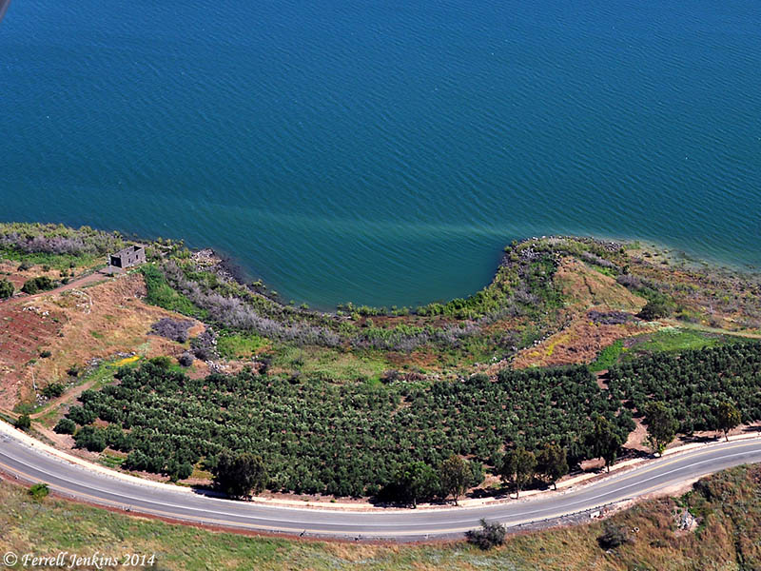
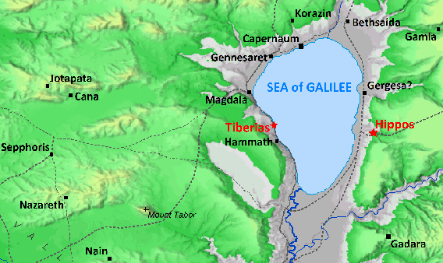
Parable of the Sower

Slide 12
Parable of the Sower
What is the background of this parable?
The large crowd
Mt. 13:2; Mk. 4:1; Lk. 8:4; Jn. 6:26
“whoever does the will of My Father”
Mt. 12:50; Mt. 13:1

Slide 13
Parable of the Sower
Who is the sower?
Jesus does not identify
Jesus Himself? Mt. 13:13
Disciples/Anyone who preaches Word?

Slide 14
Parable of the Sower
What is the seed?
Mt. 13:19 – “the word of the kingdom”
Mk. 4:14 – “the sower sows the word”
Lk. 8:11 – “the seed is the word of God”
Matthew infers by use of “the word”
Mt. 13:19, 20, 22, 23

Slide 15
Parable of the Sower
What is the seed?
EARNHART:
“This parable is telling us in plain language that the word of God is in and of itself the germinating seed of life, not the word plus some mysterious workings of the Holy Spirit.” p. 38
“Even Satan knows where the power is. ‘Then the devil comes and takes away the word from their heart, so that they will not believe and be saved.’ Lk. 8:12” p. 39

Slide 16
Parable of the Sower
What do the four different soil types represent?
Each soil represents a type of heart or a condition of heart
Heart = Mind
The mind is inferred in all accounts by terms that indicate “mind”: hear/heard, believe, joy, worries

Slide 17
Parable of the Sower
Soil #1: “beside the road”
The Hard Heart
Hears but “does not understand it” – Mt. 13:19
No response to the message
“Hopeless in unyielding hardness”
5. What do the birds represent?

Slide 18
Parable of the Sower
Soil #2: “the rocky places”
The Shallow Heart
A purely/mostly emotional response
Word has not gone down deeply into understanding and will
“They have entertained no long thoughts”

Slide 19
Parable of the Sower
Soil #2: “the rocky places”
6. What does the sun represent?
A change in circumstances
“Affliction”, “persecution”, “temptation”
“Immediately he falls away”
Cf. “Immediately receives it with joy”

Slide 20
Parable of the Sower
Soil #3: “among the thorns”
The Divided Heart / The Crowded Heart
Not sown in already growing patch of thorns
But sown in soil which had the seeds of thorns already in it
A heart full of competing concerns
“The voice of God becomes dim in the clamor”

Slide 21
Parable of the Sower
Soil #3: “among the thorns”
7. What do the thorns represent?
“worry of the world”
“deceitfulness of wealth”
“the desires for other things”
“pleasures of this life”

Slide 22
Parable of the Sower
Soil #4: “the good soil”
8. What are the characteristics of the good ground?
“an honest and good heart” – Lk. 8:15
Not necessarily a “righteous” heart
Not necessarily a “good moral person” heart
Could be the heart of a wicked and sinful person

Slide 23
Parable of the Sower
Soil #4: “the good soil”
It is soft – not like “beside the road”
Mt. 13:23: “hears the word and understands it”
It is deep – not like “the rocky places”
Lk. 8:15: “heard the word…and hold it fast”
It is undefiled – not like “among the thorns”
Lk. 8:15: “bear fruit with perseverance”

Slide 24
Parable of the Sower
10. Why do you suppose that all good ground does not yield the same?
While the “honest and good heart” is a requirement, ability and opportunity will vary
Cf. The Parable of the Talents

Slide 25
Parable of the Sower
Personal Application?
Have I met myself in this parable?
What changes in my life and thinking does this parable demand of me?
“He who has ears, let him hear”

