Slide 1
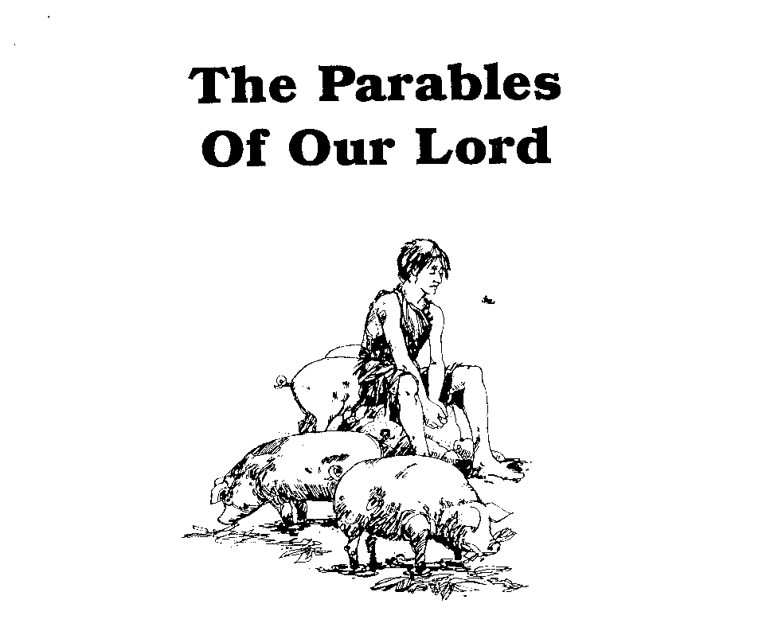
Parables of Jesus – Lesson 2
He who has ears,
let him hear

Slide 2
Parable of the Sower
What is the background of this parable?
The large crowd
Mt. 13:2; Mk. 4:1; Lk. 8:4; Jn. 6:26
“whoever does the will of My Father”
Mt. 12:50; Mt. 13:1

Slide 3
Parable of the Sower
Who is the sower?
Jesus does not identify
Jesus Himself? Mt. 13:13
Disciples/Anyone who preaches Word?

Slide 4
Parable of the Sower
What is the seed?
Mt. 13:19 – “the word of the kingdom”
Mk. 4:14 – “the sower sows the word”
Lk. 8:11 – “the seed is the word of God”
Matthew infers by use of “the word”
Mt. 13:19, 20, 22, 23

Slide 5
Parable of the Sower
What is the seed?
EARNHART:
“This parable is telling us in plain language that the word of God is in and of itself the germinating seed of life, not the word plus some mysterious workings of the Holy Spirit.” p. 38
“Even Satan knows where the power is. ‘Then the devil comes and takes away the word from their heart, so that they will not believe and be saved.’ Lk. 8:12” p. 39

Slide 6
Parable of the Sower
What do the four different soil types represent?
Each soil represents a type of heart or a condition of heart
Heart = Mind
The mind is inferred in all accounts by terms that indicate “mind”: hear/heard, believe, joy, worries

Slide 7
Parable of the Sower
Soil #1: “beside the road”
The Hard Heart
Hears but “does not understand it” – Mt. 13:19
No response to the message
“Hopeless in unyielding hardness”
5. What do the birds represent?

Slide 8
Parable of the Sower
Soil #2: “the rocky places”
The Shallow Heart
A purely/mostly emotional response
Word has not gone down deeply into understanding and will
“They have entertained no long thoughts”

Slide 9
Parable of the Sower
Soil #2: “the rocky places”
6. What does the sun represent?
A change in circumstances
“Affliction”, “persecution”, “temptation”
“Immediately he falls away”
Cf. “Immediately receives it with joy”

Slide 10
Parable of the Sower
Soil #3: “among the thorns”
The Divided Heart / The Crowded Heart
Not sown in already growing patch of thorns
But sown in soil which had the seeds of thorns already in it
A heart full of competing concerns
“The voice of God becomes dim in the clamor”

Slide 11
Parable of the Sower
Soil #3: “among the thorns”
7. What do the thorns represent?
“worry of the world”
“deceitfulness of wealth”
“the desires for other things”
“pleasures of this life”

Slide 12
Parable of the Sower
Soil #4: “the good soil”
8. What are the characteristics of the good ground?
“an honest and good heart” – Lk. 8:15
Not necessarily a “righteous” heart
Not necessarily a “good moral person” heart
Could be the heart of a wicked and sinful person

Slide 13
Parable of the Sower
Soil #4: “the good soil”
It is soft – not like “beside the road”
Mt. 13:23: “hears the word and understands it”
It is deep – not like “the rocky places”
Lk. 8:15: “heard the word…and hold it fast”
It is undefiled – not like “among the thorns”
Lk. 8:15: “bear fruit with perseverance”

Slide 14
Parable of the Sower
10. Why do you suppose that all good ground does not yield the same?
While the “honest and good heart” is a requirement, ability and opportunity will vary
Cf. The Parable of the Talents

Slide 15
Parable of the Sower
Personal Application?
Have I met myself in this parable?
What changes in my life and thinking does this parable demand of me?
“He who has ears, let him hear”

Slide 16
Parables of Jesus – Lesson 3
He who has ears,
let him hear

Slide 17
Parable of the Seed Growing of Itself
Mark 4:26-27
26 And He was saying, "The kingdom of God is like a man who casts seed upon the soil;
27 and he goes to bed at night and gets up by day, and the seed sprouts and grows--how, he himself does not know.
28 "The soil produces crops by itself; first the blade, then the head, then the mature grain in the head.
29 "But when the crop permits, he immediately puts in the sickle, because the harvest has come."

Slide 18
Parable of the Seed Growing of Itself
What is the Message?
The earthly story:
Once the seed is sown, the only thing a sower can do is wait for the growth and maturing of the seed.
The spiritual lesson:
Once the word is preached, we can only wait for the fruit of conversion (emphasis on “he himself does not know”)
Once the word is preached, we can be sure there will be positive results (emphasis on “the soil produces crops”)

Slide 19
Parable of the Seed Growing of Itself
What is the background of this parable?
Same setting as Parable of the Sower
It appears after Parable of the Sower and before Parable of the Mustard Seed
Spoken to the whole multitude?

Slide 20
Parable of the Seed Growing of Itself
Interpretation?
Jesus does not explain this parable.
We should look for a “general point”.
Individual elements can be identified based on the “general point”.

Slide 21
Parable of the Seed Growing of Itself
2. Who is the Sower?
Jesus does not identify – just like the Parable of the Sower
3. What is the seed?
Jesus does not identify – unlike the Parable of the Sower

Slide 22
Parable of the Seed Growing of Itself
3a. What is the soil?
Jesus does not identify
“Honest and good heart”?

Slide 23
Parable of the Seed Growing of Itself
4. What is the relation of the sower to the seed springing and growing up?
Sower: “goes to bed at night and gets up by day”
Seed: “spouts and grows – how, he himself does not know”

Slide 24
Parable of the Seed Growing of Itself
5. What does the statement “the earth bringeth forth fruit of herself” suggest?
There is an element(s) to the process that is out of the control of the sower
Seeds will grow and harvest will come in the right soil, climate, situation

Slide 25
Parable of the Seed Growing of Itself
6. What is the “fruit” that is in view in this parable?
7. What does the progression of “the blade” to “the ear” to “the full corn in the ear” describe?
Stages of growth don’t appear significant
“Mature grain” is the desired and expected result

Slide 26
Parable of the Seed Growing of Itself
8. Who is he that puts in the sickle?
9. Unto what “harvest” does the parable refer?
In the context of the word produces fruit, it would seem neither reaper nor harvest have a specific meaning
Jesus at final judgment?

Slide 27
Parable of the Seed Growing of Itself
10. What is the relation of the seed to the harvest?
Harvest is only possible when the seed is sown

Slide 28
Parable of the Seed Growing of Itself
Lesson Summary
We cannot know how the word will affect a person
There is a part of the conversion process that only God knows
We can be sure that the word planted in an hones and good heart will produce harvest
We must not give up planting

