Slide 1
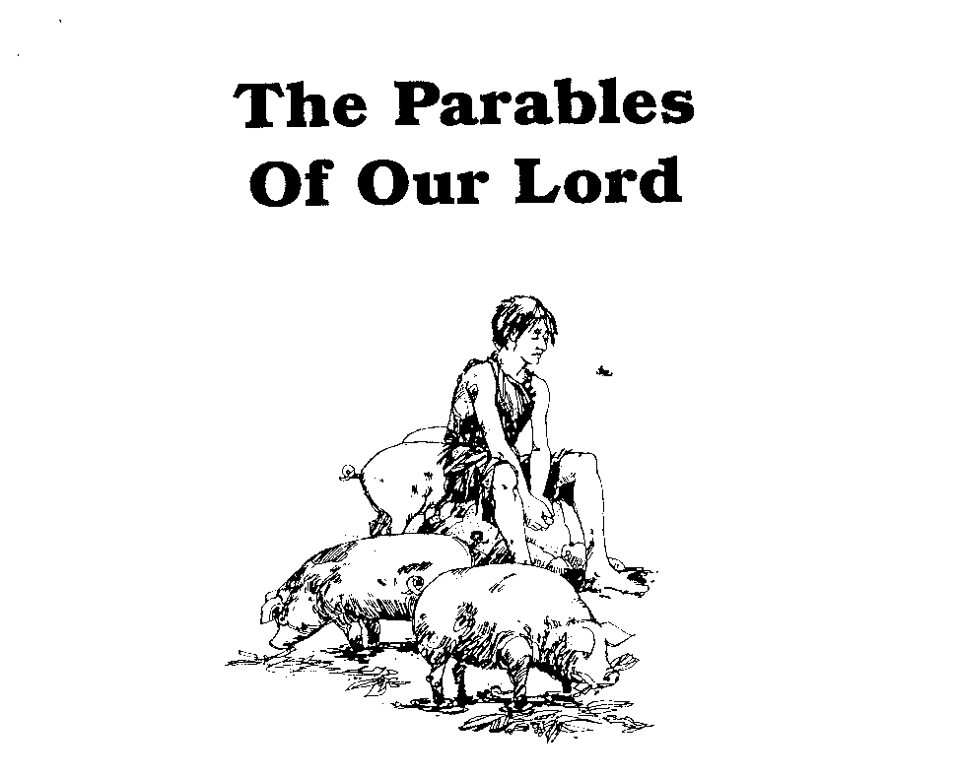
Parables of Jesus – Lesson 4
He who has ears,
let him hear

Slide 2
Parable of the Tares
Review:
Parables generally have a single point/lesson
A single parable does not reflect the whole of God’s plan
Details are not necessarily significant
Any interpretation must be in accord with other plain scripture

Slide 3
Parable of the Tares
1. What is the background for this parable?
Beside the Sea of Galilee
A large multitude
Jesus’ first extensive use of parables recorded
8 parables recorded from this setting
7 in Matthew 13
1 in Mark 4

Slide 4
Parable of the Tares
2. What two seeds are involved in this parable? What do they represent?
“good seed” – v. 24
Jesus: “these are the sons of the kingdom – v. 38
“tares” – v. 25
Jesus: “the sons of the evil one” – v. 38

Slide 5
Parable of the Tares
TARES:
the bearded darnel, the Lolium temulentum, a species of rye-grass. It bears the closest resemblance to wheat till the ear appears, and only then the difference is discovered. It grows plentifully in Syria and Palestine. (Easton’s Bible Dictionary)

Slide 6
Parable of the Tares
3. Where did the sower sow the good seed? What does this represent?
“in his field” – v. 24
Jesus: “the field is the world” – v. 38

Slide 7
Parable of the Tares
4. What explanation is given for the presence of the tares in the field? Who is this?
“an enemy has done this” – v. 28
Jesus: “the enemy who sowed them is the devil” – v. 39

Slide 8
Parable of the Tares
5. Who is the Sower?
Jesus: “the one who sows the good seed is the Son of Man” – v. 37

Slide 9
Parable of the Tares
6. What solution is given for the removal of the tares?
Slaves/servants: “go and gather them up” – v. 28
Sower/landowner: “allow both to grow together until the harvest..” – v. 30

Slide 10
Parable of the Tares
7. When will this be accomplished and by whom?
“in the time of harvest I will say to the reapers” – v. 30
Jesus: “the reapers are the angels” – v. 39
Jesus: “so shall it be at the end of the age” – v. 40

Slide 11
Parable of the Tares
8. Who are the tares?
Jesus: “all stumbling blocks, and those that commit lawlessness” – v. 41

Slide 12
Parable of the Tares
9. Explain how Christ’s kingdom has those who are wicked in it?
The “field” is the “world”
When the angels gather “out of His kingdom” (v. 41) they are the reapers gathering out of the field, i.e., the world
Thus, if “field” = “world” then Christ’s kingdom must refer to the “world” as His kingdom

Slide 13
Parable of the Tares
The Kingdom of God/Heaven can mean:
The dwelling place of God/place of eternal reward. Mt. 7:21-23; Mt. 25:34
The creation/earth. Psa. 24:1; Jer. 10:10

Slide 14
Parable of the Tares
The Kingdom of God/Heaven can mean:
The church/body/those who have been saved. Col. 1:13-14
This kingdom includes dominion over all things. Dan. 2:44; Dan. 7:13-14; Mt. 28:18; Rev. 1:5

Slide 15
Parable of the Tares
10. What does the rooting up of the tares imply?
Separation
Destruction

Slide 16
Parable of the Tares
What important lessons do we learn from this parable?
God will not remove all evil from the world until the end. He will delay some judgments.
Does not condone tolerance for sin/wickedness in the church

