Slide 2
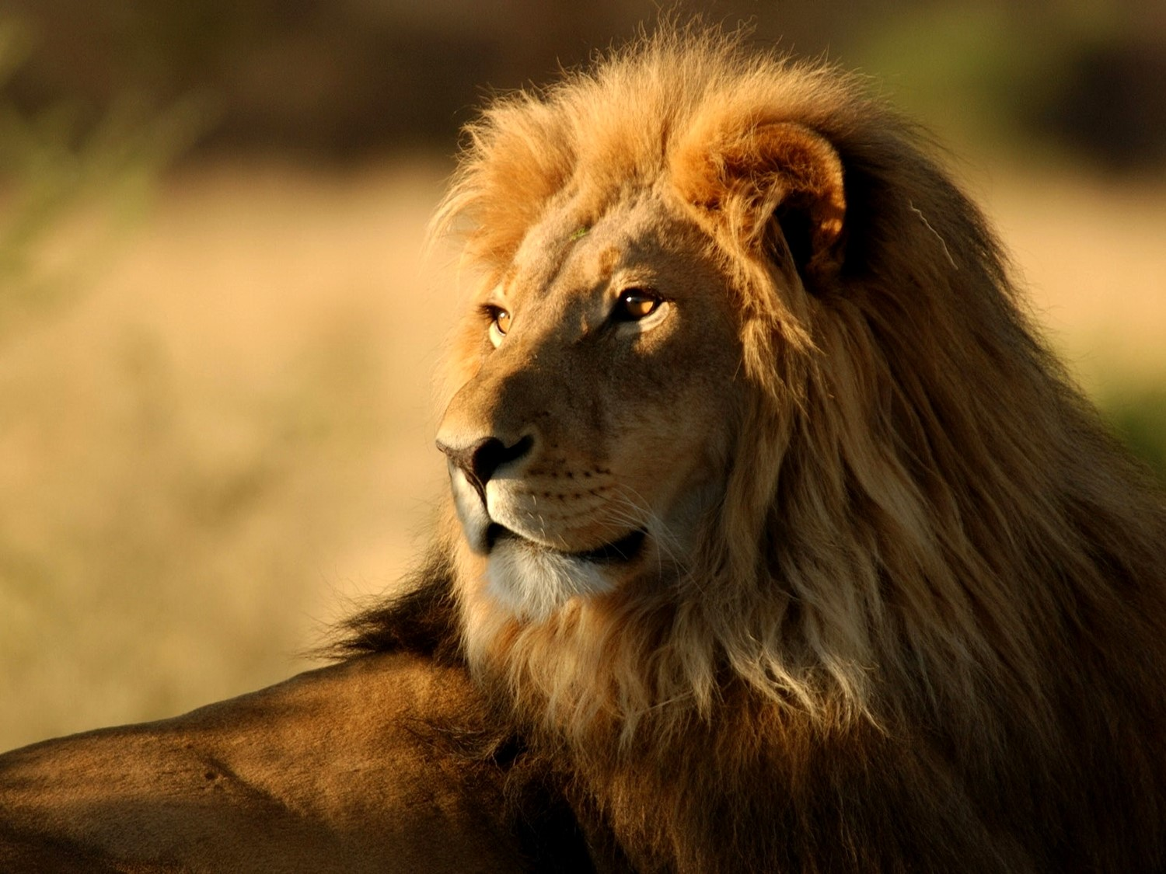
Boldness In The Face Of Conflict
Acts 3-4
The wicked flee when no one pursues, but the righteous are as bold as a lion. Proverbs 28:1
Notes:
2

Slide 3
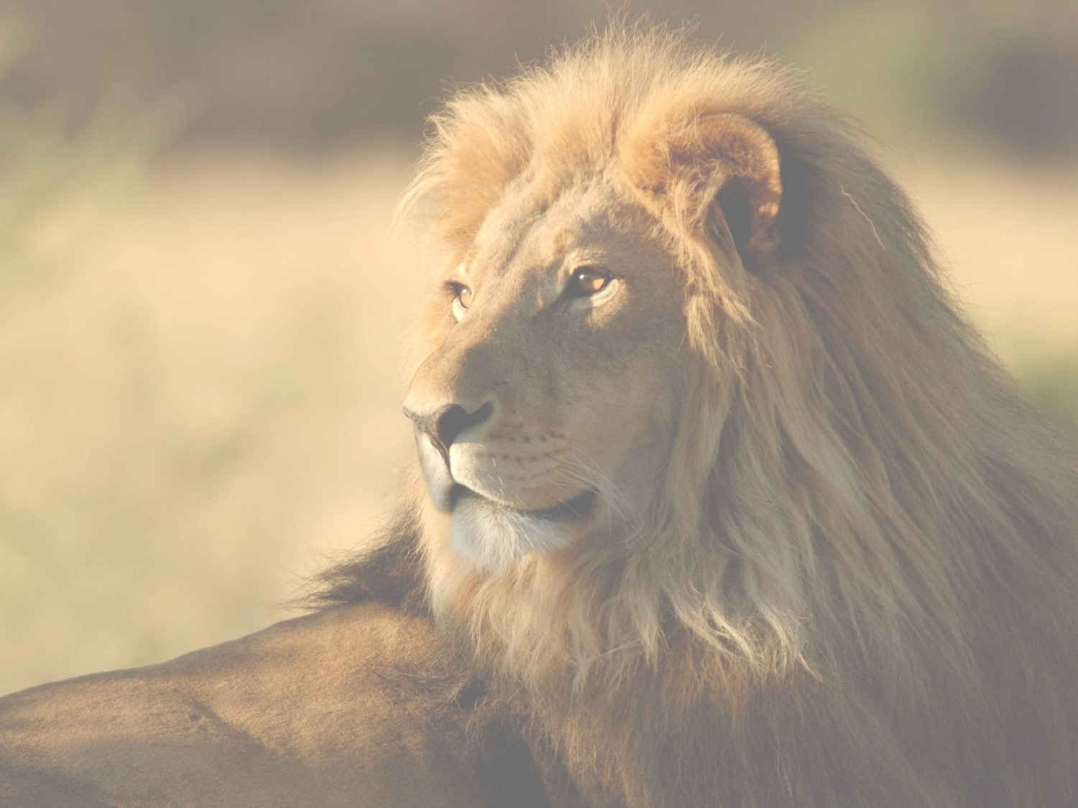
Boldness in the Face of Conflict
Acts 3-4
Healing the lame man 3:1-11
Peter Preaches 3:12-26
Peter and John arrested 4:1-4
Facing the Sanhedrin 4:5-22
Prayer for boldness 4:23-31
Notes:
3

Slide 4
Boldness in the Face of Conflict
Acts 3-4
God’s people facing increasing conflict
Some lessons for us
Teaching the Truth sometimes brings conflict
Acts 14:22
2nd Timothy 3:12
James 1:2-4
Notes:
4

Slide 5
Boldness in the Face of Conflict
Acts 3-4
Despite opposition, God’s purposes will come to pass
Psalm 2
Acts 4:4, 5:14
We must look to God for our strength
Acts 4:24-25
Notes:
5

