Slide 1
MAN IN THE MIRROR
Matthew 21:28-32

Slide 2
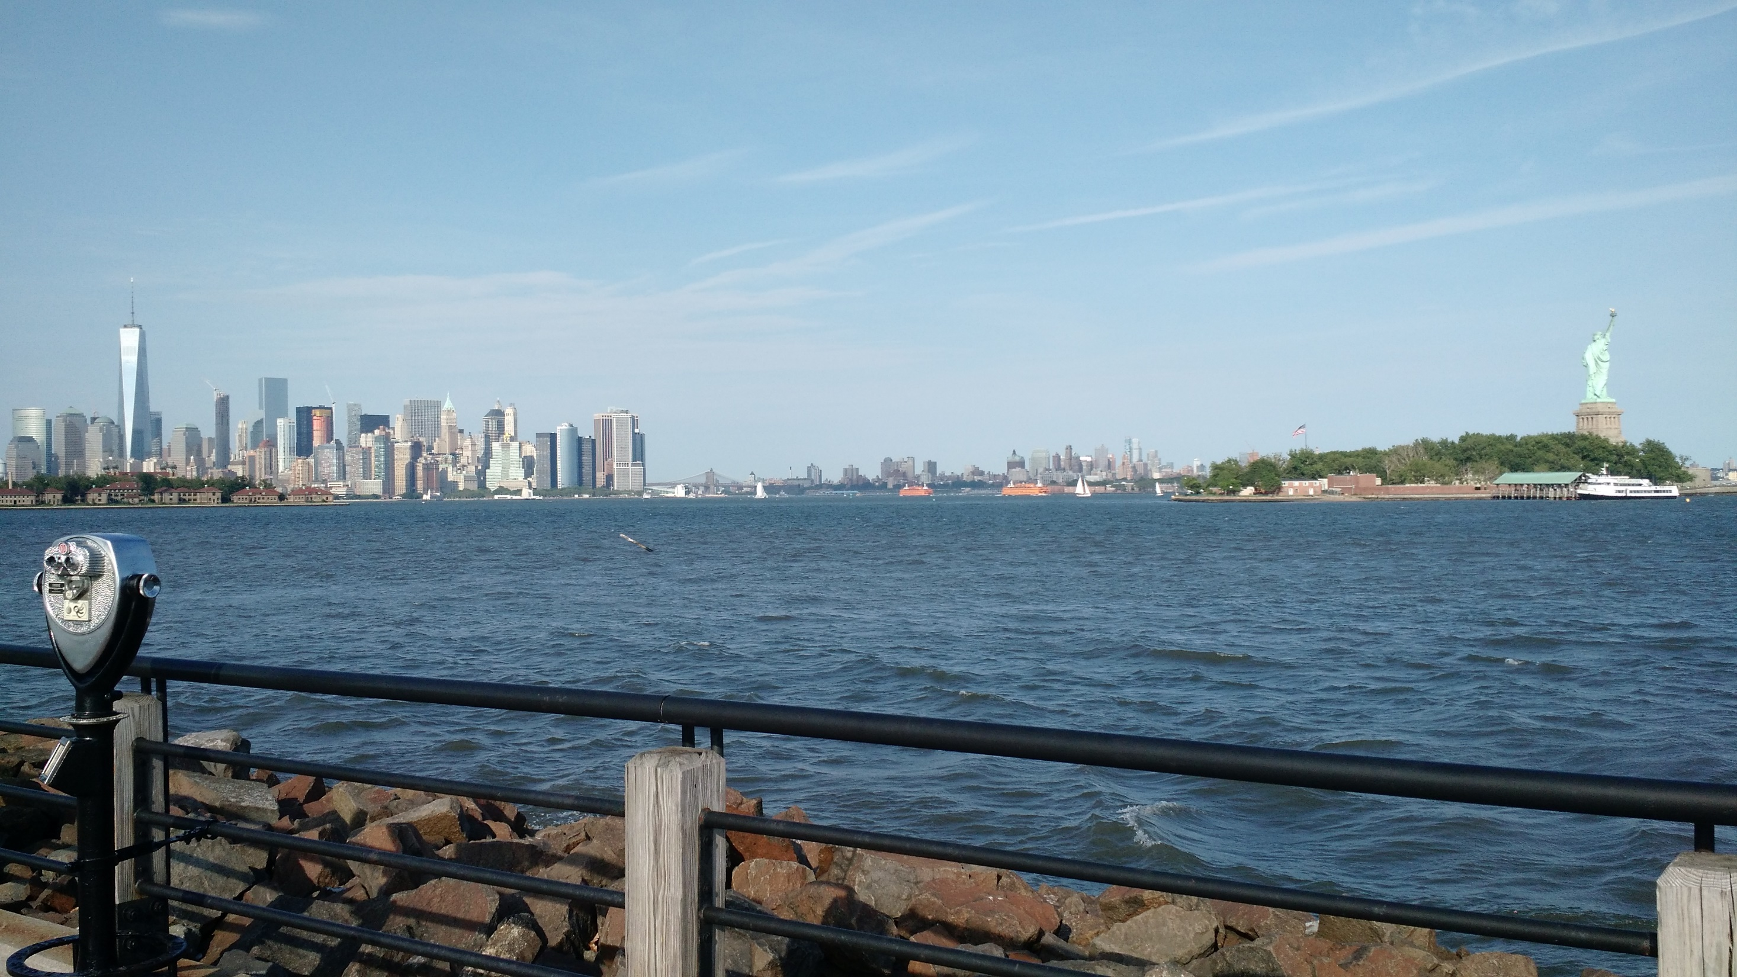

Slide 3
GAZE INTO THE MIRROR

Slide 4
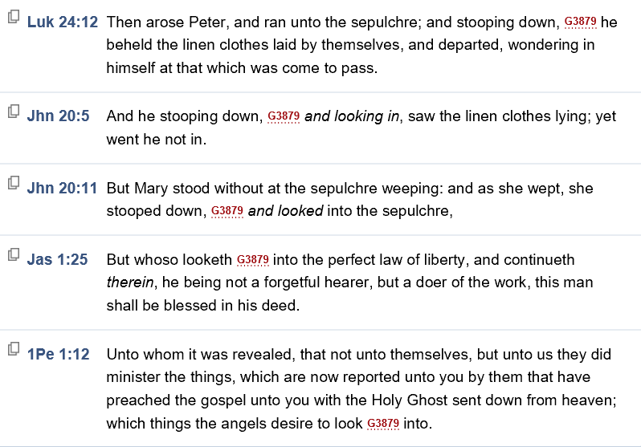

Slide 5
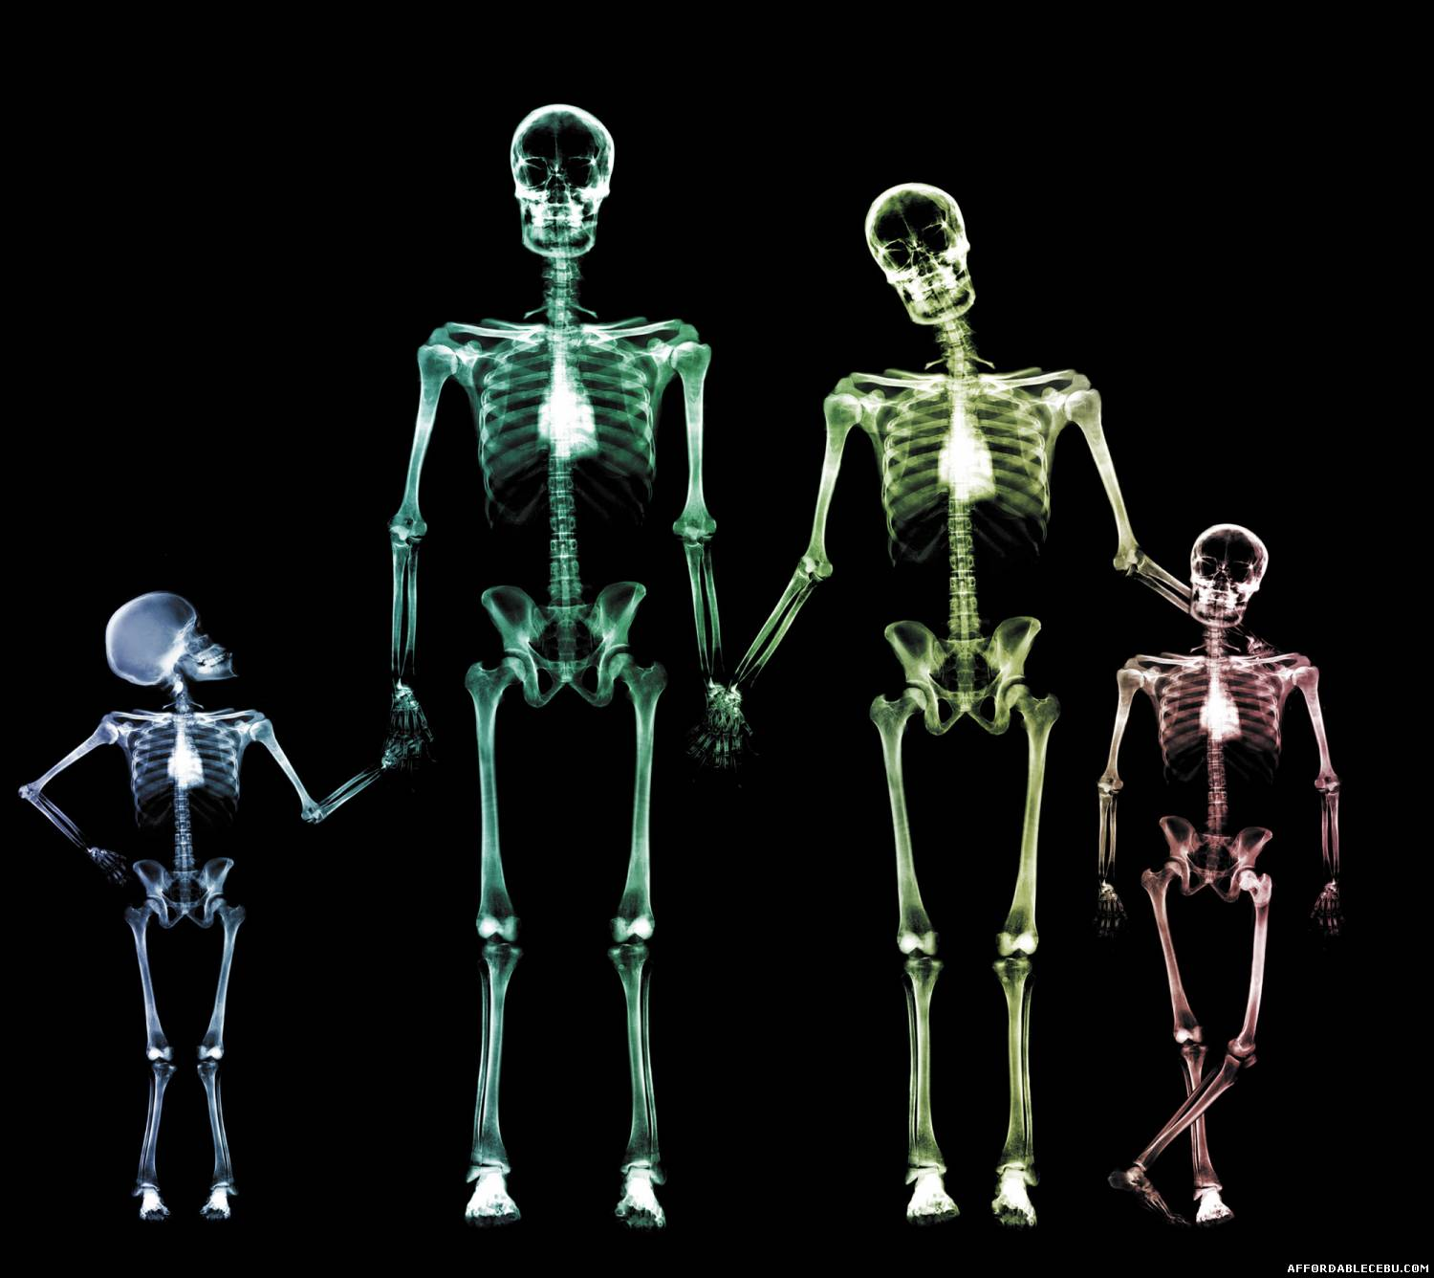
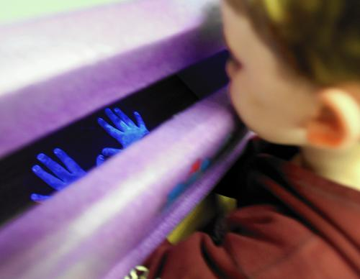
NEED TO STARE
IT EXPOSES ME ^{(Heb 4:12-13)}
Who I really am ^{(James 1:23; Rev} ^{3:17)}
To the dangers of life ^{(Prov 1-9)}
Notes:
Proverbs 1:18 outcome of the sinners who entice
Proverbs 2:12 deliver from the evil man, 2:16 deliver from the evil woman.
Proverbs 5:3-8 who she really is

Slide 6
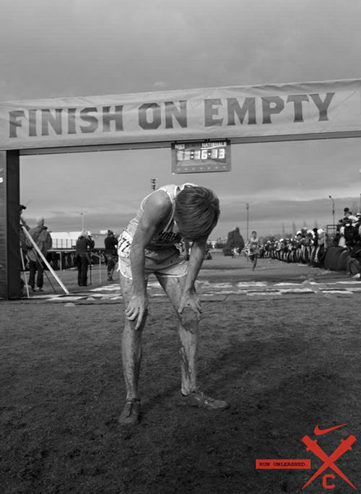
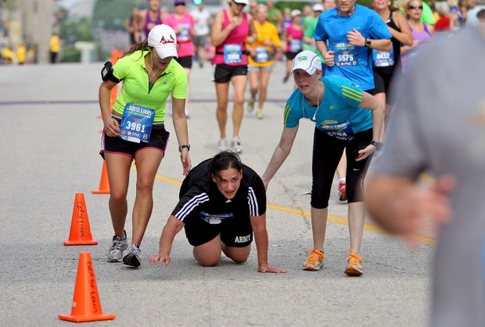
NEED TO STARE
IT EXPOSES ME ^{(Heb 4:12-13)}
IT ENCOURAGES ME ^{(Heb 4:11-16)}
To continue ^{(Heb 4:11)}
To draw near in times of need ^{(Heb 4:14-16)}
Notes:
Someone says to you, “You need to take a long look in the mirror” to expose some problem or hypocrisy. We have a false image of ourselves. Some time we see it better in other people (ex David with Bathsheba).
The Word exposes me (like an X-ray; Black light)
Even when we don’t look the way we should we should draw near bc Jesus can understand and help

Slide 7
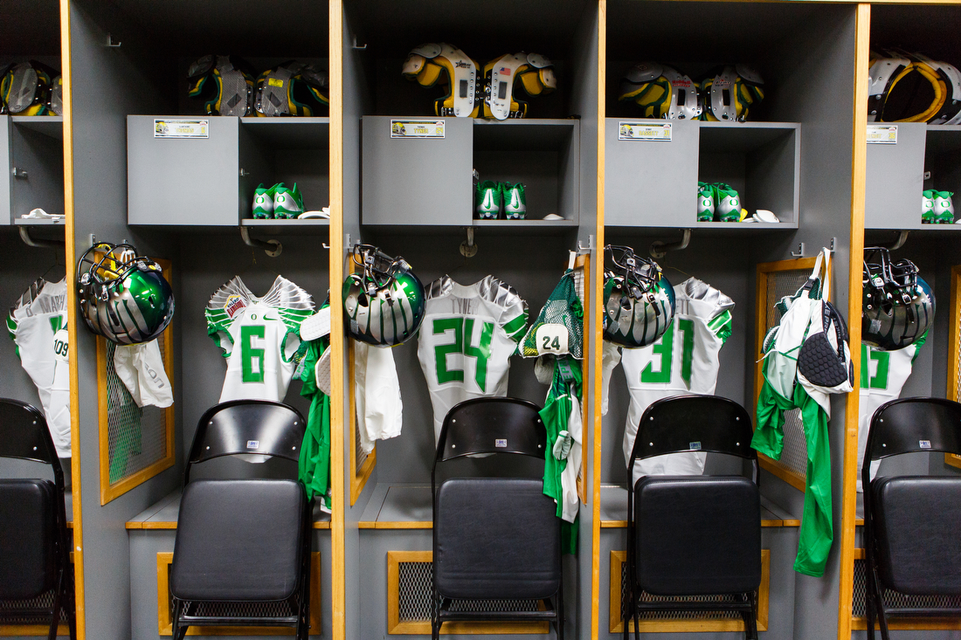
NEED TO STARE
IT EXPOSES ME ^{(Heb 4:12-13)}
IT ENCOURAGES ME ^{(Heb 4:11-16)}
IT EQUIPS ME ^{(2 Tim 3:16-17)}
For every good work
Notes:
Someone says to you, “You need to take a long look in the mirror” to expose some problem or hypocrisy. We have a false image of ourselves. Some time we see it better in other people (ex David with Bathsheba).
The Word exposes me (like an X-ray; Black light)
Even when we don’t look the way we should we should draw near bc Jesus can understand and help

Slide 8
3 DIFFERENT DESIRES TO STARE
I REALLY WANT TO
Look and be my best ^{(Rev 19:7-8)}
Willing to put in the work ^{(1 Tim 4:6-10; 2 Peter 1:5-11)}
I see the results ^{(Psa 119:97-104)}
Notes:
I need to clean my apartment, but I have no desire to.

Slide 9
3 DIFFERENT DESIRES TO STARE
I REALLY WANT TO
I KINDA WANT TO
Willing to hear it often ^{(Acts 24:22-26)}
As long as it is benefits/convenient… ^{(Matt 13:20-22)}
As long as I understand it… ^{(John 6:60-66)}
Notes:
I need to clean my apartment, but I have no desire to.

Slide 10
3 DIFFERENT DESIRES TO STARE
I REALLY WANT TO
I KINDA WANT TO
I DON’T WANT TO
I appear I want to ^{(2 Tim 3:5-7)}
Love self, money, pleasure not God ^{(2 Tim 3:1-5)}
Notes:
I need to clean my apartment, but I have no desire to.

Slide 11
NEED ______
___________ WANT
EXPOSED
ENCOURAGED
EQUIPPED
REALLY
KINDA
DO NOT

