Slide 2
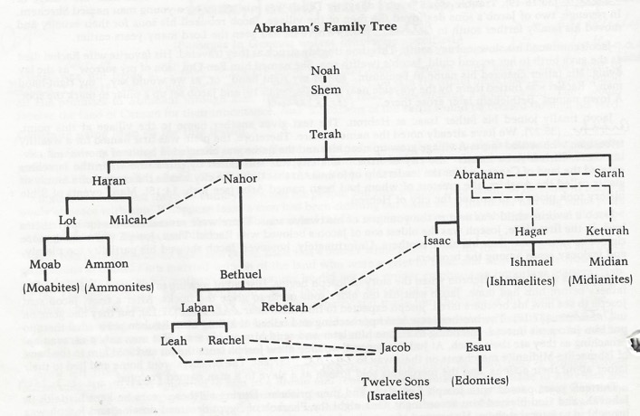

Slide 3
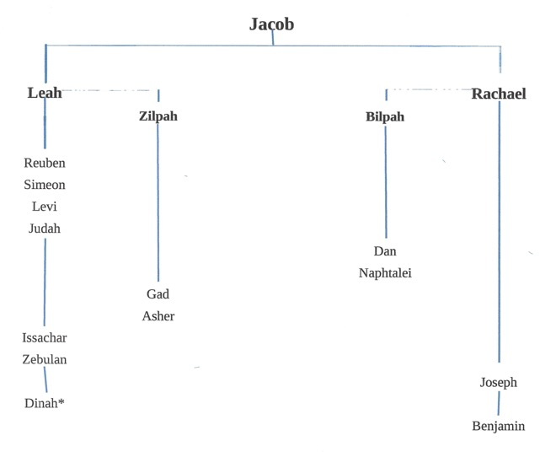

Slide 4
How Many in the Exodus?
Exodus tells us in 1:5 that there were 70 in the group when Jacob went down into Egypt.
Genesis 46:26-27 gives us Jacob +66 and Joseph and his two sons. Total 70
From this humble beginning, with God's help, in the Exodus were some 600,000 men plus women and children and older men plus a mixed multitude, Exodus 12:38

Slide 5
How Long Slaves in Egypt?
The chronology of the "sojourning" is variously estimated. Those who adopt the longer term reckon thus:
| Years | | From the descent of Jacob into Egypt to the | death of Joseph 71 | | From the death of Joseph to the birth of | Moses 278 | | From the birth of Moses to his flight into | Midian 40 | | From the flight of Moses to his return into | Egypt 40 | | From the return of Moses to the Exodus 1 | | 430
Others contend for the shorter period of two hundred and fifteen years, holding that the period of four hundred and thirty years comprehends the years from the entrance of Abraham into Canaan (see Septuagint and Samaritan) to the descent of Jacob into Egypt. They reckon thus:
| Years | | From Abraham's arrival in Canaan to Isaac's | birth 25 | | From Isaac's birth to that of his twin sons | Esau and Jacob 60 | | From Jacob's birth to the going down into | Egypt 130 | | (215) | | From Jacob's going down into Egypt to the | death of Joseph 71 | | From death of Joseph to the birth of Moses 64 | | From birth of Moses to the Exodus 80 | | In all... 430

Slide 6
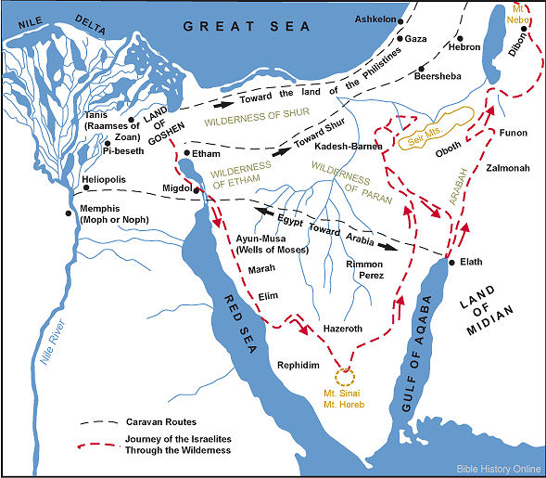
Current view of Exodus

Slide 7
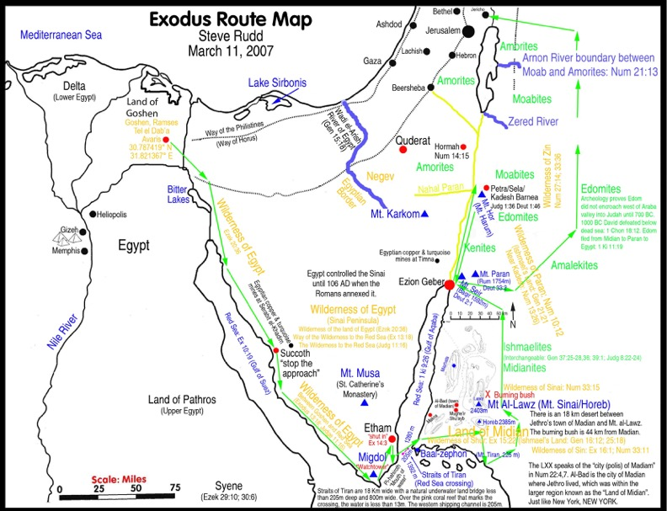
Alternate Route for Exodus

Slide 8
The Exodus
What do we know about the route of the Exodus? Actually not very much. The Egyptians may have helped bracket the timing of the period when the Israelites were in Egypt by literally erasing the written history for an era which has been very sensitive to them.
As for the route followed by the ex slaves most of the points listed in Exodus and Numbers are no longer known.
The Bible itself is our best reference for that entire period.

